Slide 1
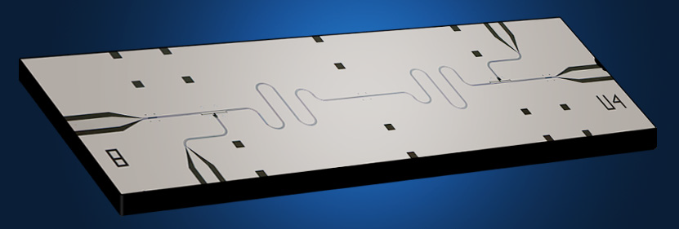
Quantum Computing
Nick Bonesteel
Discovering Physics, Nov. 16, 2012
θ
H
H
U_{f}
φ
H

Slide 2
What is a quantum computer, and what can we do with one?

Slide 3
A Classical Bit: Two Possible States
0

Slide 4
A Classical Bit: Two Possible States
1

Slide 5
Single Bit Operation: NOT
NOT
x y
0 1
1 0
x
y
0

Slide 6
Single Bit Operation: NOT
NOT
x y
0 1
1 0
x
y
1

Slide 7
A Quantum Bit or “Qubit”
0

Slide 8
A Quantum Bit or “Qubit”
1

Slide 9
A Quantum Bit or “Qubit”
0

Slide 10
A Quantum Bit or “Qubit”
0
1

Slide 11
A Quantum Bit or “Qubit”
Quantum superposition
of 0 and 1
0
1

Slide 12
A Quantum Bit or “Qubit”
1

Slide 13
A Quantum Bit or “Qubit”
0
1

Slide 14
A Quantum Bit or “Qubit”
0

Slide 15
A Quantum Bit: A Continuum of States
θ
0
1
cos
θ
sin
θ
+

Slide 16
A Quantum Bit: A Continuum of States
θ
Actually, qubit states live on the surface of a sphere.
φ
θ
θ
cos
0
+
sin
e
−
i
φ
1
2
2

Slide 17
A Quantum Bit: A Continuum of States
But the circle is enough for us today.
θ
0
1
cos
θ
sin
θ
+

Slide 18
A Quantum NOT Gate
X

Slide 19
A Quantum NOT Gate
X
X

Slide 20
A Quantum NOT Gate
X

Slide 21
A Quantum NOT Gate
X
X

Slide 22
Hadamard Gate
H
H

Slide 23
Hadamard Gate
H
H

Slide 24
Hadamard Gate
H
H

Slide 25
Hadamard Gate
H
H

Slide 26
Hadamard Gate
H
H is its own inverse
H

Slide 27
Hadamard Gate
H
H is its own inverse
H

Slide 28
Hadamard Gate
H
H is its own inverse
H

Slide 29
Hadamard Gate
H
H is its own inverse
H

Slide 30
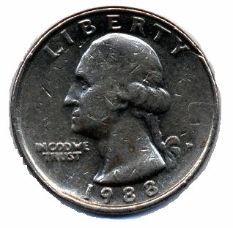
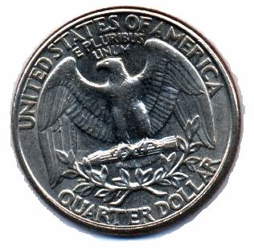
Fair Coin
Trick Coin

Slide 31
Balanced Function
or
Unbalanced Function
or

Slide 32
A Two Qubit Subroutine to Evaluate f(x)
U_{f}

Slide 33
A Two Qubit Subroutine to Evaluate f(x)
Input x can be either 0 or 1
U_{f}
Output is f(x)
Initialize to state “0”

Slide 34
A Two Qubit Subroutine to Evaluate f(x)
Input x can be either 0 or 1
U_{f}
This qubit can also be in state “1”

Slide 35
A Two Qubit Subroutine to Evaluate f(x)
Input x can be either 0 or 1
Bar stands
for “NOT”
U_{f}
This qubit can also be in state “1”
0 = 1, 1 = 0

Slide 36
A Two Qubit Subroutine to Evaluate f(x)
U_{f}
U_{f}
Balanced
Unbalanced
or
or

Slide 37
A Quantum Algorithm (Deutsch-Jozsa ‘92)
H
H
U_{f}
H

Slide 38
A Quantum Algorithm (Deutsch-Jozsa ‘92)
H
H
U_{f}
H

Slide 39
A Quantum Algorithm (Deutsch-Jozsa ‘92)
H
H
U_{f}
H

Slide 40
A Quantum Algorithm (Deutsch-Jozsa ‘92)
H
H
U_{f}
H

Slide 41
A Quantum Algorithm (Deutsch-Jozsa ‘92)
H
H
U_{f}
H

Slide 42
A Quantum Algorithm (Deutsch-Jozsa ‘92)
H
H
U_{f}
H
Only ran U_{f} subroutine once, but f(0) and f(1) both appear in the state of the computer!

Slide 43
A Quantum Algorithm (Deutsch-Jozsa ‘92)
H
H
U_{f}
H
If f is balanced: f(0) = f(1) and f(0) = f(1)

Slide 44
A Quantum Algorithm (Deutsch-Jozsa ‘92)
H
H
U_{f}
H
If f is balanced: f(0) = f(1) and f(0) = f(1)

Slide 45
A Quantum Algorithm (Deutsch-Jozsa ‘92)
H
H
U_{f}
H
If f is balanced: f(0) = f(1) and f(0) = f(1)

Slide 46
A Quantum Algorithm (Deutsch-Jozsa ‘92)
H
H
U_{f}
H
If f is unbalanced: f(0) = f(1) and f(0) = f(1)

Slide 47
A Quantum Algorithm (Deutsch-Jozsa ‘92)
H
H
U_{f}
H
If f is unbalanced: f(0) = f(1) and f(0) = f(1)

Slide 48
A Quantum Algorithm (Deutsch-Jozsa ‘92)
H
H
U_{f}
H
If f is unbalanced: f(0) = f(1) and f(0) = f(1)

Slide 49
A Quantum Algorithm (Deutsch-Jozsa ‘92)
H
H
U_{f}
H
Balanced:
Unbalanced:

Slide 50
A Quantum Algorithm (Deutsch-Jozsa ‘92)
H
H
U_{f}
H
Balanced:
Unbalanced:

Slide 51
A Quantum Algorithm (Deutsch-Jozsa ‘92)
H
H
U_{f}
H
Measure top
qubit
Balanced:
Unbalanced:

Slide 52
A Quantum Algorithm (Deutsch-Jozsa ‘92)
H
H
U_{f}
H
Measure top
qubit
Balanced:
Unbalanced:

Slide 53
A Quantum Algorithm (Deutsch-Jozsa ‘92)
H
H
U_{f}
H
Measure top
qubit
Balanced:
Unbalanced:

Slide 54
One qubit
H

Slide 55
Two qubits
H
H

Slide 56
Two qubits
H
H
0
1
2
3
Counting in binary

Slide 57
Three qubits
H
H
H

Slide 58
Three qubits
H
H
H
0
1
2
3
4
5
6
7

Slide 59
N qubits
H
H
N
H
H
0
1
2
3
…
2^{N}-1

Slide 60
N qubits
H
H
H
H
Quantum superposition of
all possible input states!

Slide 61
N qubits
H
H
H
H
Quantum superposition of
all possible input states!
For N=250 the number of states is roughly the number of atoms in the universe!

Slide 62
N qubits
H
One function call
H
U_{f}
H
H
Quantum superposition of
all possible input states!
For N=250 the number of states is roughly the number of atoms in the universe!

Slide 63
N qubits
H
One function call
H
U_{f}
H
x can be any integer
From 0 to 2^{N}-1
H
Quantum superposition of
all possible input states!
For N=250 the number of states is roughly the number of atoms in the universe!

Slide 64
N qubits
H
One function call
H
U_{f}
H
x can be any integer
From 0 to 2^{N}-1
H
Quantum superposition of
all possible input states!
Evaluate f(x) for all possible inputs!

Slide 65
Massive Quantum Parallelism
H
Run program U_{f} once, get result for all possible inputs!
H
U_{f}
H
H
Only one problem: When I measure this state I only learn the value of f(x) for one input x. (No free lunch!)
However, people have shown that a quantum computer can use quantum parallelism to do things no classical computer can do.

Slide 66
Prime Factorization
Given two prime numbers p and q,
p x q = C Easy
C p, q Hard
Best known classical factoring algorithm scales as
time = exp(Number of Digits)
Mathematical Basis for Public Key Cryptography.

Slide 67
Quantum Factorization
In 1994 Peter Shor showed that a Quantum Computer could factor an integer exponentially faster than a classical computer!
time = (Number of Digits)
Shor’s algorithm exploits Massive Quantum Parallelism.
3

Slide 68
OK, so how do we make a quantum computer?

Slide 69
Boolean Logic Gates
Not
NOR
x y z
0 0 1
0 1 0
1 0 0
1 1 0
x y
0 1
1 0
x
x
y
z
y
Any classical computation can be carried out using these two gates

Slide 70
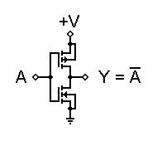
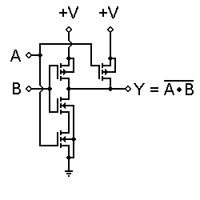
Transistor Logic
A
A
A
A B
B

Slide 71
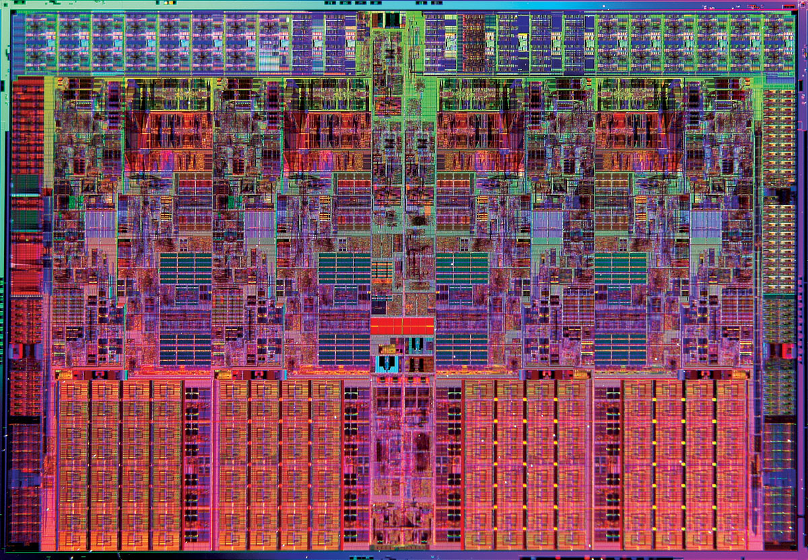
The Integrated Circuit
Core i7: 731,000,000 transistors

Slide 72
Single Qubit Gates
U

Slide 73
Controlled-NOT Gate
X
X
X
X

Slide 74
Universal Set of Gates
U
X
Quantum Circuit
X
U
X
X
U
X
Any quantum computation can be carried out using these two gates

Slide 75
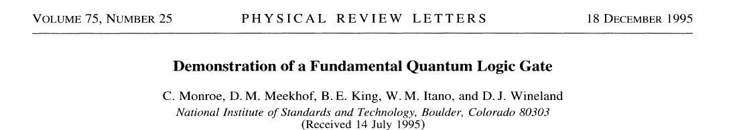
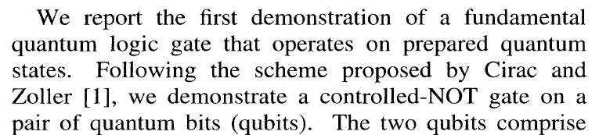
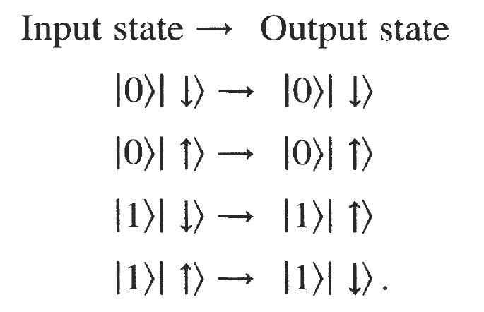
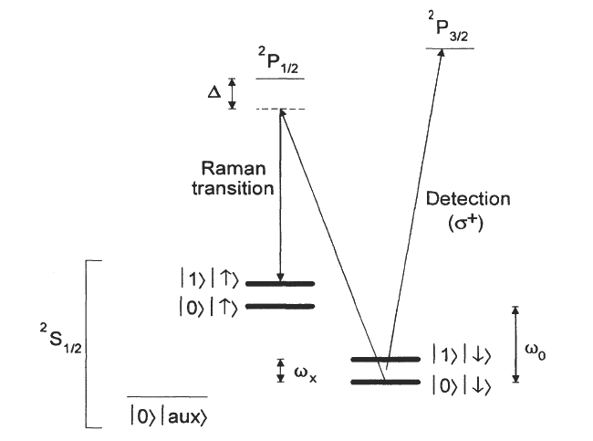
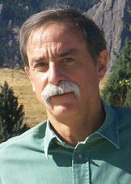
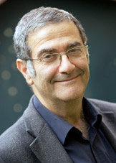
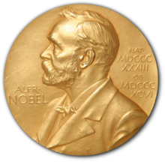
Dave
Wineland
Serge
Haroche
2012 Nobel Prize in Physics

Slide 76
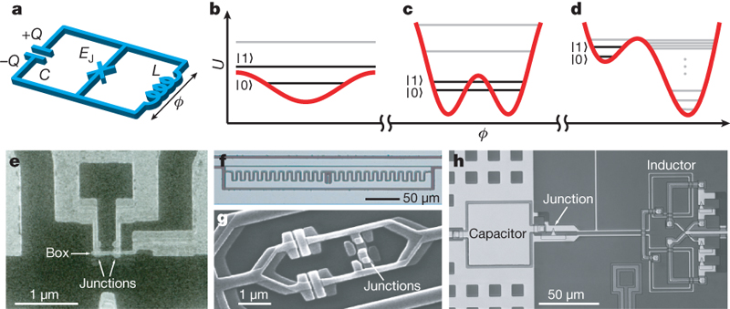
State of the Art: Superconducting Qubits
From : “Quantum Computers,” T. D. Ladd et al., Nature 464, 45-53 (2010)

Slide 77
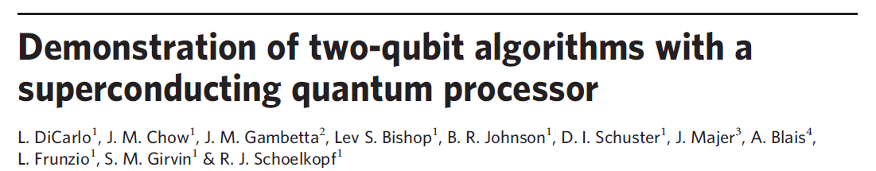
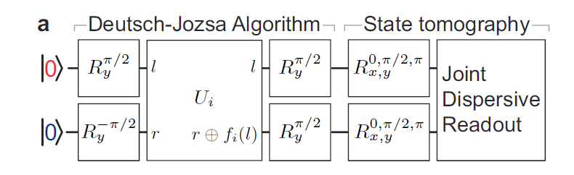
Nature 460, 240-244 (2009)
2 superconducting qubits coupled by a microwave resonator
High fidelity (~95%)
2-qubit gates on a time scale of 30 ns.

Slide 78
Nature 460, 240-244 (2009)
2 superconducting qubits coupled by a microwave resonator
High fidelity (~95%)
2-qubit gates on a time scale of 30 ns.

Slide 79
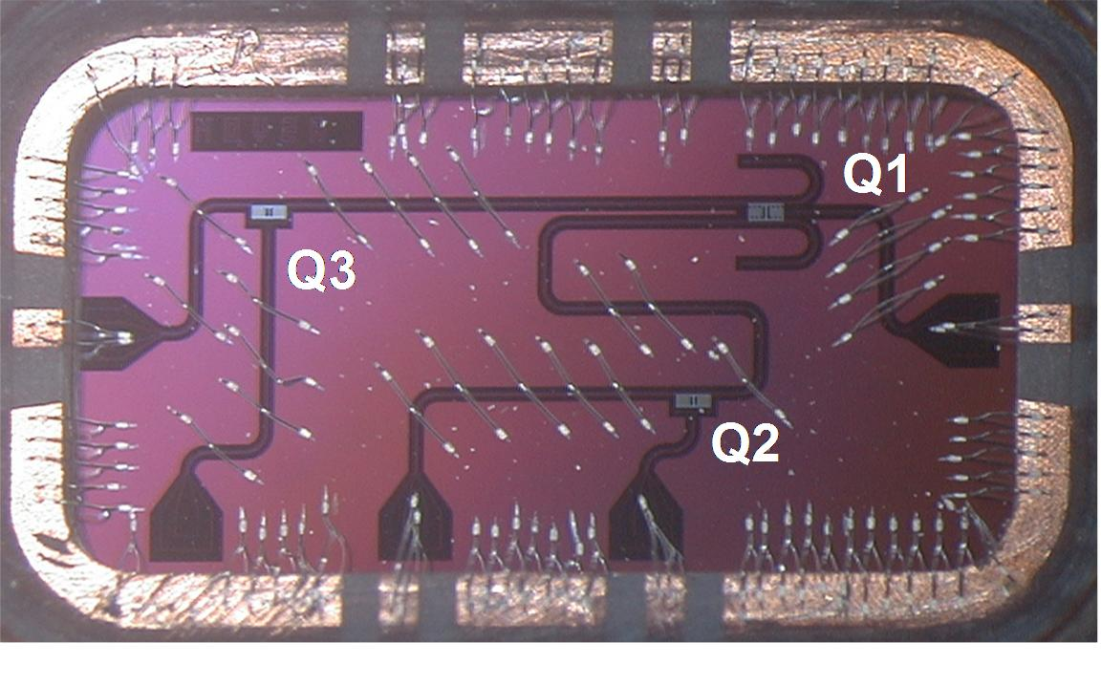
First steps toward a scalable quantum computer
8 mm
From: http://ibmquantumcomputing.tumblr.com/

Slide 80
The Real Problem: Decoherence!

Slide 81
The Real Problem: Decoherence!
Qubit

Slide 82
The Real Problem: Decoherence!
Qubit
Everything else

Slide 83
The Real Problem: Decoherence!
Qubit
Everything else
Over time….

Slide 84
The Real Problem: Decoherence!
Qubit
Everything else
Over time….
Quantum coherence of qubit is inevitably lost!

Slide 85
The Real Problem: Decoherence!
Qubit
Everything else
Over time….
Quantum coherence of qubit is inevitably lost!
Amazingly enough, quantum computing is still possible using what is known as “fault-tolerant quantum computation.”

Slide 86
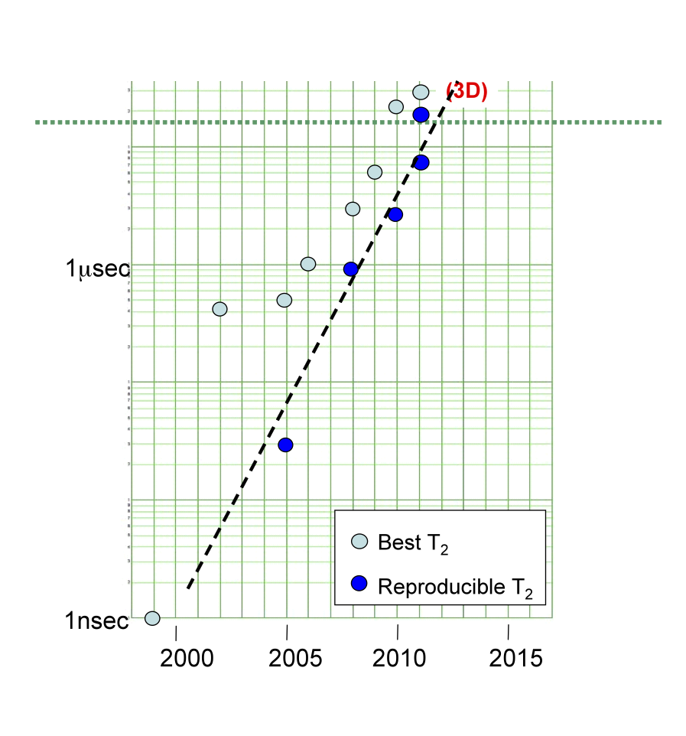
Coherence Times for Superconducting
Qubits
Threshold for fault-tolerant quantum computation.
From: “Superconducting Qubits Are Getting Serious”, M. Steffen, Physics 4, 103 (2011)

Slide 87
Coherence Times for Superconducting
Qubits
Threshold for fault-tolerant quantum computation.
This is what most of my own research on quantum computing is focused on.
From: “Superconducting Qubits Are Getting Serious”, M. Steffen, Physics 4, 103 (2011)

Slide 88
Conclusions
A deep question: Do the laws of nature allow us to manipulate quantum systems with enough accuracy to build “quantum machines” ?

Slide 89
Conclusions
A deep question: Do the laws of nature allow us to manipulate quantum systems with enough accuracy to build “quantum machines” ?
If the answer is “yes” (as it seems to be), then quantum computers are coming!

