Slide 1
Galaxy Formation
by
Enrique V. Zepeda
10/01/2012

Slide 2
Introduction
First galaxies formed due to fluctuations of density in some areas of the early universe.
Two theories or the formation of disk galaxies: the first one is that disk galaxies formed due the collapse of a gas cloud. the other one tells that galaxies formed by merging halos of Dark Matter.

Slide 3
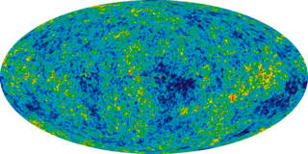
Background
After the Big Bang, most of the matter thine universe was evenly distributed for sometime. In that state stars and galaxies did not form.
But after a few hundreds of millions of years, as the universe started to cool down. Small fluctuations on density in different areas started to appear.

Slide 4
Observed properties of galaxies
Thin and fast rotating galaxy disk
Halo stars
Globular clusters
High velocity clouds
Supermassive black holes

Slide 5
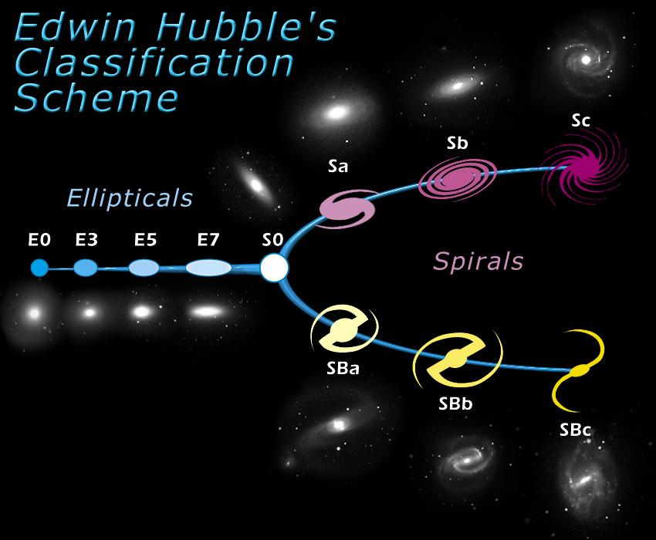

Slide 6
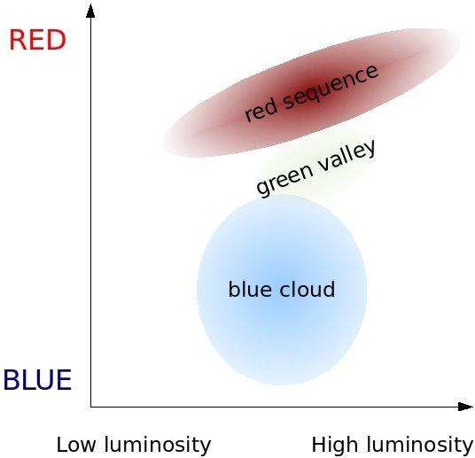
Galaxy color-magnitude diagram

Slide 7
Formation of disk (spiral) galaxies
One theory explains that disks galaxies form by the collapsing of large gas clouds that start spinning faster as the gas is contracting.
This is called a "top-down" scenario.
However, this theory is not widely accepted because observations of the early universe suggest a "bottom-up" scenario.

Slide 8
Formation of disk (spiral) galaxies (cont'd)
Another theory suggest that disk galaxies are formed by the merging of dark matter halos containing protogalaxies. As mass increases the dark matter is distributed to the size while the gas inside contracts into a disk.
The problem with this theory is that it does not explai how the contracting gas stops.

Slide 9
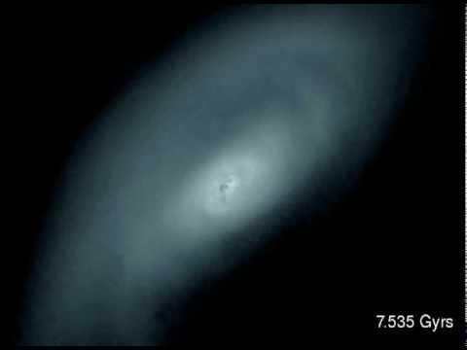
Links

Slide 10
References
http://en.wikipedia.org/wiki/Galaxy_formation_and_evolution
http://onlinelibrary.wiley.com/doi/10.1046/j.1365-8711.2001.04259.x/pdf
http://iopscience.iop.org/0004-637X/725/2/2312/pdf/0004-637X_725_2_2312.pdfhttp://www.ncbi.nlm.nih.gov/pmc/articles/PMC34192/pdf/pq000067.pdf

