Slide 1
The Physics of Star Formation
Alec Fisher
09/17/2012

Slide 2
A Quick Background on Stars
A star is held together from its enormous mass, and its ability to produce its own energy via nuclear fusion.
There are many different types of stars. Some are magnitudes more massive than the sun, and some are magnitudes less massive.
Stars exist mostly inside of the many various types of galaxies. A star not gravitationally locked into a galaxy is very rare.
Rate of star formation is approximately 275 million a day

Slide 3
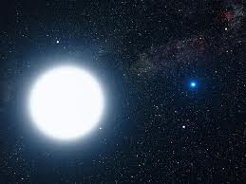
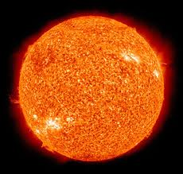
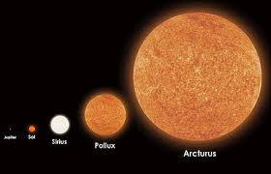

Slide 4
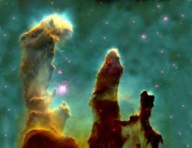
Formed in the ISM
Areas of dense molecular clouds
Mostly H₂
Bok globules
(2) The Pillars of Creation in the Eagle Nebula

Slide 5
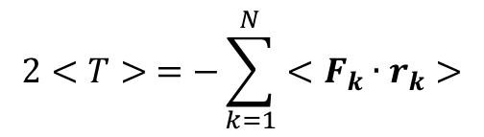
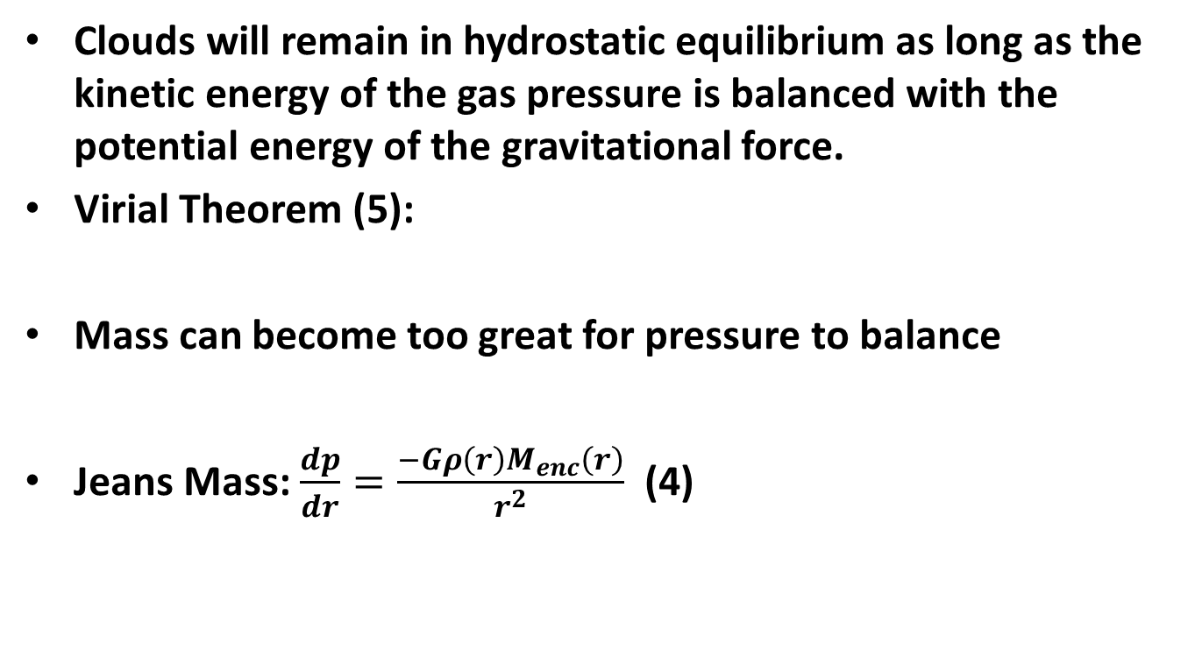
Collapsing of the cloud
Clouds will remain in hydrostatic equilibrium as long as the kinetic energy of the gas pressure is balanced with the potential energy of the gravitational force.
Virial Theorem (5):
Mass can become too great for pressure to balance
Jeans Mass: $\frac{dp}{dr}=\frac{−Gρ\left(r\right)M_{enc}\left(r\right)}{r^{2}}$ (4)
$$2<T> =−\sum_{k=1}^{N}{<F_{k}∙r_{k}>}$$

Slide 6
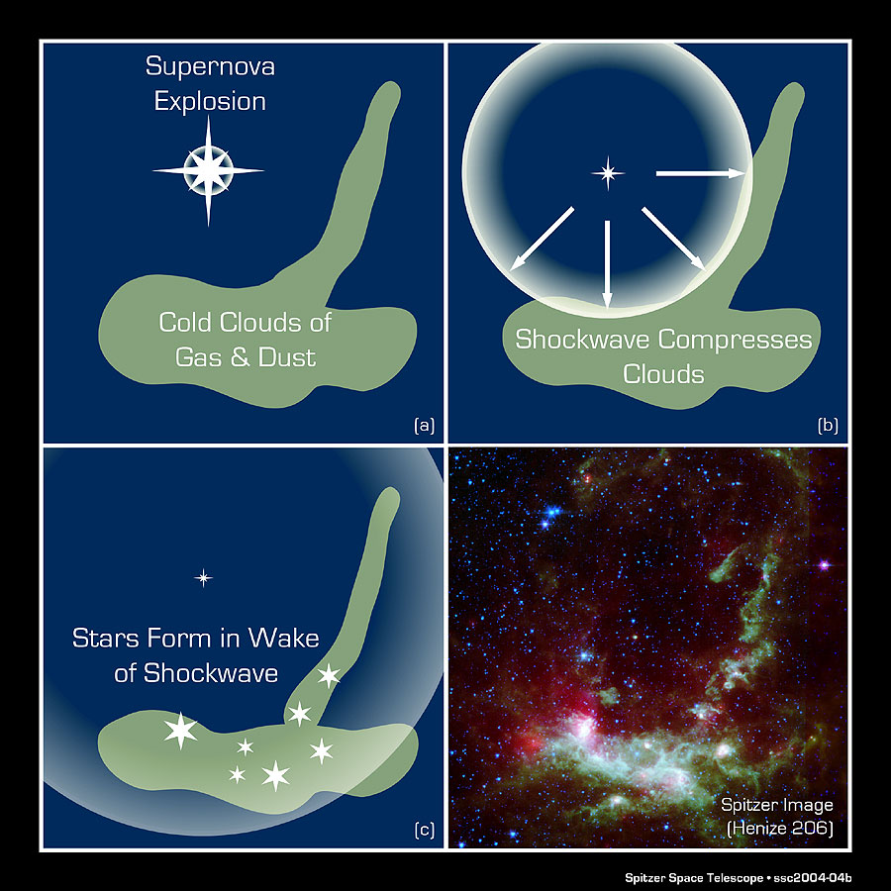
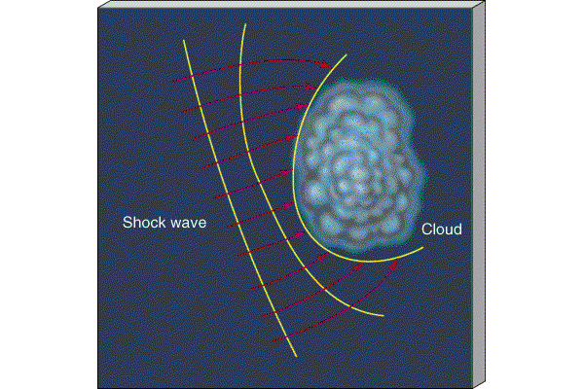
Shockwave

Slide 7
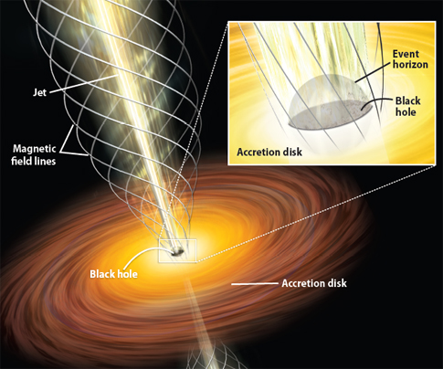
Black holes can emit accreted matter via x-ray radiation creating a relativistic jet, hindering or aiding star formation

Slide 8
As the molecular clouds collapse, they break apart into smaller pieces
Gravitational Potential Energy increases
Cloud fragments collapse to a stellar mass
Density increases causing opaqueness

Slide 9
The opaque cloud is now at a temperature of roughly 100 K. Infrared radiation occurs.
First Hydrostatic core is formed. Continues to heat up due to Virial Theorem.
Shockwaves further heat up the star.
Hydrogen ionization occurs at roughly 2000 K.
Density decreases due to these processes. Convection and radiation continue cause the radius of the core to drop.

Slide 10
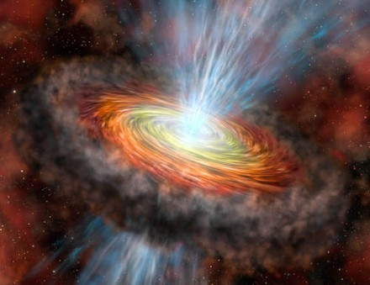
Protostar
As the radius decreases, the temperature of the hydrostatic core will increase. Continues until star can support itself.

Slide 11
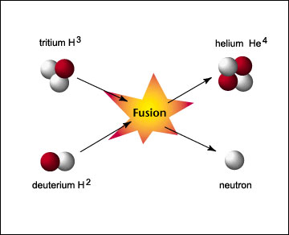
Material will continue to rain down on the protostar, causing an increase in mass and, thus, an increase in density as the star continues to contract.
The star will achieve a temperature of 10⁶ K, and deuterium fusion will begin:

Slide 12
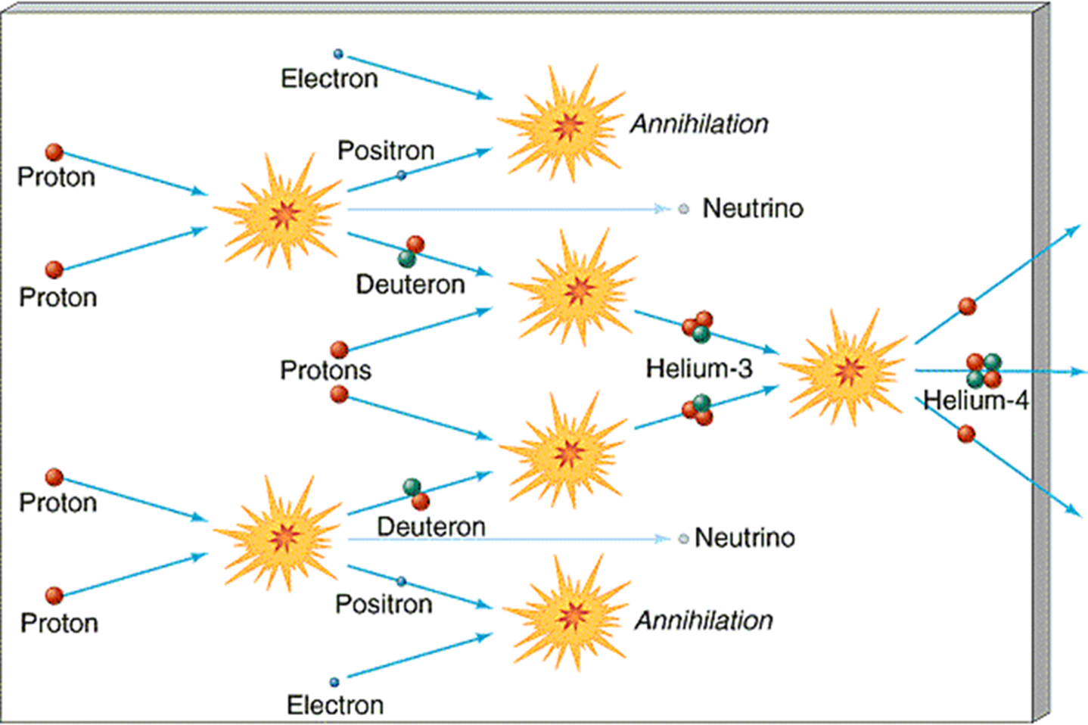
Once deuterium begins fusing, contraction will slow drastically. Gravitation contraction fuels the star.
Protostar will continue to contract until the Hayashi limit is reached, where it will then fuse Hydrogen. The star has been created.

Slide 13
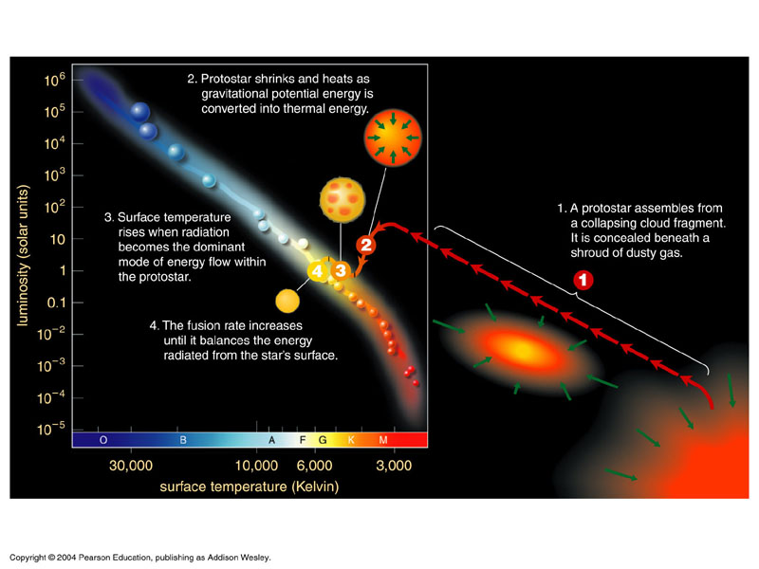
(7)H-R diagram of a protostar

Slide 14
Timescales of protostar collapse can range between 10⁴ and 10⁹.
30 solar mass protostar < 10,000 years
1 solar mass protostar = 30 million years
0.2 solar mass protostar = 1 billion years

Slide 15
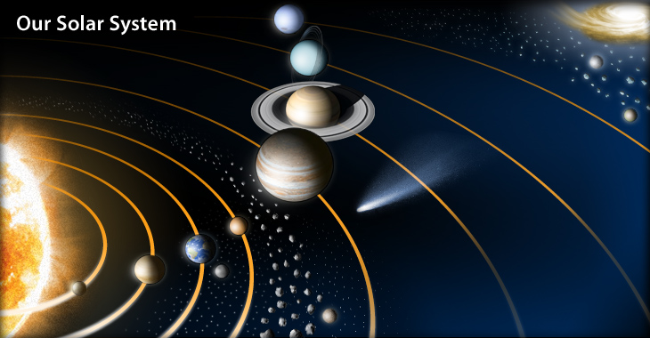
Terrestrial and Jovian Planets form

Slide 16
(1)http://curious.astro.cornell.edu/question.php?number=644
(2) https://encrypted-tbn0.google.com/images?q=tbn:ANd9GcTp5uMXCwBK4drAqi6ta-kKdSzFUdj1z8Z7h7ZCLls7ViveejLg
(3) http://en.wikipedia.org/wiki/Star_formation
(4) http://en.wikipedia.org/wiki/Jeans_mass
(5) http://en.wikipedia.org/wiki/Virial_theorem
(6)http://www.google.com/imgres?um=1&hl=en&sa=N&biw=1600&bih=799&tbm=isch&tbnid=OB_M-UnM9l5KdM:&imgrefurl=http://www.uni.edu/morgans/astro/course/Notes/section2/new9.html&docid=VV-PWcUj1rrInM&imgurl=http://www.uni.edu/morgans/astro/course/Notes/section2/shockwave_sn.jpg&w=900&h=900&ei=Fm1WUP2uDYbY8gSC8YDQAg&zoom=1&iact=rc&dur=227&sig=116826453993561246470&page=1&tbnh=146&tbnw=139&start=0&ndsp=34&ved=1t:429,r:4,s:0,i:88&tx=58&ty=63
(7)http://www.google.com/imgres?um=1&hl=en&sa=N&biw=1600&bih=799&tbm=isch&tbnid=96FdjbnFB4YVbM:&imgrefurl=http://boojum.as.arizona.edu/~jill/NS102_2006/Lectures/Starformation/starformation.html&docid=Ab6IiK8Sa6BMhM&imgurl=http://boojum.as.arizona.edu/~jill/NS102_2006/Lectures/Starformation/17-06.jpg&w=800&h=600&ei=MZRWUPi9Mom89QTcjoCoBg&zoom=1&iact=rc&dur=701&sig=116826453993561246470&page=1&tbnh=144&tbnw=192&start=0&ndsp=32&ved=1t:429,r:0,s:0,i:76&tx=141&ty=78
(8)http://www.astronomy.ohio-state.edu/~pogge/Ast162/Unit2/starform.html

