Slide 1
Mars one
Hampton Black – 11/5/12

Slide 2
What is mars one?
Mars One is a private, apolitical organization whose intent is to establish a colony on Mars by 2023 through the integration of existing, readily available technologies from industry leaders world-wide.

Slide 3

The people in charge
The main founder of this company is a Dutch entrepreneur named Bas Lansdorp who, although has a master of science in mechanical engineering, will not offer the technical expertise for such a monumental endeavor. Instead, he acts more as the businessman in charge of everything and outsources it all to scientists, researchers, and other industry experts.

Slide 4
The plan
Suppliers:
  Astrobiotic Technology
  ILC Dover (used by NASA during the Apollo era)
  MDA Corporation (robotic technology used on shuttle and ISS)
  Paragon Space Development (life support systems on ISS)
  Space Exploration Technologies, or Space-X (the only current private company able to send successful rendezvous missions with the ISS)
  Surrey Satellite Technology (Used by the gov’t, and military to design/develop satellites)
  Thales Alenia Space (develops safe pressurized elements in the ISS)

Slide 5
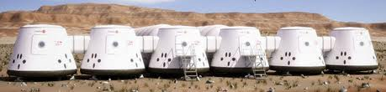
The plan
2013:
  Beginning of the astronaut selection process
  Preparation of a test simulation for the astronauts, using accurate replicas of the entire system they will use.

Slide 6
2014:
  Preparation of the first launch in 2016.
2016:
  The first launch is scheduled to be in January 2016. It will be a supply mission and will drop off 2500 kg of spare parts, solar photovoltaic panels, and other general supplies.
  They also plan on launching the two satellites they will use for communication from Earth to Mars this year.

Slide 7
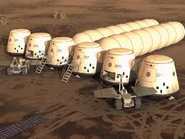
2018:
  They will launch another rocket to send the first settlement rover to the landing site. The general location of the outpost is known, the rover will just have to locate the most ideal location for the settlement.
2021:
  By 2021, they will send another 6 rockets. Two will contain a living unit as its cargo, two will contain a life support system, and the other two will provide an additional supply unit and second rover.

Slide 8
2022:
  The rovers will set up most of the equipment on their own, and the electronics on board the life support units will produce stable and safe amounts of water, oxygen, and atmosphere production, preparing the site for the arrival of the astronauts.
2023:
  Scheduled arrival of first four astronauts on mars.
  Initial set-up tasks include: connecting tubes between individual capsules, configuring/activating the food production unit, and assembling the remaining solar photovoltaic panels.
  Several weeks after the astronauts’ arrival, five more cargo missions will be sent to Mars – additional living units, life support units, and a third rover.
2025:
  Second manned mission to Mars, bringing an additional four astronauts to build and grow the community.
  Starting the cycle of sending four astronauts to Mars every two years, continuously growing the settlement.

Slide 9
Questions
There are many different details on such an extensive project such as this, so I will allow the audience to guide the direction of the specific details the Mars One corporation has decided on in various areas of the mission.

Slide 10
References:
http://mars-one.com/en/

