Slide 1
Some physics topics you probably didn’t think about. Statistical mechanics at the borders of physics.
Per Arne Rikvold
Professor of Physics

Slide 2
Statistical Physics
Physics of systems consisting of many interacting “parts.”
The “parts” could be
Nucleons
Atoms
Molecules
Organisms
Biological species
Power plants and consumers
…..

Slide 3
Research Topics:
Nonequilibrium statistical mechanics
Surface electrochemistry
Dynamics of magnetic nanodevices and thin films
Biological evolution
Applications of network theory to power grids
Methods:
Monte Carlo and Molecular Dynamics simulations
Quantum-mechanical Density Functional Theory (DFT)
Stochastic differential equations
Numerical linear algebra
Analytical methods

Slide 4
Surface Electrochemistry
Important for the understanding of surface reactions, energy storage, and new methods to synthesize nanomaterials.
Excellent job and funding opportunities
Electrosorption of bromine (Br) on silver (Ag)
Using Ising lattice-gas models of the surface.

Slide 5
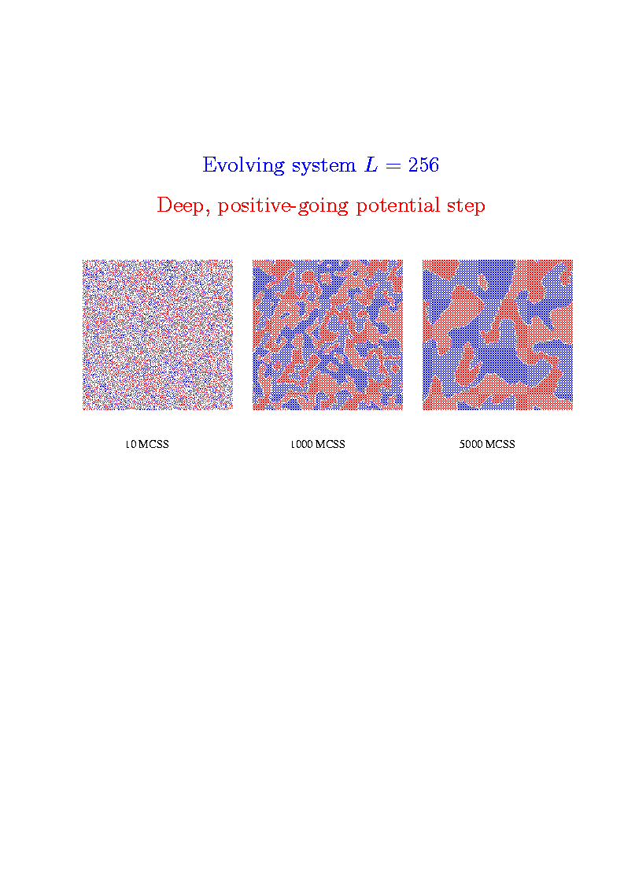

Slide 6
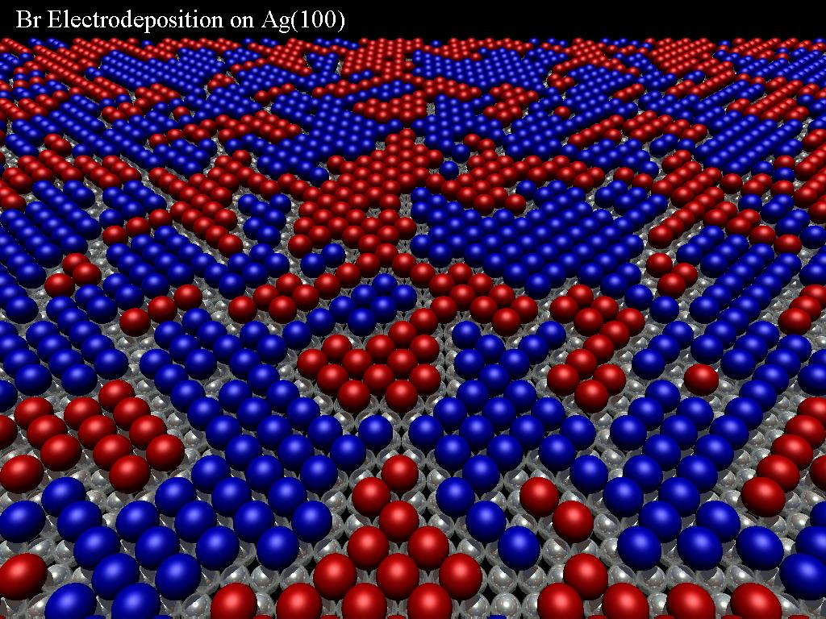
Configuration of Ordering System

Slide 7
A new charging method for Li-ion batteries, suggested by Molecular Dynamics simulations

Slide 8
Li-ion batteries
Popular energy sources for mobile applications (cell phones, cameras, laptops, cars, ...) + Rechargeable + High energy-to-weight ratio (> 10² Wh/kg) + High voltage (¼ 3.6 V) + Slow discharge when idle ( < 10%/month) + Inexpensive raw materials (unlike fuel cells) - Lose capacity with time - High internal resistance - Safety concerns (fire, explosion) - Slow recharge (> 5 hours)

Slide 9
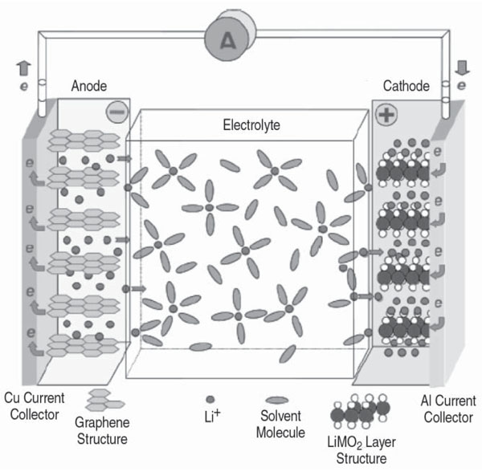
Structure of a Li-ion cell
Chemical reactions:
LiCoO₂ + C₆
Discharge
Charge
Li_{1-x}CoO₂ + C₆Li_{x}
Claus Daniel: http://www.tms.org/pubs/journals/JOM/0809/Fig2.jpg

Slide 10
Simulation of charging process
Large-scale molecular dynamics simulations to model environment near charged graphite sheets
Model system:
Graphite sheets, electrolyte, counter ions, Li⁺ ions
Software: SPARTAN (Hartree-Fock point charges) AMBER force fields for MD GAFF (generalized Amber force field) NAMD scalable MD package
VMD visualization
Notes:
10

Slide 11
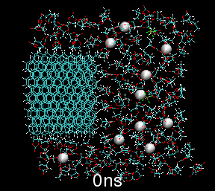
Animation: No Oscillating Field
Duration: 150 ns
Notes:
11

Slide 12
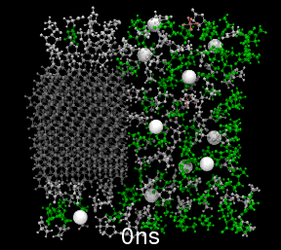
Simulation with Oscillating Field
Duration 42 ns, intercalation at 39 ns
Notes:
12

Slide 13
Nanomagnetism
Important for the development of new ultrahigh-density recording media.
Excellent funding and job opportunities.
Based on the physics of decay of metastable media (nonequilibrium statistical mechanics).

Slide 14
Simulated Nanomagnets
C
u
9 nm x 9 nm x 150 nm
Fe particle
H=800 Oe, T=20 K
Landau-Lifshitz-Gilbert
Langevin simulation
(micromagnetics)
4949 lattice points
Time: 1.2 ns
r
M
z
l

Slide 15
Flux-line visualization

Slide 16
Statistical Physics of Evolution and Ecology
Does evolution proceed uniformly or
in fits and starts?
Scarcity of intermediate forms (“missing links”)
in the fossil record may suggest fits and starts.
Fit-and-start evolution termed punctuated equilibria by Gould and Eldredge.
Punctuated equilibria dynamics resemble
nucleation and growth in phase transformations
and
stick-slip motion in friction and earthquakes.

Slide 17
Model
Individuals of many species
Compete for resources
Interact directly (predator/prey, etc.)
Individuals who get many resources and much food have larger probability of reproducing.
Mutations that produce new species occur during reproduction.

Slide 18
Simulation Results
Diversity,
D(t)
N_{tot}(t),
normalized
n_{I} > 1000
n_{I} 2 [101,1000]
n_{I} 2 [11,100]
n_{I} 2 [2,10]
n_{I} = 1
Quasi-steady states (QSS) punctuated by active periods. Self-similarity.

Slide 19
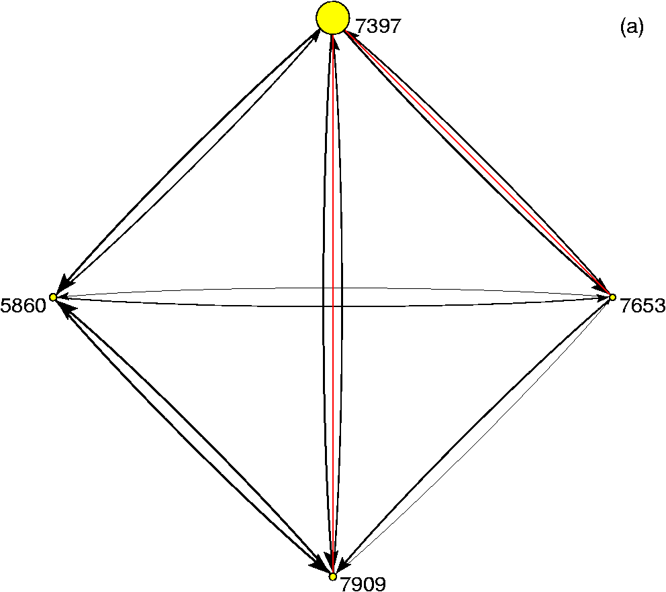
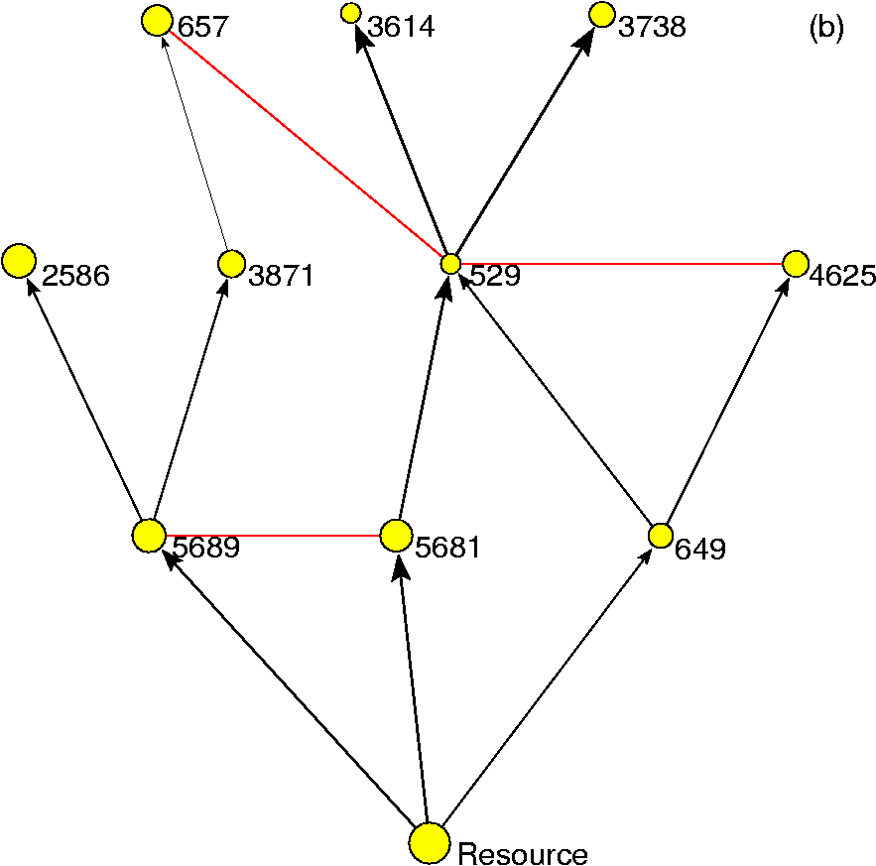
Typical community structures
Model A
Model B
Mutualistic community
Predator-prey food web

Slide 20
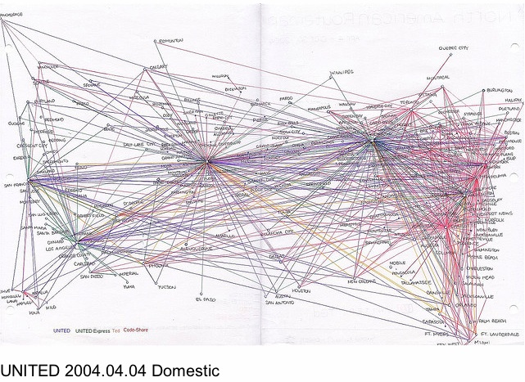
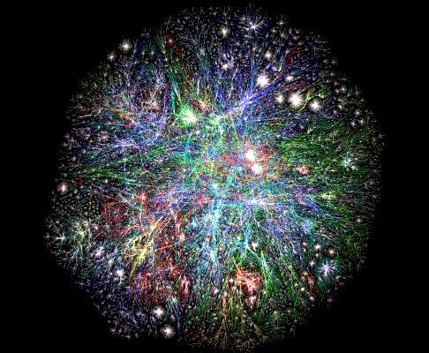
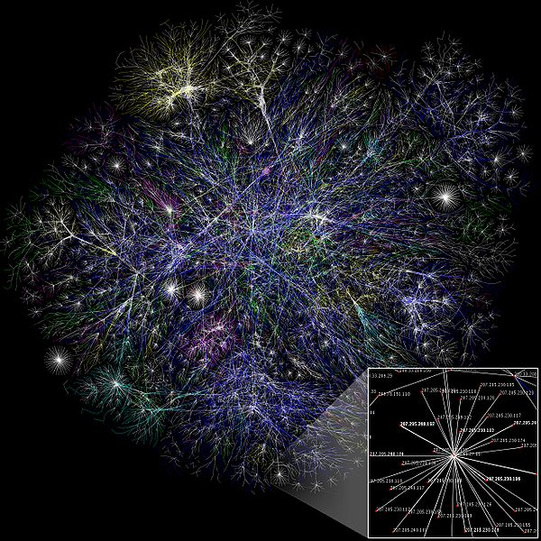
Some other network examples
www.tokyometro.jp
http://contrailscience.com/30-years-of-airline-travel/
The Internet. From Wikipedia
World Wide Web. www.opte.org

Slide 21
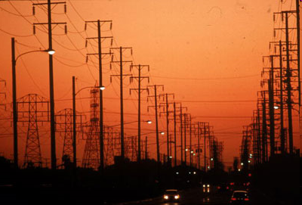
Applications of network theory
to power grids
Motivation:
Society relies heavily on power grid performance
Modern & future power grids are large, complex, integrated
Vulnerability to natural disasters, hostility, software failure
Network theory is in rapid development

Slide 22
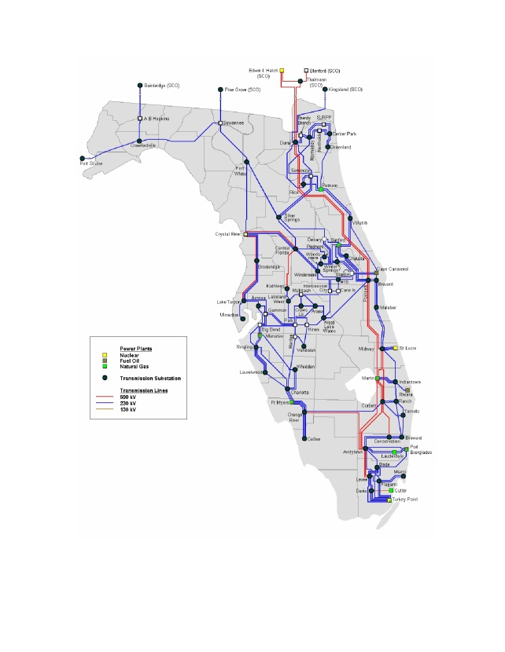
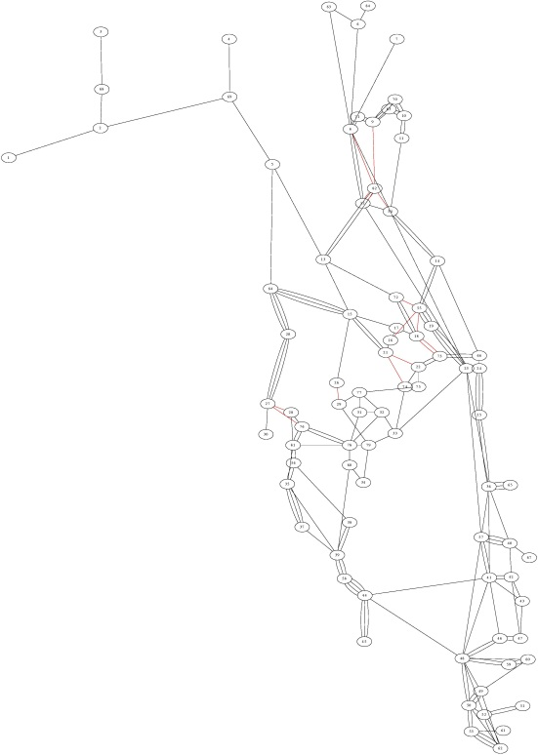
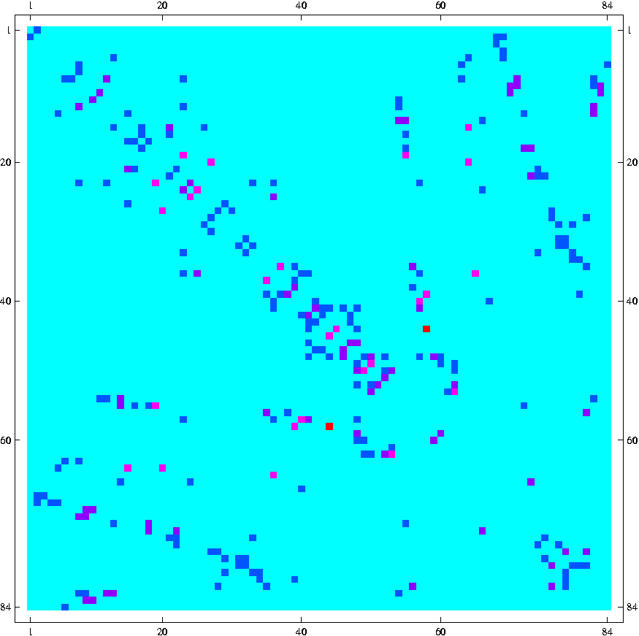
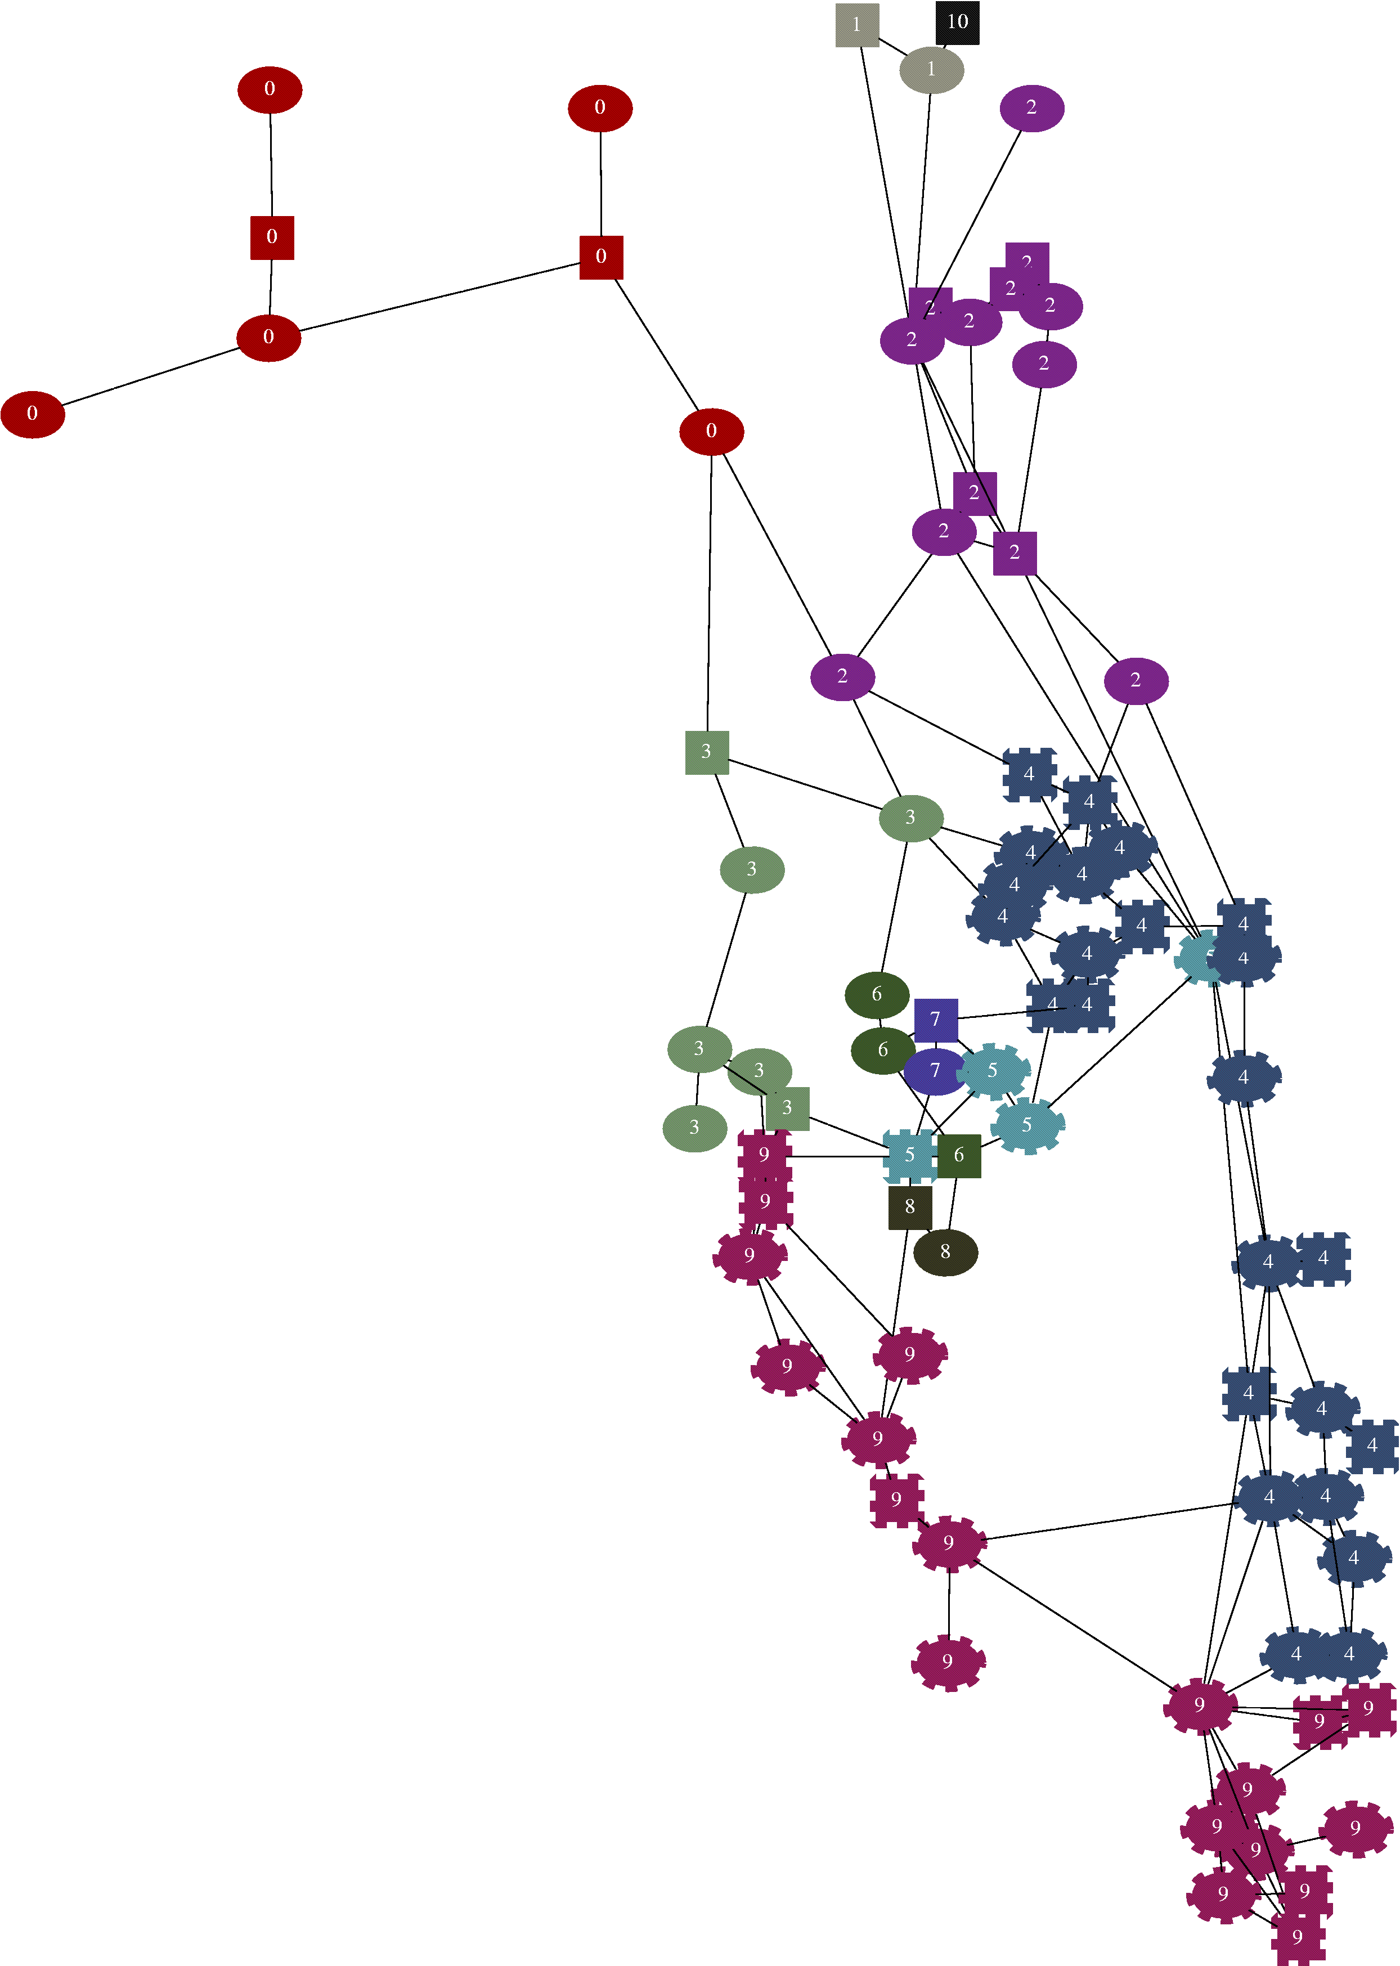
Floridian power grid
Florida electric power grid map
31 generators
53 loads
Corresponding network
84 vertices
Optimal partitioning into 8 clusters.

Slide 23
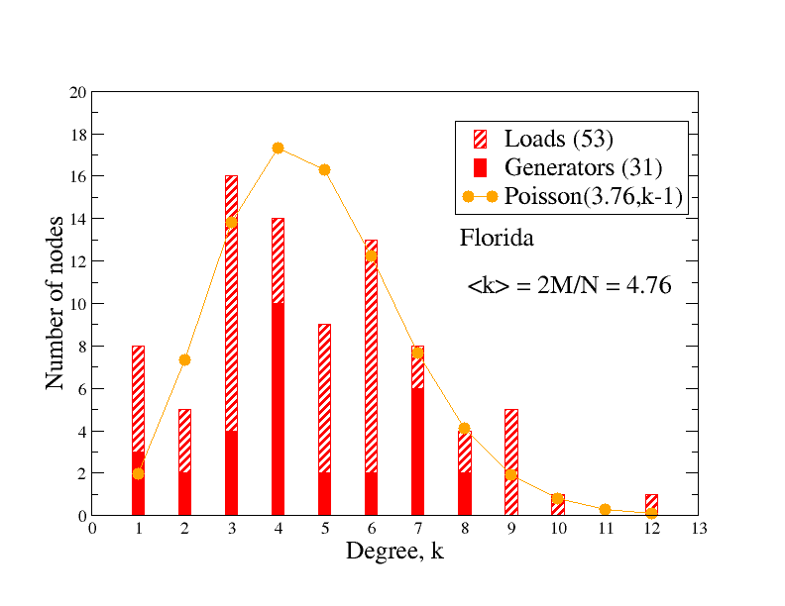
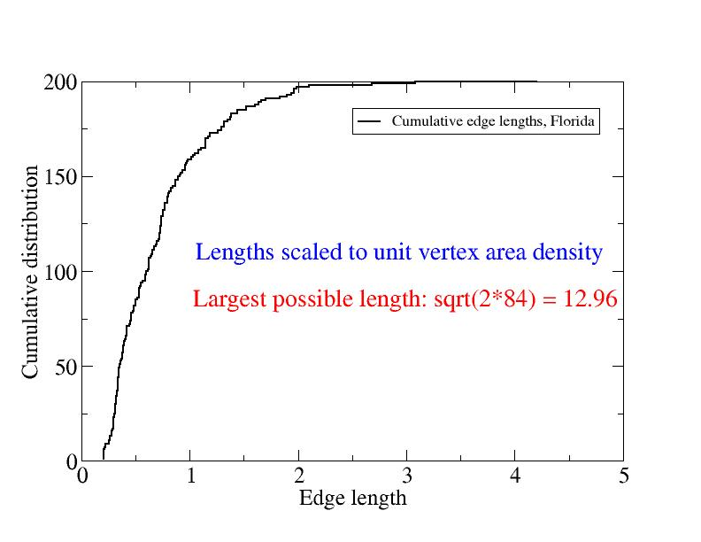
Building a model power grid that we can play with. First attempt.
Geographically embedded network
Scale such that area density of vertices is unity (N vertices in square of side N^{1/2} )
Proportion of power plants (Florida: 31/84)
Real Florida degree distribution
Real Florida edge-length distribution
<edge length> = 1.09

Slide 24
“Cooling” Florida

Slide 25
Grand Conclusion
Physics can be used to study lots of problems that most people would never think of as “physics”!

