Slide 1
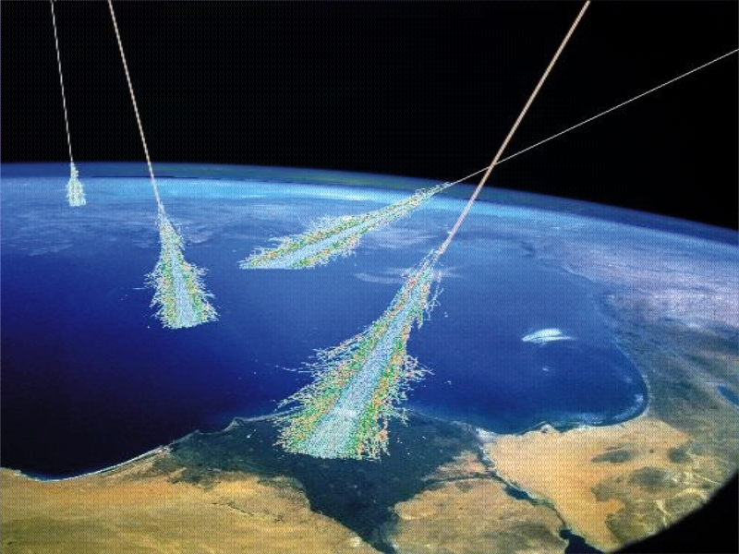
Introduction to cosmic rays

Slide 2
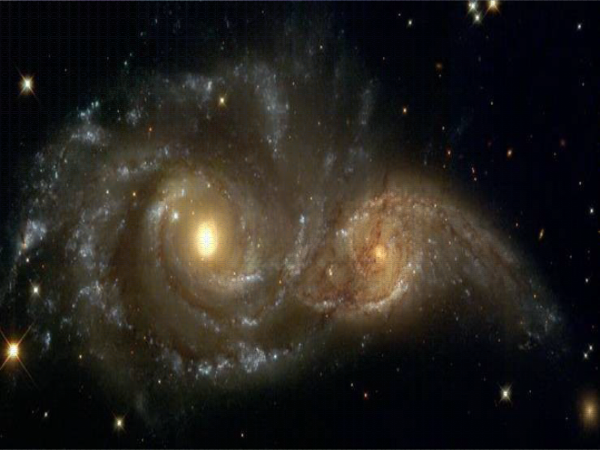
COSMIC RAYS:
Messages from exploding stars and even more powerful objects
  What are cosmic rays?
  How were they discovered?
  How do we detect them?
  What can we learn from them?
  Where do they come from?

Slide 3
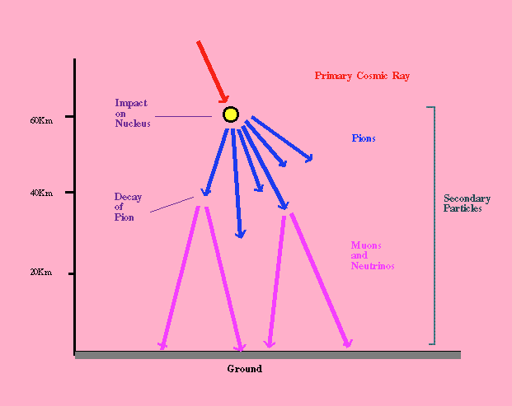
Cosmic rays
  Discovered by Victor Hess (1912)
  Observations on mountains and in balloon: intensity of cosmic radiation increases with height above surface of Earth – must come from “outer space”
  Much of cosmic radiation from sun (rather low energy protons)
  Very high energy radiation from outside solar system, but probably from within galaxy

Slide 4
Role in Physics and Astrophysics
Part of the rise of “modern” physics: early radiation detectors (ionization chambers, electroscopes) showed a dark current in the absence of sources.
Until 1952, cosmic ray research = experimental particle physics
  discoveries: muon, pion, and other particles
  Energy of highest energy cosmic rays (> 10²⁰ eV) >> energy available with accelerators
extraterrestrial nature of cosmic rays confronted astronomers, but challenge could not be faced until mid 20th century.
Today, cosmic rays are an important part of research of solar system and galactic astrophysics, including the ISM

Slide 5
History of CR's: 1785-1902
1785 Charles Coulomb
  Discovered that charged body in the air becomes discharged→ “there are ions in the atmosphere”
1902 Rutherford, McLennan, Burton
  Discovered that penetrating radiation passes through the atmosphere

Slide 6
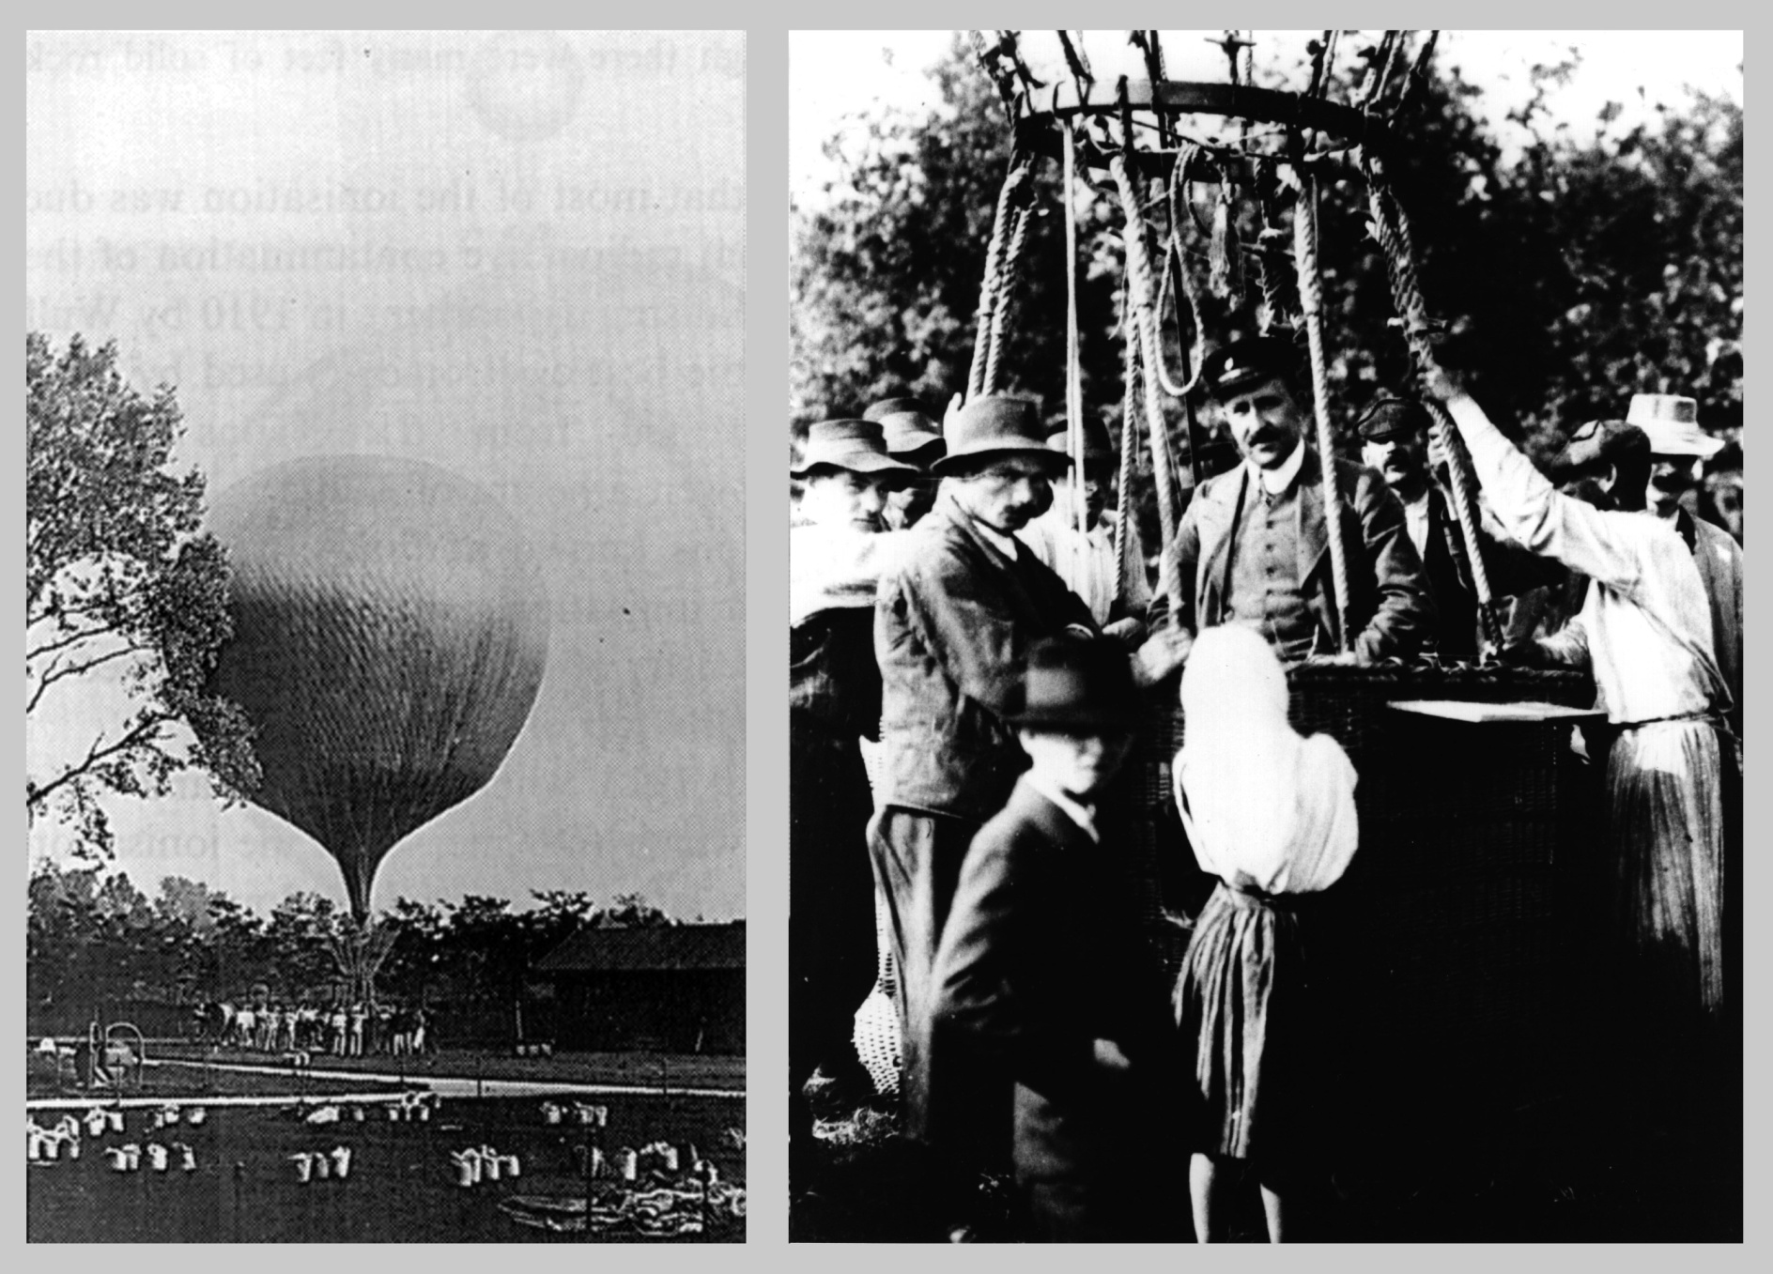
Victor Hess’ Balloon ride 1912

Slide 7
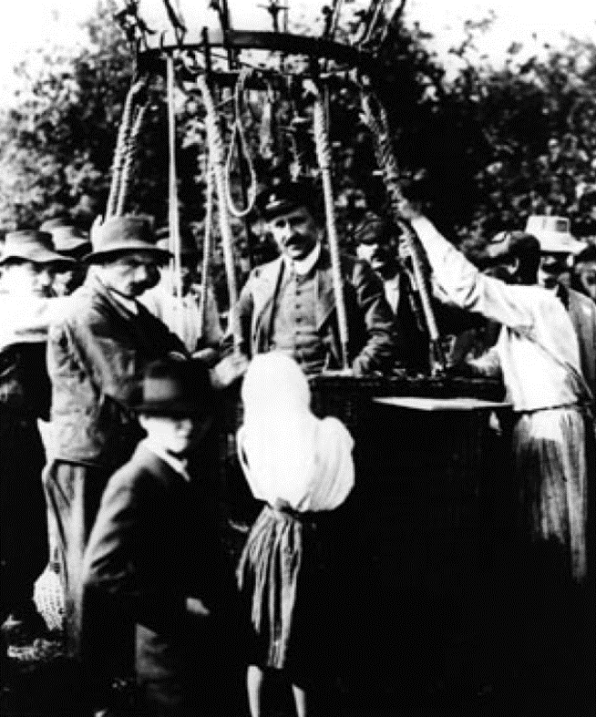
History of Cosmic Rays: Hess
1912 Victor Hess
  Investigated sources of radiation – took balloon up to 5000 meters
  Found radiation increased after 2500 meters
  Hess & Kohlhörster (by 1914): balloon flights to 9 km
  Studies of the variation with height, latitude & longitude confirmed the particle nature of cosmic rays (name by Millikan) originating above the Earth’s atmosphere.
  radiation is coming from space ... “cosmic radiation”
  Nobel Prize in 1936
Hess after his flight, which he
took without breathing apparatus
in very cold and thin air!

Slide 8
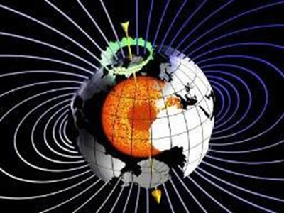
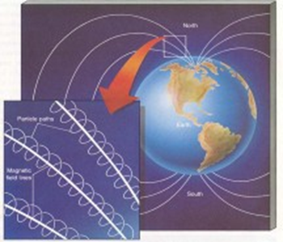
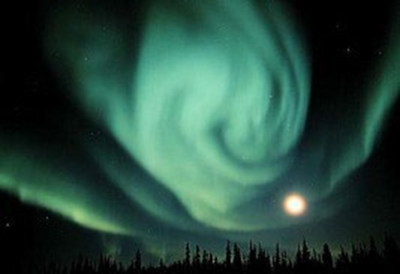
History of Cosmic Rays: 1932- 1947
1932 discovery of positron
1933 Arthur Compton
  Radiation intensity depends on magnetic latitude
1937 Street and Stevenson, Anderson and Neddermeyer
  Discovery of the muon particle in cosmic rays (207 x heavier than an electron)
1938: extensive air showers (Auger)
1946 Kaons (“V particles”)
1947 pion (Lattes, Occhialini and Powell)

Slide 9
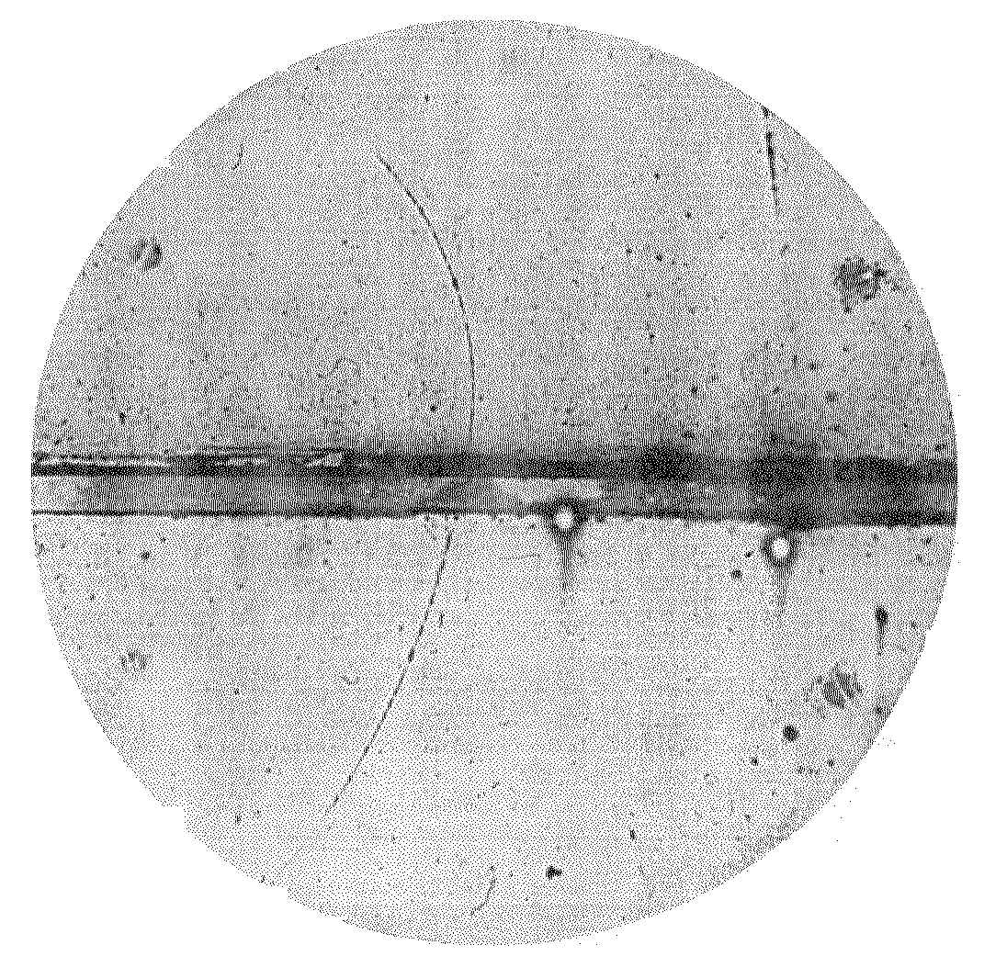
Positron
Positron (anti-electron)
  Predicted by Dirac (1928) -- needed for relativistic quantum mechanics
  existence of antiparticles doubled the number of known particles!!!
  Positron track going upward through lead plate
    Photographed by Carl Anderson (Aug. 2, 1932)
    Particle moving upward, as determined by increase in curvature of the top half of the track after it passed through lead plate,
    and curving to the left, meaning its charge is positive

Slide 10
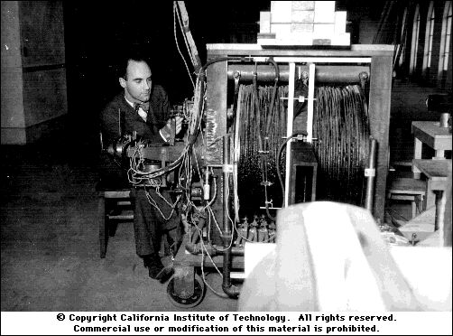
Anderson and his cloud chamber

Slide 11
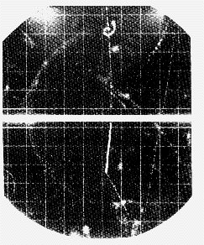
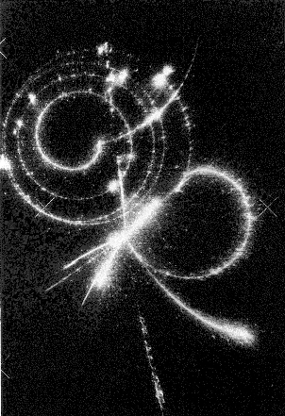
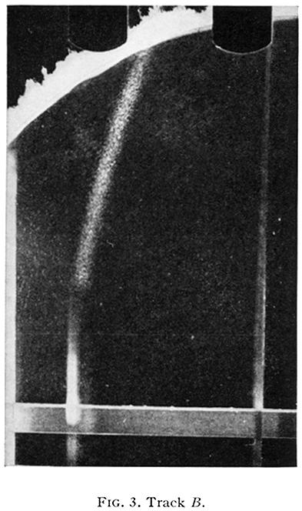
More particles: Muon
1937: “mesotron” is observed in cosmic rays (J. Curry Street, Edward C. Stevenson and Carl Anderson, Seth Neddermeyer “mesotron” -- mass between that of electron and proton
New particle first interpreted to be the particle predicted by Yukawa as mediator of strong nuclear interaction
However it was shown
in 1941 that mesotrons didn’t
interact strongly with matter.

Slide 12
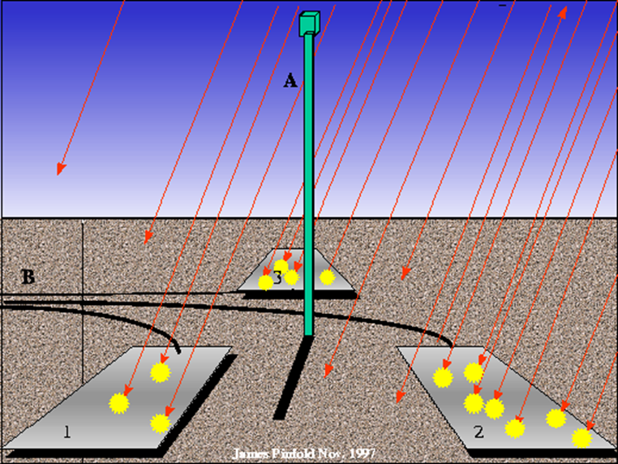
History of Cosmic Rays: 1938
Pierre Auger and Roland Maze - “Extensive Air Showers”
  Rays in detectors separated by 20m (later 200m) arrive simultaneously
  “coincidence”

Slide 13
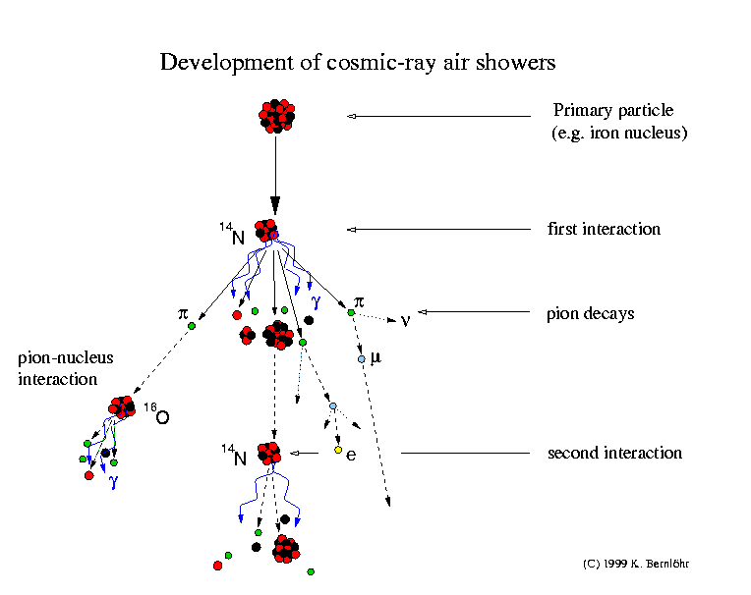

Slide 14
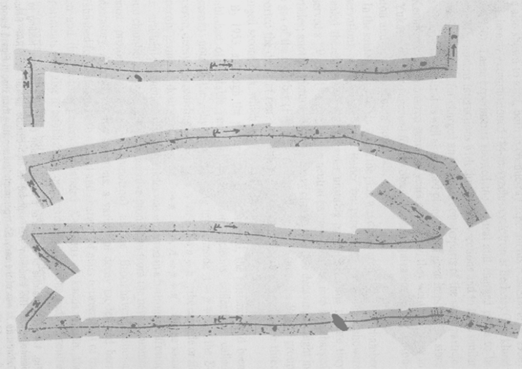
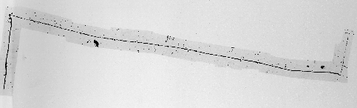
Discovery of pion
Lattes, Occhialini and Powell (Bristol, 1947) (+ graduate student Hugh Muirhead): observed decay of a new particle into two particles
decay products:
  muon (discovered 1937),
  the other is invisible (Pauli's neutrino).
muon in turn also decays into electron and neutrino

Slide 15
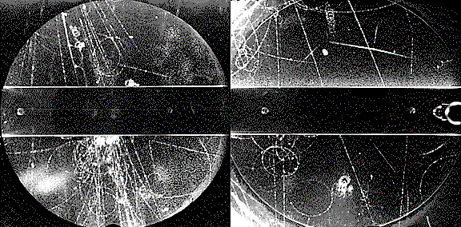
Kaons
First observation of Kaons:
  Experiment by Clifford Butler and George Rochester at Manchester
  Cloud chamber exposed to cosmic rays
  Left picture: neutral Kaon decay (1946)
  Right picture: charged Kaon decay into muon and neutrino
  Kaons first called “V” particles
  Called “strange” because they behaved differently from others

Slide 16
What are cosmic rays?
Cosmic rays are high energy particles from outer space.
About 1000 cosmic rays per second strike each square meter area of Earth's atmosphere.
Most cosmic rays are produced in our Galaxy by supernova explosions and by objects such as neutron stars and black holes.
Large fraction of very low energy cosmic rays produced by the Sun, with maxima during violent events called flares and coronal mass ejections (solar storms).
About 89 % of Galactic cosmic rays are protons, 9 % are helium nuclei, and the rest are nuclei of heavier atoms.
Extragalactic CR: origin unknown, composition unknown, but probably mostly protons

Slide 17
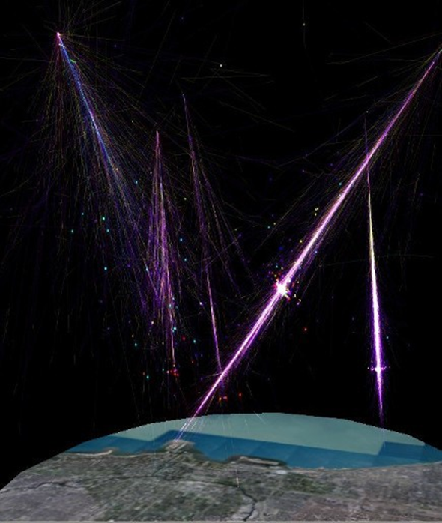
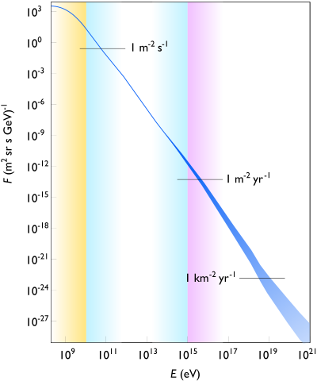
Flux vs energy
<10¹⁰ eV: many solar
<10¹⁵ eV: mostly galactic
>10¹⁵ eV: extragalactic
CR showers
(artist’s impression)
https://commons.wikimedia.org/wiki/File:Cosmic_ray_flux_versus_particle_energy.svg#/media/File:Cosmic_ray_flux_versus_particle_energy.svg

Slide 18
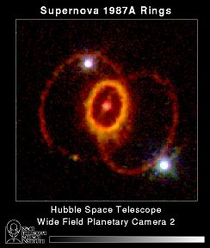
CRs from Supernovae
Cosmic rays produced by
  supernova explosions
  neutron stars
  AGNs (“active galactic nuclei”) ( with black holes)
  Quasars
  Gamma ray bursts
  …. ?
Photo of the remains of Supernova 1987A:
  taken by Hubble Space Telescope in 1994 (7 years after observation of SN explosion)

Slide 19
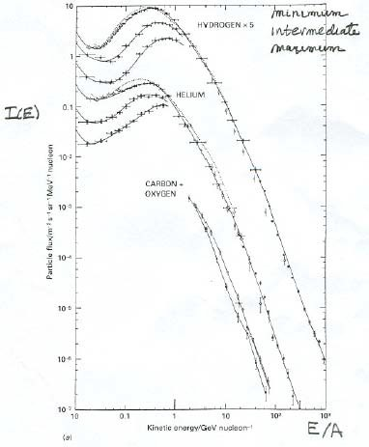
Solar contribution
Beyond 1GeV/nucleon, I(E) decreases rapidly with E (approximate power law, (E/GeV)^{-2.75}
low-energy behavior more complicated, strongly influenced by what happens in the Sun
figure shows spectra at three levels of solar activity: Sun changes the CR intensity at low energies

Slide 20
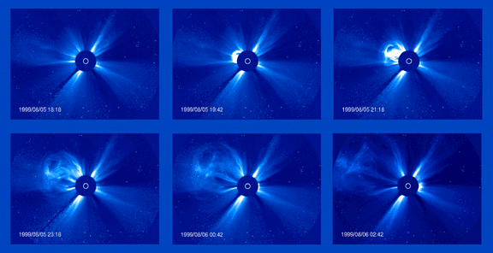
CRs from Sun
Cosmic rays are also produced by the Sun during violent events called coronal mass ejections.
Sequence of SOHO images showing a coronal mass ejection (CME) exploding outward from the Sun (http://sohowww.nascom.nasa.gov/home.html) (ESA + NASA)

Slide 21
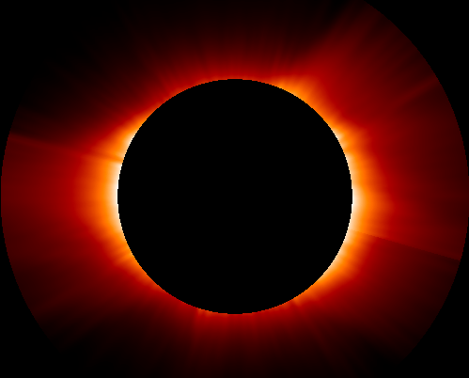
Solar Wind
S.W. = stream of plasma released from the upper atmosphere of the Sun.
mostly electrons, protons and alpha particles
Mass loss of Sun: 1 Mton/s
energies usually between 1.5 and 10 keV.
Speeds ≈ 400km/s
varies in density, temperature, and speed over time and over solar longitude.
emitted from the corona (outermost layer of Sun’s atmosphere, very hot (≈ 1.5⋅10⁶ K))
The Sun's corona, taken by the SOHO satellite with a special camera that blocks out light from the Sun's main disk. Courtesy of SOHO consortium. SOHO is a project of international cooperation between ESA and NASA."

Slide 22
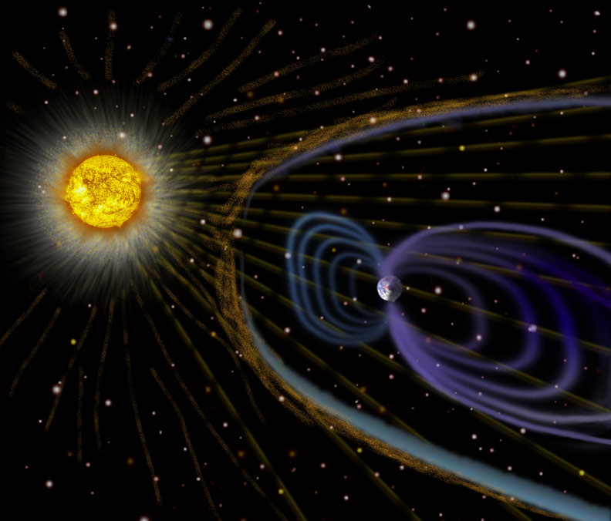
Interaction of solar wind with Earth’s magnetosphere
Interaction of solar wind with Earth’s magnetic field ⇒ modification of E mag field
Particles deflected, low energy particles travel around Earth
some trapped in Van Allen belt
Some channeled to poles (spiral around mag field lines) ⇒ aurora

Slide 23
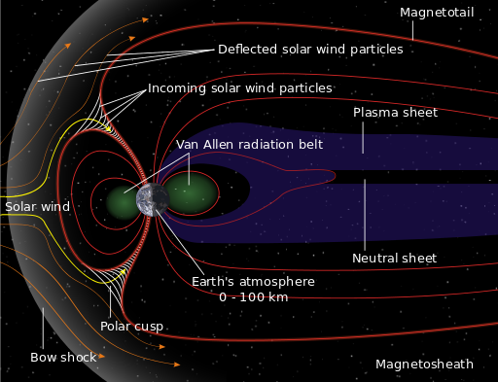
Interaction of solar wind with Earth’s magnetosphere
Interaction of solar wind with Earth’s magnetic field ⇒ modification of E mag field
Particles deflected, low energy particles travel around Earth
some trapped in Van Allen belt
Some channeled to poles (spiral around mag field lines) ⇒ aurora
https://en.wikipedia.org/wiki/Solar_wind
http://solarscience.msfc.nasa.gov/SolarWind.shtml
http://helios.gsfc.nasa.gov/sw.html

Slide 24
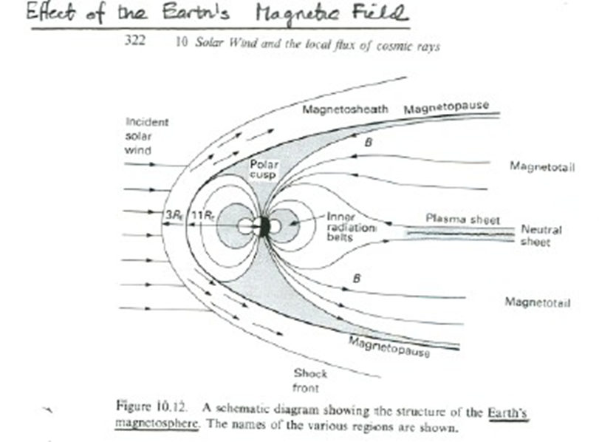
Effects of the Earth’s Magnetic Field
The effects of the Earth’s magnetic field have been studied extensively for more than 100 years and are reasonably well understood. Satellite observations of CRs extend beyond this region.

Slide 25
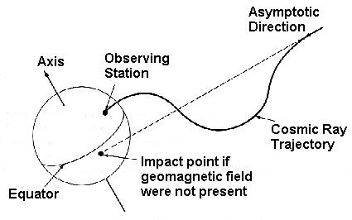
Cosmic rays and Earth
cosmic ray approaching Earth first encounters Earth's magnetic field.
magnetic field repels some particles altogether. Those that get through are deflected by the magnetic field.
Computer simulations to determine how the starting direction ("asymptotic direction") is related to the impact point.

Slide 26
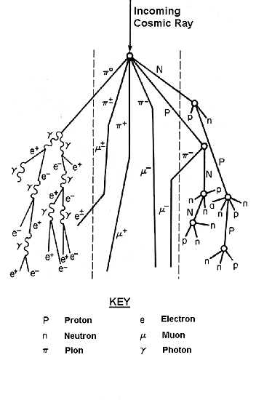
Cosmic ray showers (cascade)
Collision of primary cosmic ray with atom in Earth's atmosphere, ⇒ produce one or more new energetic particles -- "secondary" cosmic rays
secondary particles strike other atmospheric atoms ⇒ still more secondary cosmic rays ⇒ “atmospheric cascade”
If energy of primary cosmic ray high enough (>500 MeV) ⇒ particles produced in cascade can reach Earth's surface

Slide 27
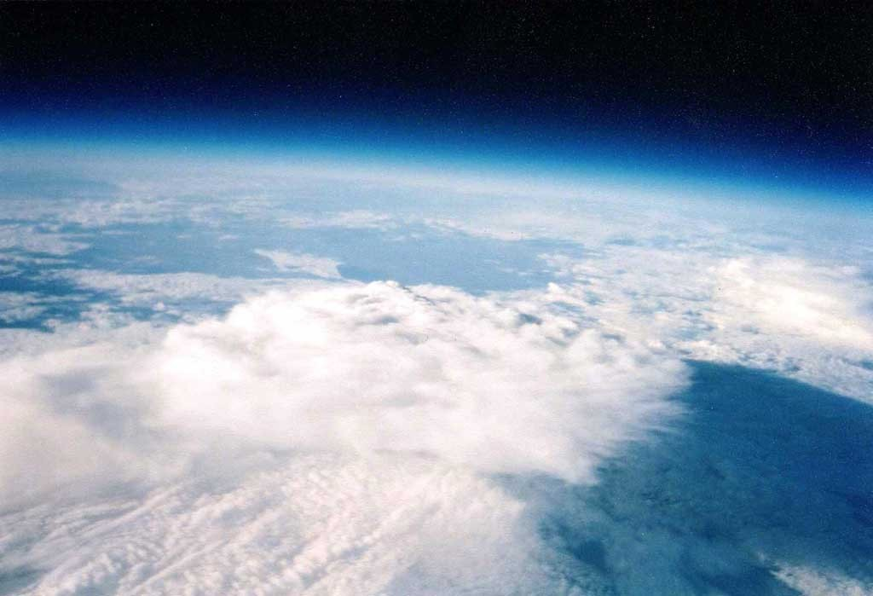
Cosmic Ray “Showers”
Space
“Primary” Cosmic Ray
(Ion, for example a proton)
Earth’s atmosphere
Atmospheric Nucleus
_{π}o
_{π}-
π⁺ “Secondary” Cosmic Rays...
(about 50 produced after first collision)
γ
γ
_{π}o
_{π}-
π
+
_{e}+ _{e}−
γ
γ
_{μ}+
ν_{μ} muon
neutrino
γ
_{e}−
Creating:
Electromagnetic Shower
(mainly γ -rays)
Hadronic Shower
Plus some:
(mainly muons and neutrinos Neutrons
reach earth’s surface)
Carbon-14

Slide 28
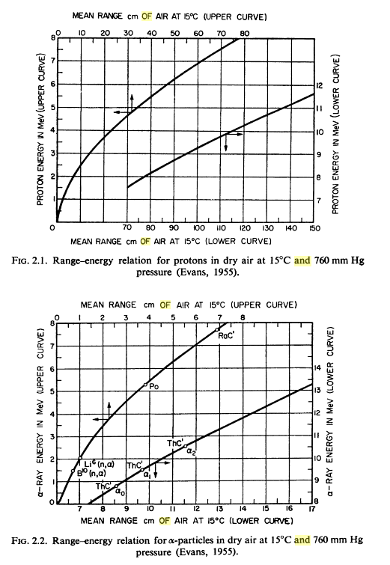
Energy loss in atmosphere
Most CRs have E < 1 GeV.
particles created in showers interact primarily with atomic electrons, exciting & ionizing atoms
For E>10 MeV, range ∼ scales with energy as E^{5/3}
range of a 10 MeV proton is only ~ 112cm (1.3 g cm⁻²)

Slide 29
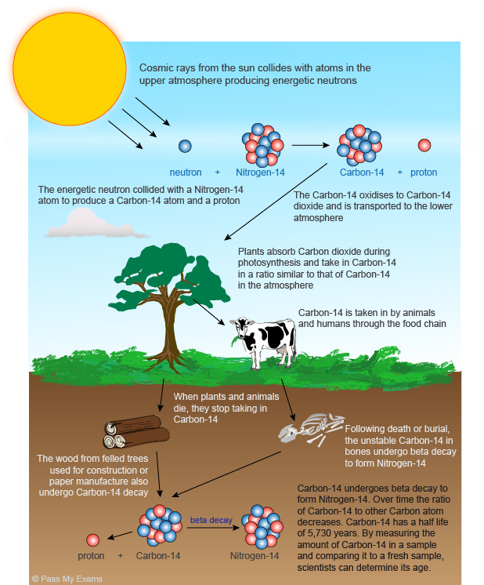
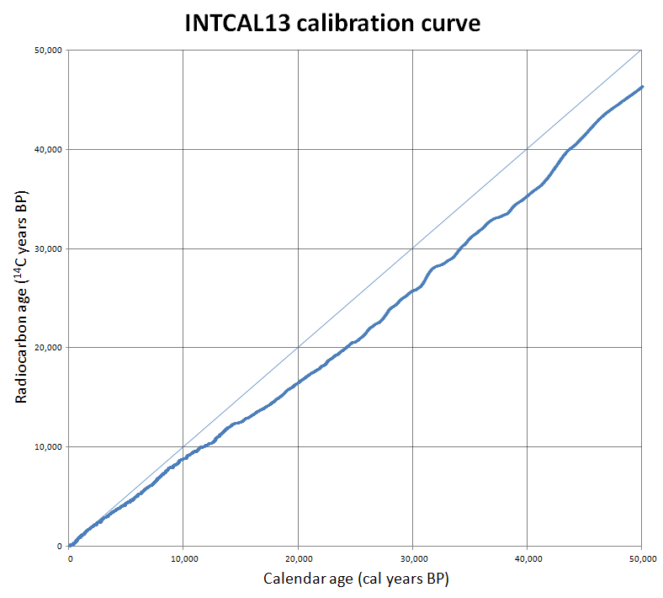
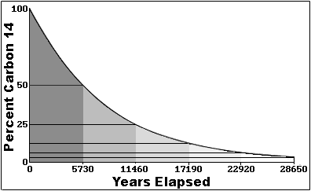
Radiocarbon dating
Works up to 50,000 years
Calibration and understanding time dependence of cosmic ray flux crucial

Slide 30
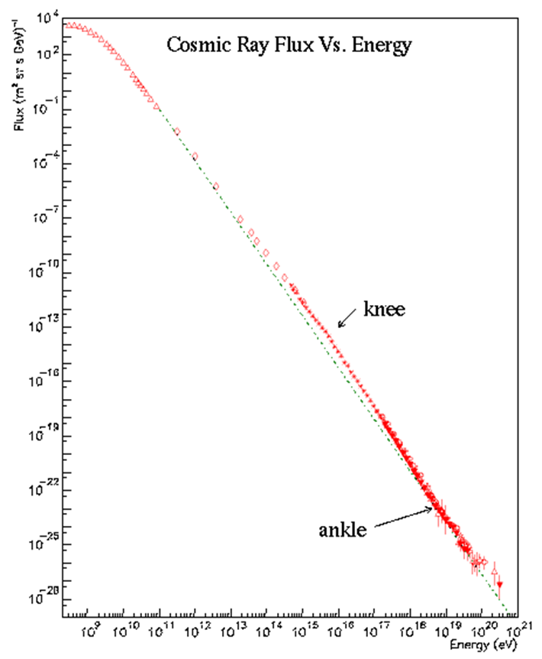


Primary Cosmic Rays
composition:
  Mostly H (≈89%) and He (9%) nuclei (p, α)
  heavier elements (≈1%) (Li, Be, B..)
  Electrons (≈1%)
energy spectrum:
  Peak at ≈ 0.3 GeV
  Very steep fall-off with energy, steepening at “knee”, resume at “ankle”
  Lower-energy CRs are common, high- energy CRs are rare
Flux = nb/((unit area) × (unit solid angle) × (unit time))
Energy achieved by man-made accelerator

Slide 31
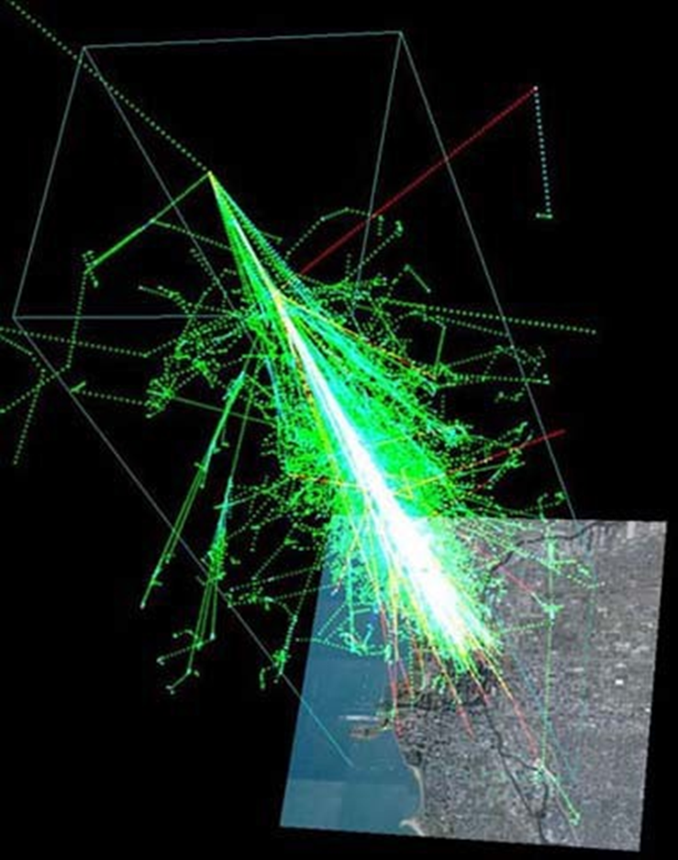
Secondary Cosmic Rays
Shower particles:
  Electrons, photons
  Kaons, pions
  muons, neutrinos
  Can travel faster than the speed of light in air (they are still slower than the speed of light in vacuum)
  150 muons are striking every square meter of the Earth every second
  Not all shower particles reach ground – some stopped in atmosphere

Slide 32
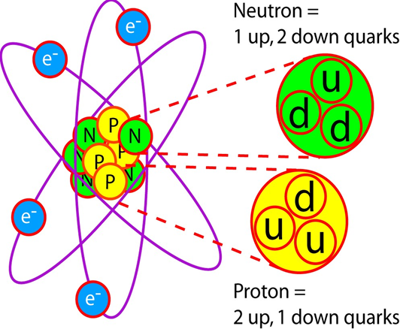
Matter in CR
Atoms
  made of protons, neutrons, electrons
  Protons, neutrons made of quarks (+ gluons)
Kaons, pions
  made of quarks + gluons
muons, neutrinos
  Produced when pions decay
  Muons make up most of secondary CR that reach Earth’s surface
  Decay into electrons and neutrinos
  Muons discovered as “penetrating component of CR”

Slide 33
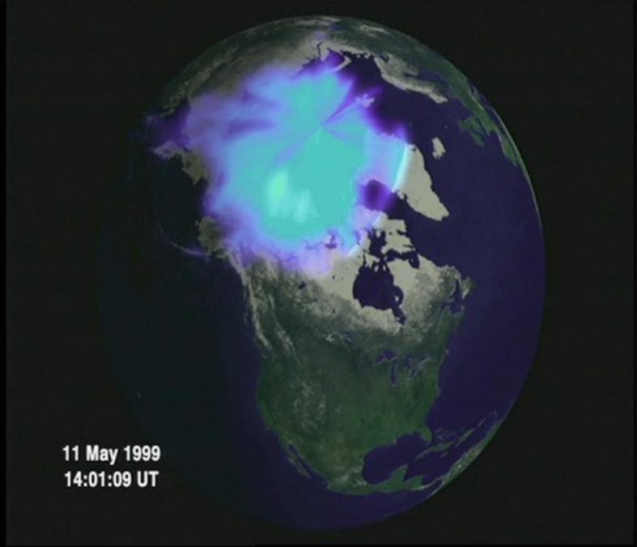
summary
(primary) cosmic rays are nuclei (mostly H, He, but also some heavier)
Primary cosmic rays hit the upper atmosphere, releasing showers of secondary cosmic rays
Even though many CRs reach the Earth’s surface, CRs can be slowed and stopped by matter (Hess found more radiation at higher altitude)!
Flux falls steeply with Energy
Aurora due to interaction of CR with atmosphere

Slide 34
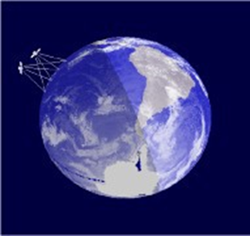
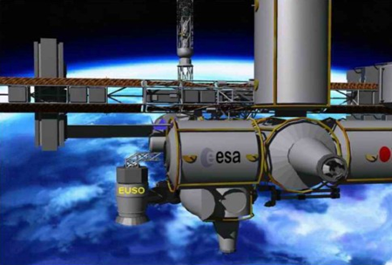
How to detect cosmic rays
observatories in space
  Study the “primary” original cosmic ray w/o interference from the atmosphere
  Disadvantage:
    expensive detector
    too small to “catch” a lot of them
observatories on the ground
  Good: cheaper, bigger, and detect a lot more!
  Bad: measure cascades induced by primary ⇒ it takes some work to figure out what the primary is like.
  Can either detect the particles, or look for the light as those particles bounce off the air and create fluorescence

Slide 35
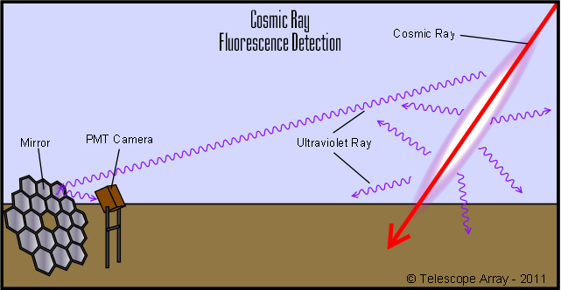
Passage of particles through atmosphere
  ⇒ionization and excitation of the gas molecules (mostly nitrogen).
  some of this excitation energy is emitted in the form of visible and UV radiation
  use mirror arrays to collect light and focus on PMTs

Slide 36
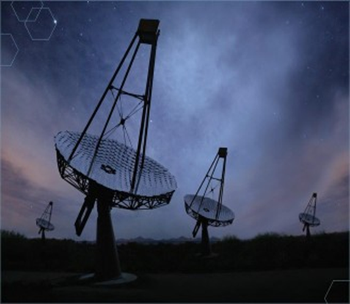
CR detectors: bigger is better
They catch more cosmic rays overall
Detect more of the ones that are rare! Ultra-high-energy cosmic rays (UHECRs) with more than 10¹⁸ eV are found only one per square km per century!
Big area can detect larger shower ⇒ from higher-energy CRs
The West Desert provides an ideal location for fluorescence observations.
  An altitude of ~4,500 feet where the nearest population centers are more than 30 miles away
  Light pollution is mostly blocked by the surrounding mountains.
  For 347 days per year, the visibility is better than 10 miles.

Slide 37
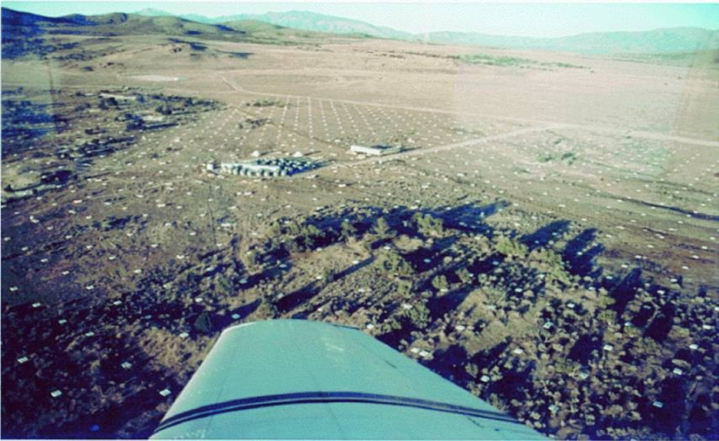
Particle detector arrays
Casa Mia, Utah (pictured below) – one of the first “big” CR detectors: 1089 detectors spaced 15 meters

Slide 38
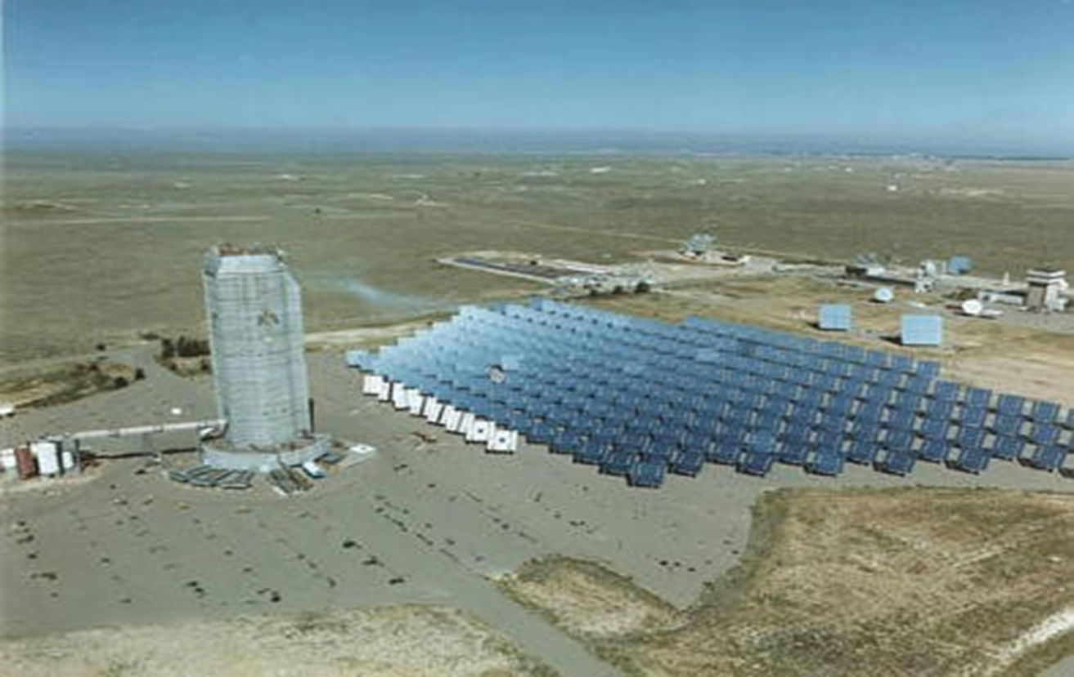
Large Observatories
STACEE: Albuquerque, New Mexico
STACEE uses some of the facility's 212 heliostats to collect Cherenkov light.
Cherenkov light is like a sonic boom,
but for light. It’s produced by
electrons in air showers generated by
high energy gamma rays.

Slide 39
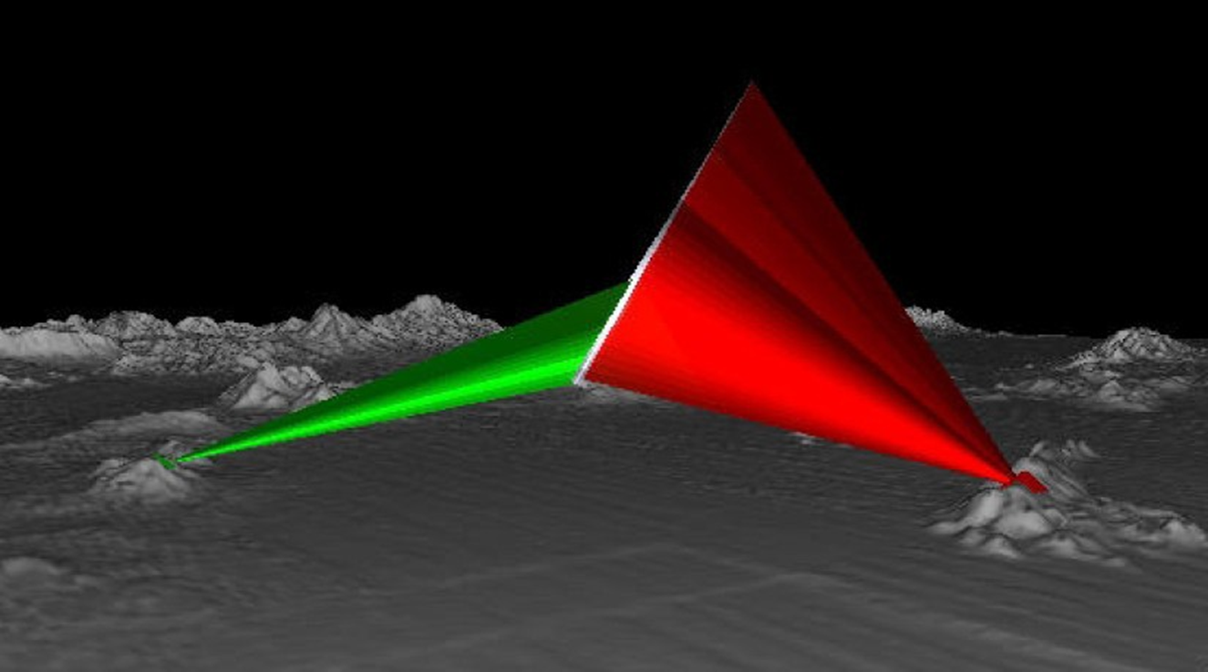
Air scintillation detector
1981 – 1992: Fly’s Eye, Utah
1999 - present: HiRes, then Telescope Array, same site
  2 detector systems for stereo view
  42 and 22 mirrors a 2m diameter
  Each mirror reflects light into 256 photomultipliers
  Sees showers up to 20-30 km high
http://www.physics.adelaide.edu.au/astrophysics/hires/example.html

Slide 40
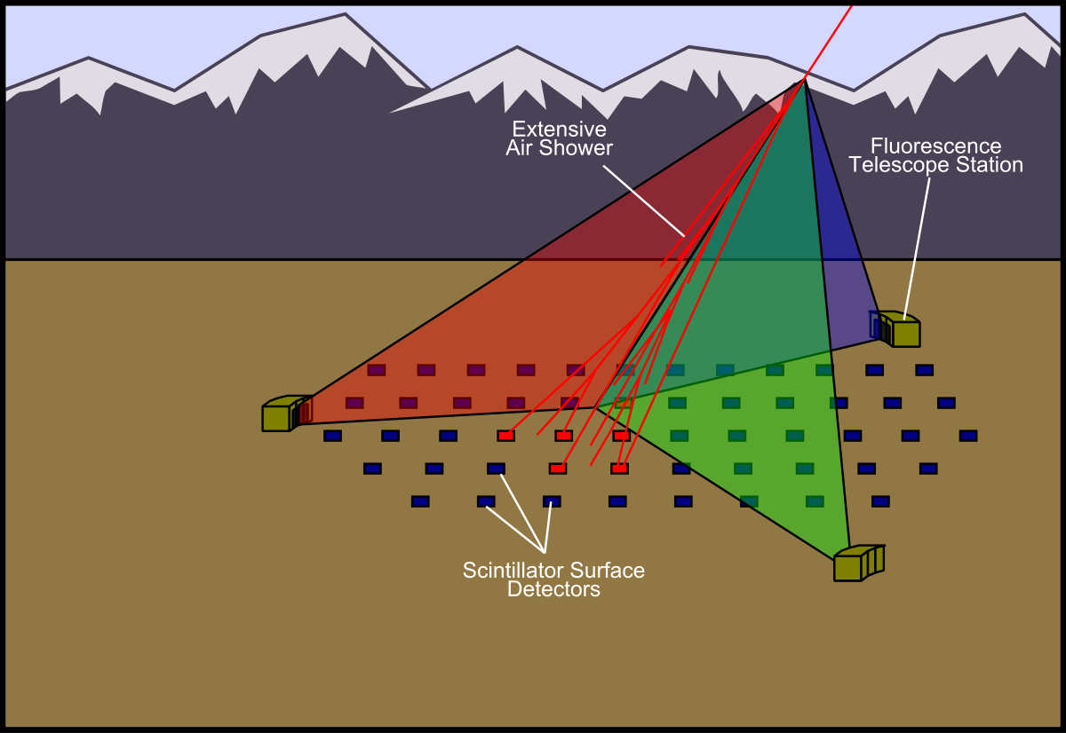
Telescope Array

Slide 41
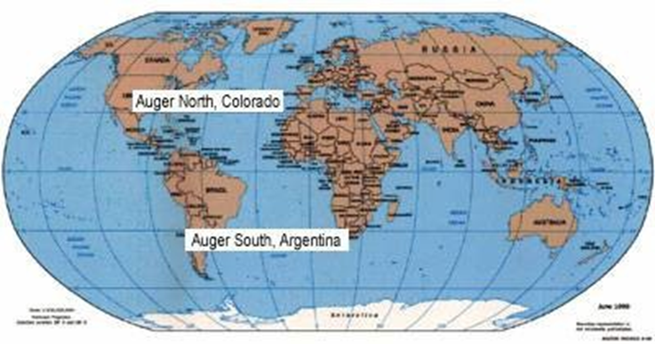
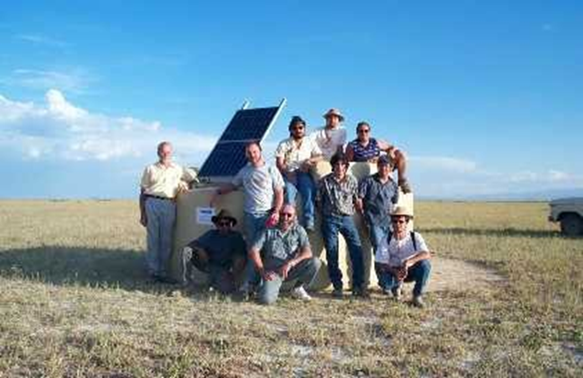
Pierre Auger Project
Pierre Auger Observatory in Las Pampas around Malargue, Argentina.
Auger North was planned for installation in Eastern Colorado (and reached the status of the Highest Priority of the European Space Agency at one point), but later cancelled.
PAO comprises 1600 surface detectors covering an area roughly 3000 square kilometers
observes 10³ showers/day

Slide 42
What can we learn from Cosmic Rays?
Where they come from
How they are produced
How they are accelerated
What elements are in the universe

Slide 43
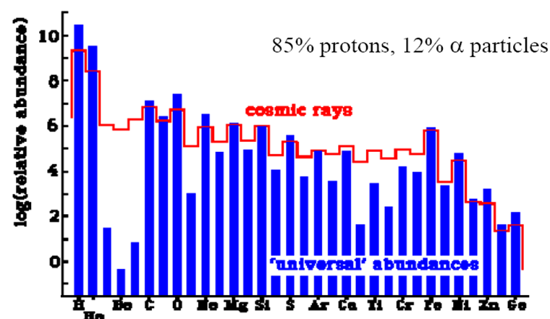

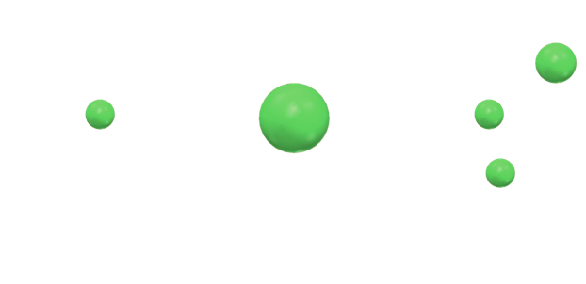
Elements in the universe
Abundance of elements:
  Abundance of elements in CR ≠ abundance in universe
  Elements heavier than He more frequent in CR than expected
  Due to collisions of CR with other atoms somewhere in space
  These collisions are a major source of lithium, beryllium and boron in the universe (“spallation reactions”)

Slide 44

Source of cosmic rays
Stars produce low-energy CRs
  e.g., “Solar wind” -- protons, α and other particles
Supernovae produce medium - energy CRs
But what makes “Ultra High Energy Cosmic Rays” (UHECRs), i.e. cosmic rays with E > 10¹⁸ eV???

Slide 45

CR from SuperNovae
X-ray image by Chandra of Supernova 1006
Shockwave from the supernova hits gas surrounding the explosion, possibly accelerating CRs to 10¹⁵ eV. Not enough energy for UHECRs!
Blue: XC-rays from high energy particles
Red: X-rays from heated gas

Slide 46


Sources of HE cosmic rays
cosmic rays with E < 10¹⁸ eV deflected in the galactic magnetic field ⇒ sources cannot be determined
But UHECRs (with E > 10¹⁸ eV) much less deflected (travel straighter) ⇒ their direction should point towards their origin
Galactic magnetic field
M83 spiral galaxy

Slide 47

UHECRs very rare
UHECR:
  E>10¹⁸ eV
  <1 per km² per year!
UHECR detection:
  very rare
  ⇒ need very large detectors to see them
Telescope arrays, large collaborations

Slide 48

Energy range of Cosmic Ray Spectrum (10⁸-10²¹ eV)
Power law defined from 10¹⁰-10¹⁵ eV steepens
at the “knee” and recovers beyond the “ankle”.
The puzzle of ultra high- energy CRs:
  energy too high for them to be confined by the Galactic B-field,
  can’t be produced by SNe,
  can’t come from very large distances because of interaction with CMB photons
“knee”
.
GZK
limit
“ankle”

Slide 49
Ultra High Energy Cosmic Rays: GZK cut-off
UHECRs we have detected appear to come from all directions, ⇒ probably come from far away (only sources nearby are galaxies in few directions)
Problem: UHECRs should lose energy when traveling long distances (> 50Mpc)
  Interaction with CMB ⇒ GZK cut-off
Another problem: have no working model of mechanism of acceleration to such

Slide 50
GZK cut-off
Interaction between CR and CMB (cosmic background radiation):
  For proton energy > E_{GZK} = 5×10¹⁹ eV, formation of Δ resonance becomes energetically possible
  ⇒ energy of primary protons drained off into pion production
  CR proton of energy > E_{GZK} cannot travel farther than 50Mpc (= 162ly)

Slide 51
Sources of UHECRs
Colliding galaxies
Supermagnetized neutron stars
Giant black holes spinning rapidly
Sources of gamma ray bursts
  Supernova or hypernova
    Collapse into neutron star or quark star or black hole
  Merging neutron stars
  ???
Something else we haven’t thought about yet?

Slide 52

Future of CR research
Understand origin of UHECRs
  Sources and production mechanisms
Are there really EECRs (> E_{GZK} )? (AGASA controversy)
Space based large detectors to view atmosphere from above
A composite image showing cosmic ray distribution in the sky

