Slide 1
Quantum physics
(quantum theory, quantum mechanics)
Part 1

Slide 2
Outline
Introduction
Problems of classical physics
Black-body Radiation
  experimental observations
  Wien’s displacement law
  Stefan – Boltzmann law
  Rayleigh - Jeans
  Wien’s radiation law
  Planck’s radiation law
photoelectric effect
  observation
  studies
  Einstein’s explanation
Quantum mechanics
  Features
  postulates
Summary
Quantum Physics

Slide 3
Question: What do these have in common?
  lasers
  solar cells
  transistors
  computer chips
  CCDs in digital cameras
  Ipods
  superconductors
  .........
Answer:
  They are all based on the quantum physics discovered in the 20th century.

Slide 4
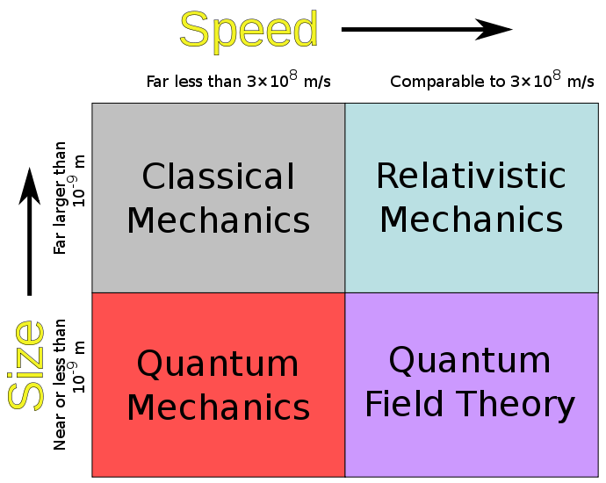
“Classical” vs “modern” physics

Slide 5
Why Quantum Physics?
“Classical Physics”:
  developed in 15th to 20th century;
  provides very successful description “macroscopic phenomena, i.e. behavior of “every day, ordinary objects”
    motion of trains, cars, bullets,….
    orbit of moon, planets
    how an engine works,..
    Electrical and magnetic phenomena
  subfields: mechanics, thermodynamics, electrodynamics,
“There is nothing new to be discovered in physics now. All that remains is more and more precise measurement.”
--- William Thomson (Lord Kelvin), 1900

Slide 6
Why Quantum Physics? – (2)
Quantum Physics:
  developed early 20th century, in response to shortcomings of classical physics in describing certain phenomena (blackbody radiation, photoelectric effect, emission and absorption spectra…)
  describes microscopic phenomena, e.g. behavior of atoms, photon-atom scattering and flow of the electrons in a semiconductor.
Quantum Mechanics
  a collection of postulates based on a huge number of experimental observations.
  Extremely successful theory

Slide 7
Quantum Physics
QP is “weird and counterintuitive”
    “Those who are not shocked when they first come across quantum theory cannot possibly have understood it” (Niels Bohr)
    “Nobody feels perfectly comfortable with it “ (Murray Gell-Mann)
    “I can safely say that nobody understands quantum mechanics” (Richard Feynman)
But:
    QM is the most successful theory ever developed by humanity
    underlies our understanding of atoms, molecules, condensed matter, nuclei, elementary particles
    Crucial ingredient in understanding of stars, …

Slide 8
Classical Point of View – Newtonian Mechanics
Motion of particles: particle trajectories.
Particle:
  indivisible mass point object with well-defined properties (observables) that can be measured,
  Observables (e.g. position and momentum) specify the state of the particle
  All properties of a particle can be known to infinite precision.
System:
  = collection of particles which interact among themselves via internal forces, and/or with the outside world via external forces.
  State of a system = collection of the states of the particles that comprise the system.
Conclusions:
  trajectory ➔ state descriptor of Newtonian physics,
  Evolution of the state➔ Use Newton's second law
  Causality: ➔ Two identical systems with the same initial conditions, subject to the same measurement will yield the same result.

Slide 9
Quantum Point of View
Quantum particles can act as both particles and waves ⇒Wave – particle duality
Quantum state:
  conglomeration of several possible outcomes of measurement of physical properties
  ⇒ Quantum mechanics uses the language of probability theory (random chance)
Observer is part of the system which is studied:
  observer cannot observe a microscopic system without altering some of its properties.
Quantization:
  Many observables are "quantized", i.e. spectrum of possible values is not continuous:
    Energy, angular momentum,

Slide 10
Heisenberg Uncertainty Principle
For a microscopic particle, one cannot precisely specify the values of a particle's position and its momentum, i.e.
“Uncertainties” of our knowledge of position and momentum cannot be arbitrarily small
Position and momentum are “incompatible variables”.
Heisenberg uncertainty principle strikes at the very heart of the classical physics, the particle trajectory.

Slide 11
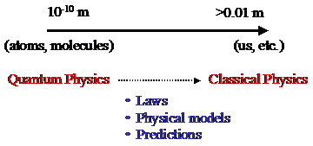
Correspondence Principle
Classical physics works well for macroscopic objects
For consistency, classical physics must be limit of QP for distances/sizes >> atomic scale
In general: new theory should reproduce the results of older well-established theories (which become limiting cases) in those domains where the old theories work.
“correspondence principle” (Niels Bohr, 1913, 1920)
  quantum mechanical description of systems must reproduce classical physics in the limit of large distances, (e.g. large quantum numbers in atoms)
  Non-classical phenomena (uncertainty, wave-particle duality,..) must become undetectable

Slide 12
Particle-Wave Duality -
behavior of a "microscopic" particle is very different from that of a classical particle:
  in some experiments it resembles the behavior of a classical wave (not localized in space)
  in other experiments it behaves as a classical particle (localized in space)
Corpuscular theories of light:
  treat light as though it were composed of particles, but can not explain diffraction and interference
  Maxwell's theory of electromagnetic radiation:
    can explain these two phenomena, which was the reason why the corpuscular theory of light was abandoned.

Slide 13
Particle-Wave Duality
Waves as particles:
  Max Planck’s explanation of black-body radiation (1899)
    assumed that the molecules of the cavity walls, described using a simple oscillator model, can only exchange energy in quantized units.
  Einstein’s photon hypothesis(1905)
    energy in an electromagnetic field is not spread out over a spherical wavefront, but instead is localized in individual clumps - quanta.
    Each quantum of frequency f (“photon”) has a discrete amount of energy E=hf and momentum p=hf/c = h/λ
    travels through space with speed of light,
    used to explain the photoelectric effect, later confirmed by the X-ray experiments of Compton.
Particles as waves
  Louis de Broglie matter waves
    Wavelength associated with particle λ=h/p
  Double-slit experiment
    use electron gun instead of using a light source
    electrons are diffracted by the slit and then interfere in the region between the slits and the detector.

Slide 14
Thermal radiation
thermal radiation = e.m. radiation emitted by a body by virtue of its temperature
spectrum is continuous, comprising all wavelengths
thermal radiation formed inside body by random thermal motions of its atoms and molecules, repeatedly absorbed and re-emitted on its way to surface ⇒ original character of radiation obliterated ⇒ spectrum of radiation depends only on temperature, not on identity of object
amount of radiation actually emitted or absorbed depends on nature of surface
good absorbers are also good emitters (Kirchhoff)
  http://hyperphysics.phy-astr.gsu.edu/hbase/thermo/absrad.html
  http://casswww.ucsd.edu/archive/public/tutorial/Planck.html
  http://panda.unm.edu/Courses/Finley/P262/ThermalRad/ThermalRad.html
  http://csep10.phys.utk.edu/astr162/lect/light/radiation.html
  http://www.youtube.com/watch?v=CDncSyDvpdQ
  http://www.enotes.com/topic/Kirchhoff's_law_of_thermal_radiation
  http://ip.anndannenberg.com/IPHandouts/Heattransfernotes.pdf

Slide 15
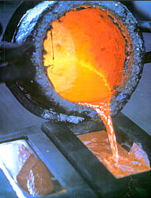
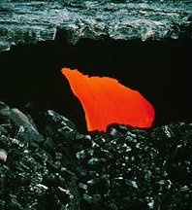
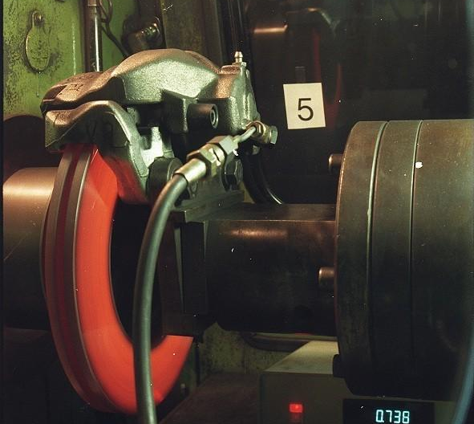
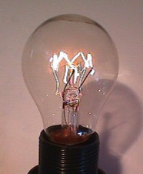
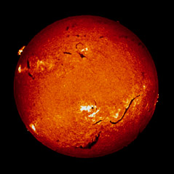
warm bodies emit radiation

Slide 16
Blackbody Radiation
Known since centuries: when a material is heated, it radiates heat and its color depends on its temperature
emission spectrum depends on the material
Example: heating elements of a stove:
  Dark red: 550ºC
  Bright red: 700ºC
  Then: orange, yellow and finally white (really hot !)
Theoretical description: simplifications necessary
-- idealization: Blackbody

Slide 17
Blackbody?
A material is constantly exchanging heat with its surrounding (to remain at a constant temperature):
  It absorbs and emits radiations
  Problem: it can reflect incoming radiations, which makes a theoretical description more difficult (depends on the environment)
Idealization: black body
blackbody is a perfect absorber:
  Incoming radiation is totally absorbed and none is reflected

Slide 18
Black-body radiation
“Black body”
  perfect absorber
    ideal body which absorbs all e.m. radiation that strikes it, any wavelength, any intensity
    such a body would appear black ⇒ “black body”
  must also be perfect emitter
    able to emit radiation of any wavelength at any intensity -- “black-body radiation”
“Hollow cavity” (“Hohlraum”) kept at constant T
    hollow cavity with small hole in wall is good approximation to black body (Kirchhoff 1859)
    thermal equilibrium inside, radiation can escape through hole, looks like black-body radiation
    Kirchhoff’s challenge to theorists: calculate spectrum of hollow cavity radiation (black body radiation)

Slide 19
Blackbody radiation – Stefan-Boltzmann
“Global description”, i.e without frequency dependence:
  Descriptions successful, i.e. in agreement with observations
Joseph Stefan (1879) first measured temperature dependence of the total amount of radiation emitted by blackbody at all wavelengths and found it varied with absolute temperature
Ludwig Boltzmann: theoretical explanation
total power output of black body: Stefan-Boltzmann law:
  For an “ideal” radiator (“black body”), total emitted power (per unit emitting area), P/A P/A = σ·T⁴ σ = 5.672 · 10⁻⁸ W m⁻² K⁻⁴ (Josef Stefan, Ludwig Boltzmann 1879, 1884)
  http://csep10.phys.utk.edu/astr162/lect/light/radiation.html http://hyperphysics.phy-astr.gsu.edu/hbase/thermo/stefan.html http://scienceworld.wolfram.com/physics/Stefan-BoltzmannLaw.html
Note that the power per unit area radiated by blackbody depends only on the temperature, and not of other characteristic of the object, such as its color or the material, of which it is composed.
An object at room temperature (300 K) will double the rate at which it radiates energy as a result of temperature increase of only 57º.

Slide 20
Black body radiation – Wien’s law
Wien’s displacement law (1893)
peak vs temperature:
λ_{max} ·T = C, C= 2.898 · 10⁻³ m⋅K
inverse relationship between the wavelength λ_{max} of the peak of the emission of a black body and its temperature when expressed as a function of wavelength
  http://en.wikipedia.org/wiki/Wien's_displacement_law hyperphysics.phy-astr.gsu.edu/hbase/quantum/wien2.html http://scienceworld.wolfram.com/physics/WiensDisplacementLaw.html http://webphysics.davidson.edu/faculty/dmb/blackbody/Wiendemo.html
Example: The wavelength at the peak of the spectral distribution for a blackbody at 4300 K is 674 nm (red). At what temperature would the peak be 420 nm (violet)?
Solution: From Wien’s law, we have
λ₁T₁ = λ₂T₂
(674 x 10⁻⁹m)(4300 K) = (420 x 10⁻⁹m)(T₂)
T₂=6900 K

Slide 21
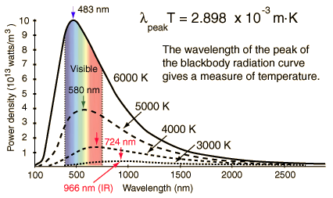

Wien’s displacement law
Intensity ρ($$,T) = power radiated per unit area per unit wavelength at a given temperature
Maximum of the distribution shifts to smaller wavelengths as the temperature increases
Wavelengths for visible light: 400 to 700 nm, UV < 400 nm, IR> 700nm

Slide 22
Wien’s displacement law
is used to
  determine the surface temperatures of stars by analyzing their radiation.
  also used to map out the variation in temperature over different regions of the surface of an object. Map = “thermograph”
Example: thermograph can be used to detect cancer because cancerous tissue results in increased circulation which produce a slight increase in skin temperature.

Slide 23
Attempts to get radiation spectrum
Wilhelm Wien (1896) ρ(f, T) = af³ exp(-bf/T), (a and b constants).
  OK for high frequency but fails for low frequencies
  http://en.wikipedia.org/wiki/Wien_approximation
  http://theochem.kuchem.kyoto-u.ac.jp/Ando/planck1901.pdf
  http://bado-shanai.net/map%20of%20physics/mopWienslaws.htm
  http://physics.info/planck/
Rayleigh-Jeans Law (1900)
ρ(f,T) = af²T (a = constant)
  (constant found to be = 8πk/c³ by James Jeans, in 1906)
  OK for low frequencies, but “ultra – violet catastrophe” at high frequencies, i.e. intensity grows ∝ f² → ∞ for f →∞ (corresponding to limit of wavelength → 0)
  http://hyperphysics.phy-astr.gsu.edu/hbase/quantum/rayj.html http://hyperphysics.phy-astr.gsu.edu/hbase/mod6.html http://scienceworld.wolfram.com/physics/Rayleigh-JeansLaw.html

Slide 24
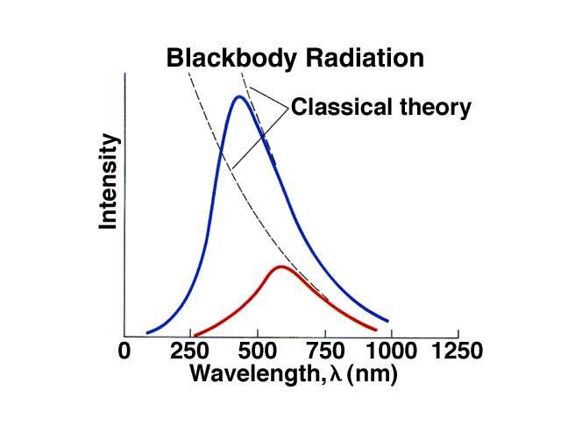
Ultraviolet catastrophe
(Rayleigh-Jeans)

Slide 25
Planck’s radiation law
Planck’s assumption:
  Radiation in the cavity emitted and absorbed by some sort of oscillators in the walls
  used Boltzmann's statistical methods to derive formula for the energy of the oscillators
two important modifications to classical theory
  the oscillators can only have certain discrete energies given by E=nhf (n = integer, f=frequency of oscillation, h=constant)
  the oscillators can absorb or emit energy only in discrete multiples of the fundamental quantum energy given by ΔE = hf

Slide 26
Planck’s radiation formula
Multiplying average oscillator energy by the number of oscillators per unit volume in the interval dλ given by n(λ)=8πcλ⁻⁴ (the number of modes of oscillation per unit volume), finally obtain the energy distribution function for the radiation in cavity:
And for blackbody radiation:

Slide 27
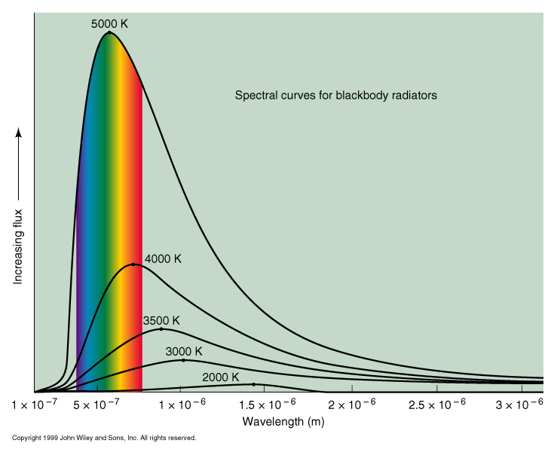

Slide 28
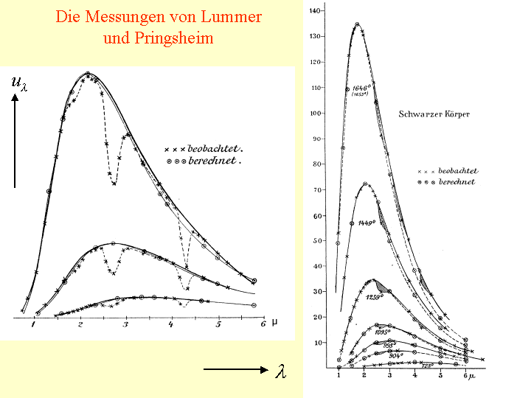
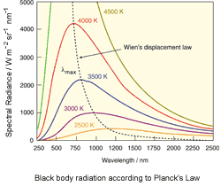
Black-body radiation spectrum
Measurements of Lummer and Pringsheim (1900)
calculation

Slide 29
Quantization
Blackbody emission spectrum explained by introducing quantized energy transfers, which resolves the ultraviolet catastrophe
  low wavelenth ⇔high-frequency (f=c/λ)
  at small wavelength, the energy needed to fill up the oscillator states increases
  due to the Boltzmann factor, the probability of the high-energy states to be occupied decreases rapidly, faster than the increase from the Rayleigh genes formula,
  no ultraviolet catastrophe
this new idea very strongly disputed,
Planck not happy with it, tried to find a way to make h→0, without success

Slide 30
Consequences of Planck’s hypothesis
oscillator energies E = nhf, n = 0,1,…;
  h = 6.626 10⁻³⁴ Js = 4.13 10⁻¹⁵ eV·s now called Planck’s constant
  ⇒ oscillator’s energy can only change by discrete amounts, absorb or emit energy in small packets – “quanta”; E_{quantum} = hf
  average energy of oscillator <E_{osc}> = hf/(e^{x} – 1) with x = hf/kT; for low frequencies get classical result <E_{osc}> = kT, k = 1.38 · 10⁻²³ J·K⁻¹

Slide 31
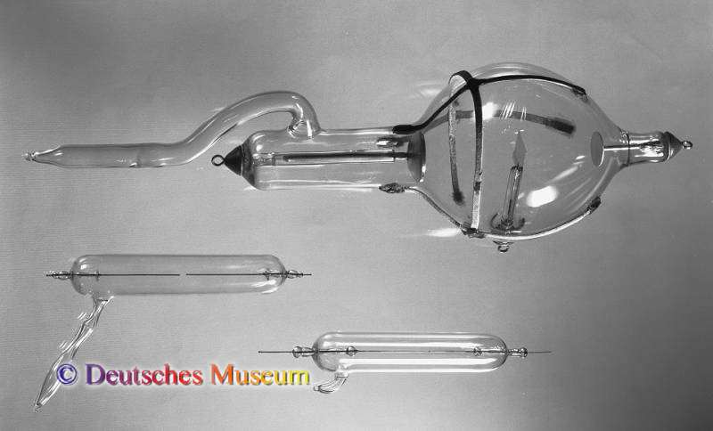
Electron
Cathode rays:
  During 2nd half of 19th century, many physicists do experiments with “discharge tubes”, i.e. evacuated glass tubes with “electrodes” at ends, electric field between them (HV)
  Johann Hittorf (1869): discharge mediated by rays emitted from negative electrode (“cathode”) -- “Kathodenstrahlen” “cathode rays”
  study of cathode rays by many physicists – find
    cathode rays appear to be particles
    cast shadow of opaque body
    deflected by magnetic field
    negative charge
  eventually realized
  cathode rays were
  particles which
  appeared much lighter
  than atoms -- named
  them electrons

Slide 32
Photoelectric effect
1887: Heinrich Hertz:
  In experiments on e.m. waves, unexpected new observation: when receiver spark gap is shielded from light of transmitter spark, the maximum spark-length became smaller
  Further investigation showed:
    Glass effectively shielded the spark
    Quartz did not
    Use of quartz prism to break up light into wavelength components ⇒ find that wavelength which makes little spark more powerful was in the UV

Slide 33
Photoelectric effect– further studies
Studies by Hallwachs, Lenard, Thomson:
  Discharge effect observed only if negative charge
  Shining light on surface causes negative particles to be emitted from surface
  Energy of particles independent of light intensity
  Energy of particles depends on color of light
  Maximum wavelength beyond which no effect
  Emitted particles same as the ones seen in “cathode ray” experiments

Slide 34
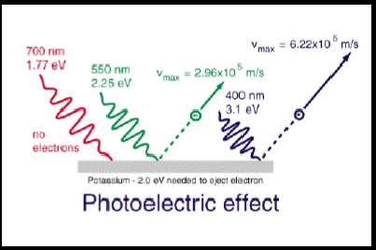
Photoelectric effect
Light can eject electrons from a metal, but only if it's frequency is above a threshold frequency (characteristic for each material)
Classically, for light as a wave, energy of light is proportional to the square of the amplitude
If light = photon with energy E=hf, energy depends on frequency

Slide 35
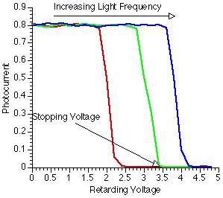
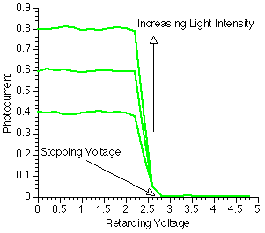

Slide 36
Photoelectric Effect
  The photoelectric effect provides evidence for the particle nature of light.
  It also provides evidence for quantization.
  If light shines on the surface of a metal, there is a point at which electrons are ejected from the metal.
  The electrons will only be ejected once the threshold frequency is reached .
  Below the threshold frequency, no electrons are ejected.
  Above the threshold frequency, the number of electrons ejected depend on the intensity of the light.

Slide 37
Explanation of photoelectric effect
1905: Albert Einstein (1879-1955) (Bern)
  Gives explanation of observation relating to photoelectric effect:
    Assume that incoming radiation consists of “light quanta” of energy hν (h = Planck’s constant, ν =frequency)
    ⇒ electrons will leave surface of metal with energy
    E = h ν – W W = “work function” = energy necessary to get electron out of the metal
    ⇒ there is a minimum light frequency for a given metal (that for which quantum of energy is equal to work function), below which no electron emission happens
    When cranking up retarding voltage until current stops, the highest energy electrons must have had energy eV_{stop} on leaving the cathode
    Therefore eV_{stop} = h ν – W

Slide 38
Verification of Einstein’s explanation
1906 – 1916: Robert Millikan (1868-1963) (Chicago)
  Did not accept Einstein’s explanation
  Tried to disprove it by precise measurements
  Result: confirmation of Einstein’s theory,
  measurement of h with 0.5% precision
1923: Arthur Compton (1892-1962)(St.Louis):
  Observes scattering of X-rays on electrons

Slide 39
Features of QP
Quantum physics is basically the recognition that there is less difference between waves and particles than was thought before
key insights:
    “wave-particle duality”
      light can behave like a particle
      particles can behave like waves (or wave packets)
    “quantization of energy”
      waves gain or lose energy only in "quantized amounts“
    particles (e.g. electrons) are indistinguishable
    detection (measurement) of a particle ⇒ wave will change suddenly into a new wave
    quantum mechanical interference – amplitudes add
    QP is intrinsically probabilistic
    what you can measure is what you can know

Slide 40
Summary
classical physics explanation of black-body radiation failed
Planck’s ad-hoc assumption of “energy quanta” of energy E_{quantum} = hν, modifying Wien’s radiation law, leads to a radiation spectrum which agrees with experiment.
old generally accepted principle of “natura non facit saltus” violated
Photoelectric effect can be explained if light is considered to be made of “light particles” -- photons
leads to development of a completely new way of looking at the microscopic world: Quantum Mechanics

