Slide 1
Quantum physics
(quantum theory, quantum mechanics)
Part 2

Slide 2
Summary of 1st lecture
classical physics explanation of black-body radiation failed (ultraviolet catastrophe)
Planck’s ad-hoc assumption of “energy quanta”
of energy E_{quantum} = hν, leads to a radiation spectrum which agrees with experiment.
old generally accepted principle of “natura non facit saltus” violated
Other evidence for “quantization”:
  Photoelectric effect (Einstein: explained by “photon” hypothesis)
  Atomic spectra
  stability of atom
Quantum theory born as attempt to address these observations

Slide 3
Outline
Recap
Steps toward QM
  Matter waves
Quantum mechanics
  Schrödinger equation
  derivation of SE from classical wave equation
  Heisenberg's matrix mechanics
  postulates of quantum mechanics
  examples of solutions to Schrödinger equation
  uncertainty (indeterminacy) principle

Slide 4
Outline (2)
quantum mechanics and atoms
  quantum mechanics of the hydrogen atom
  periodic table
Compton scattering
More on quantum mechanics
  postulates of quantum mechanics
  the problem of measurement
  probability amplitudes and quantum interference
  the double slit experiment
    classical and QM interpretations

Slide 5
Outline (3)
Interpretation of quantum mechanics
  Discussion of double slit experiment
  wave particle duality, principle of complementarity
  Copenhagen interpretation
  Other interpretations ?
Atoms in magnetic field
  Stern Gerlach experiment
  Spin

Slide 6
Steps towards QM
Planck: Vibrating atoms have only certain energies:
    E = hf or 2hf or 3hf,….
Einstein: Energy is quantized in particles called photons:
    E = hf
Bohr : Electrons in atoms can have only certain values of energy. For hydrogen:
De Broglie: matter waves

Slide 7
Momentum of a photon
Relativistic relationship between a particle’s momentum and energy: E² = p²c² + m₀²c⁴
For massless (i.e. restmass = 0) particles propagating at the speed of light: E² = p²c² , E = pc
For photon, E = hν
momentum of photon = hν/c = h/λ,
λ = h/p
“(moving) mass” of a photon: E=mc² ⇒ m = E/c² = hν/c² (photon feels gravity)

Slide 8
Matter waves
  Louis de Broglie (1925): any moving particle has wavelength associated with it: λ = h/p
  example:
    electron in atom has λ ≈ 10⁻¹⁰ m;
    car (1000 kg) at 60mph has λ ≈ 10⁻³⁸ m;
    wave effects manifest themselves only in interaction with things of size comparable to wavelength ⇒ we do not notice wave aspect of us and our cars.
  note: Bohr's quantization condition for angular momentum is identical to requirement that integer number of electron wavelengths fit into circumference of orbit.
  experimental verification of de Broglie's matter waves:
    beam of electrons scattered by crystal lattice shows diffraction pattern (crystal lattice acts like array of slits); experiment done by Davisson and Germer (1927)
    Electron microscope

Slide 9
QUANTUM MECHANICS
new kind of physics based on synthesis of dual nature of waves and particles; developed in 1920's and 1930's.
  Schrödinger’s “wave mechanics” (Erwin Schrödinger, 1925)
    Schrödinger equation is a differential equation for matter waves; basically a formulation of energy conservation.
    its solution called “wave function”, usually denoted by ψ;
    |ψ(x)|² gives the probability of finding the particle at x;
    applied to the hydrogen atom, the Schrödinger equation gives the same energy levels as those obtained from the Bohr model;
    the most probable orbits are those predicted by the Bohr model;
    but probability instead of Newtonian certainty!

Slide 10
Classical wave equation
Notes:
2

Slide 11
Schrödinger equation
Energy
De Broglie
Classical wave equ. + de Broglie
Schrödinger equation
Energy operator
(Hamiltonian)
Momentum operator

Slide 12
QM : Heisenberg
  Heisenberg’s “matrix mechanics” (Werner Heisenberg, 1925)
    Matrix mechanics consists of an array of quantities which when appropriately manipulated give the observed frequencies and intensities of spectral lines.
    Physical observables (e.g. momentum, position,..) are “operators” -- represented by matrices
    The set of eigenvalues of the matrix representing an observable is the set of all possible values that could arise as outcomes of experiments conducted on a system to measure the observable.
    Shown to be equivalent to wave mechanics by Erwin Schrödinger (1926)

Slide 13
Postulates of Quantum Mechanics
The state of a quantum mechanical system is completely specified by its wavefunction (or state function), ψ(x,t)
For every classical observable there is a linear, Hermitian operator in quantum mechanics
In any measurement associated with an operator, the only values observed are eigenvalues of the operator,
The average values of an observable is given by its expectation value,
The wavefunction obeys the Schrödinger equation
H = “Hamiltonian” = energy operator =
Notes:
2

Slide 14
Potentials and Quantization (1)
• Consider a particle free to move in 1 dimension:
Case: ‘Free’ Particle
Potential V = 0
Schrödinger Equation becomes:
0
Energy ranges from 0 to infinity….not quantized, particle can have any arbitrary velocity

Slide 15
Potentials and Quantization (2)
position of the particle is constrained by a potential
  Case: “Particle in a Box”
  V = 0 for 0 ≤ x ≤ L, V= ∞ for all other x
  The possible position of particle is limited to the dimensions of the box, 0 to L

Slide 16
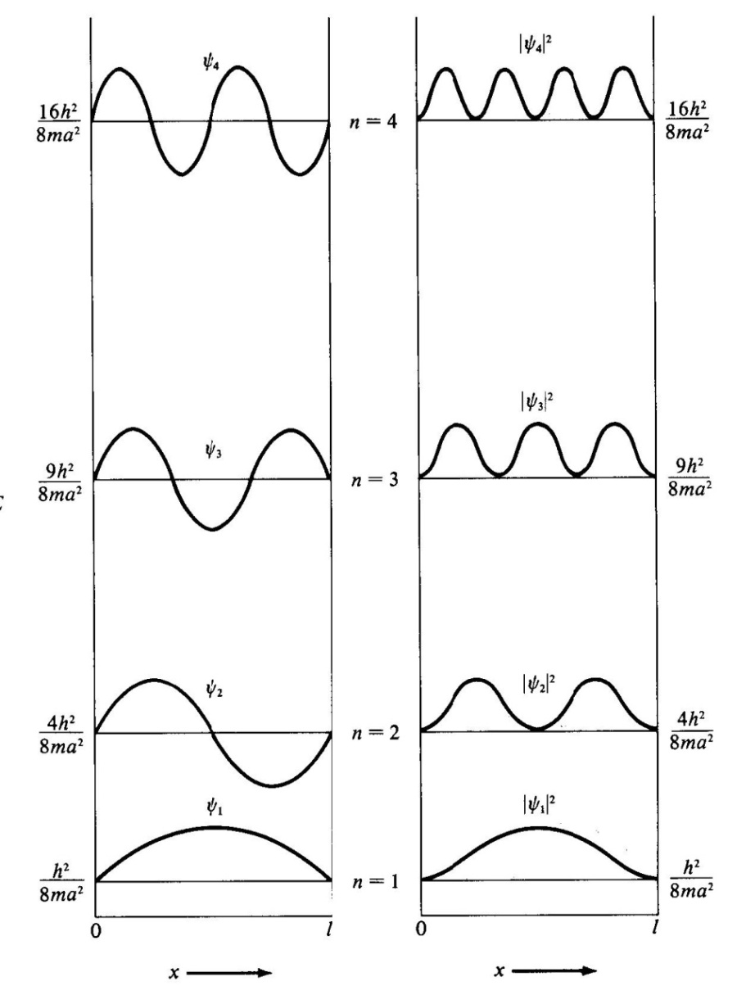
Particle in a 1-Dimensional Box
Notes:
2

Slide 17
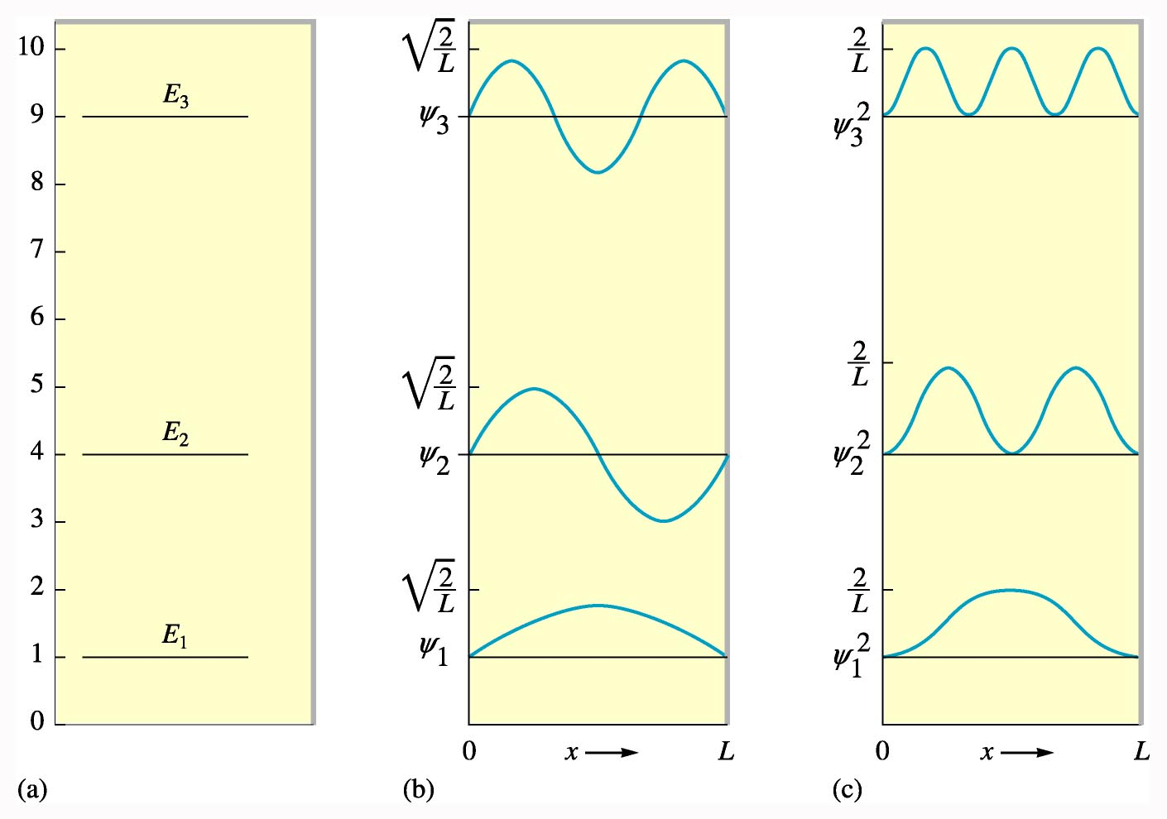
QM Solution for the particle in a box
What does the energy look like?
Like a standing wave
Energy is quantized
E
ψ
ψ∗ψ

Slide 18
Example: dye molecule
dye molecule, the length of which can be considered as the length of the “box” to which electron is limited
  L≈ 8Å=0.8 nm
  Wavelength corresponding to transition n=1 to n=2:
  Observed value is 680 nm

Slide 19
Uncertainty principle
  Uncertainty principle: (Werner Heisenberg, 1925)
    it is impossible to simultaneously know a particle's exact position and momentum Δp⋅ Δx ≥ ħ/2 h = 6.63 x 10⁻³⁴ J ⋅ s = 4.14 x 10⁻¹⁵ eV·s ħ = h/(2π) = 1.055 x 10⁻³⁴ J ⋅ s = 6.582 x 10⁻¹⁶ eV·s
    (Δp means “uncertainty” in our knowledge of the momentum p)
    also corresponding relation for energy and time: ΔE⋅ Δt ≥ ħ/2 (but meaning here is different)
  note that there are many such uncertainty relations in quantum mechanics, for any pair of “incompatible”
  (non-commuting) observables (represented by “operators”)
  in general, ΔP⋅ ΔQ ≥ ½⎮⟨[P,Q]⟩⎮
    [P,Q] = “commutator” of P and Q, = PQ – QP
    ⟨A⟩ denotes “expectation value”

Slide 20
Example of Heisenberg Uncertainty:
What is the uncertainty in velocity for an electron in a 1Å radius orbital Δx = 1 Å = 10⁻¹⁰m
  (Recall the speed of light is c = 3 x10⁸ m/s)

Slide 21
Another Example: macroscopic object
What is the uncertainty in position for a 80 kg student walking across campus at 1.3 m/s with an uncertainty in velocity of 1%.
  Δp = m Δv = (80kg)(0.013 m/s) = 1.04 kg.m/s
  Very small uncertainty……so, we know where you are!

Slide 22
from The God Particle by Leon Lederman:
Leaving his wife at home, Schrödinger booked a villa in the Swiss Alps for two weeks, taking with him his notebooks, two pearls, and an old Viennese girlfriend. Schrödinger's self-appointed mission was to save the patched-up, creaky quantum theory of the time. The Viennese physicist placed a pearl in each ear to screen out any distracting noises. Then he placed the girlfriend in bed for inspiration. Schrödinger had his work cut out for him. He had to create a new theory and keep the lady happy. Fortunately, he was up to the task.
Heisenberg is out for a drive when he's stopped by a traffic cop. The cop says, "Do you know how fast you were going?"
Heisenberg says, "No, but I know where I am."

Slide 23
Multi-electron Atoms
Similar quantum numbers – but energies are different.
No two electrons can have the same set of quantum numbers
These two assumptions can be used to motivate (partially predict) the periodic table of the elements.

Slide 24
Quantum Mechanics of the Hydrogen Atom
E_{n} = -13.6 eV/n²,
  n = 1, 2, 3, … (principal quantum number)
Orbital quantum number
  l = 0, 1, 2, n-1, …
    Angular Momentum, L = (h/2π) ·√ l(l+1)
  Magnetic quantum number - l ≤ m ≤ l, (there are 2 l + 1 possible values of m)
Spin quantum number: m_{s}= ±½

Slide 25
Periodic table
Pauli’s exclusion Principle:
  No two electrons in an atom can occupy the same quantum state.
When there are many electrons in an atom, the electrons fill the lowest energy states first:
  lowest n
  lowest l
  lowest m_{l}
  lowest m_{s}
this determines the electronic structure of atoms

Slide 26
Summary so far
electron was identified as particle emitted in photoelectric effect
Einstein’s explanation of p.e. effect lends further credence to quantum idea
Geiger, Marsden, Rutherford experiment disproves Thomson’s atom model
Planetary model of Rutherford not stable by classical electrodynamics
Bohr atom model with de Broglie waves gives some qualitative understanding of atoms, but
  only semiquantitative
  no explanation for missing transition lines
  angular momentum in ground state = 0 (1 )
  spin??
Quantum mechanics:
  Schrödinger equation describes observations
  observables (position, momentum, angular momentum..)
  are operators which act on “state vectors” – wave functions

Slide 27
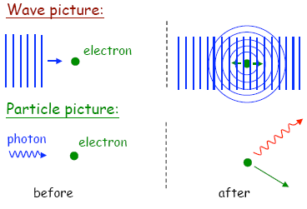
Compton scattering 1
Scattering of X-rays on free electrons;
Electrons supplied by graphite target;
Outermost electrons in C loosely bound; binding energy << X ray energy
⇒ electrons “quasi-free”
Expectation from classical electrodynamics:
  radiation incident on free electrons ⇒ electrons oscillate at frequency of incident radiation ⇒ emit light of same frequency ⇒ light scattered in all directions
  electrons don’t gain energy
  no change in frequency of light

Slide 28
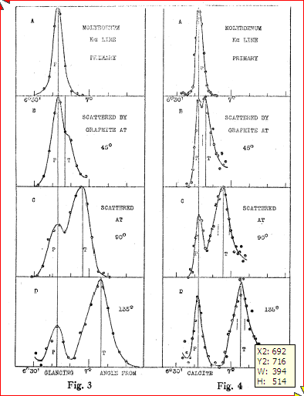
Compton scattering 2
Compton (1923) measured intensity of scattered X-rays from solid target, as function of wavelength for different angles. Nobel prize 1927.
X-ray source
Collimator (selects angle)
Crystal (selects wavelength)
θ
Target
Result: peak in scattered radiation shifts to longer wavelength than source. Amount depends on θ (but not on the target material).
A.H. Compton, Phys. Rev. 22 409 (1923)

Slide 29
Compton scattering 3
Classical picture: oscillating electromagnetic field causes oscillations in positions of charged particles, which re-radiate in all directions at same frequency as incident radiation. No change in wavelength of scattered light is expected
Compton’s explanation: collisions between particles of light (X-ray photons) and electrons in the material
Incident light wave
Oscillating electron
Emitted light wave
Before
After
scattered photon
Incoming photon
θ
Electron
scattered electron

Slide 30
Compton scattering 4
Before
After
scattered photon
Incoming photon
θ
Electron
scattered electron
Conservation of energy
Conservation of momentum
From this derive change in wavelength:

Slide 31
Compton scattering 5
unshifted peaks come from collision between the X-ray photon and the nucleus of the atom
λ’ - λ = (h/m_{N}c)(1 - cosθ) ≈ 0
since m_{N} >> me

Slide 32
Postulates of Quantum Mechanics
The state of a quantum mechanical system is completely specified by its wavefunction, ψ(x,t)
For every classical observable there is a linear, Hermitian operator in quantum mechanics
In any measurement associated with an operator, the only values observed are eigenvalues of the operator,
The average value of an observable is given by its expectation value,
The wavefunction obeys the Schrödinger equation
H = “Hamiltonian” = energy operator =
Notes:
2

Slide 33
measurement (1)
Measurement involves interaction with the system which is subject to the measurement process
Measurements always have “errors”, uncertainties, due to:
  Imperfections of measuring equipment/process ⇒ uncertain data
  System subject to random outside influences
Measurement result with quoted uncertainty is really a probabilistic statement:
  really means
  (assuming “gaussian errors”)

Slide 34
Measurement (2)
Any measurement disturbs the system ⇒ will be in a different state from the one it was in before the measurement
Examples:
  Temperature measurement: thermometer gets into thermal equilibrium with measured system ⇒in- (or out-)flux of thermal energy⇒ temperature changed
  Measure position of object – have to shine light onto it to see it, light photons transfer momentum to measured object
Influence of measurement process, as well as random outside influences (non-isolation) can more easily be minimized for big (high mass) system
⇒ expect physics of small systems to be more probabilistic

Slide 35
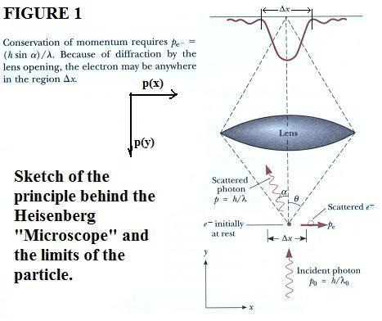
Measurement (3) “Heisenberg microscope”:
  Try to measure position of a tiny particle – image particle with a microscope
  Uncertainty of particle position ∝ angular resolution of microscope =1.22λ/D, where λ= wavelength of used light, D=diameter of objective lens
  To optimize position resolution, need small wavelength and large D
  p=h/λ, energetic photons need to be scattered off particle under large angles ⇒ momentum of particle changed
  Requirement fro precise measurement of position⇒significant jolts to particle ⇒uncertainty of momentum

Slide 36
Measurement (4)
Scientific statement about a measurement is a prediction:
  “momentum of this electron is 3±0.02 GeV/c” means: if you measure p, you will obtain (with 95% confidence) a value between 3-0.04 and 3+0.04 GeV/c
ideal measurement:
  is reproducible
  Subsequent measurement of the same quantity will yield the same result
  brings the system into a special state that has the property of being unaffected by a further measurement of the same type

Slide 37
Measurement (5): Quantum states
Existence of quantum states is one of the postulates of QM
  Any system has quantum states in which the outcome of a measurement is certain.
  These states are unrealizable abstractions, but important
  Examples:
    |E₁> = the state in which a measurement of the system’s energy will certainly return the value E₁
    |p> = the state in which a measurement of the system’s momentum will certainly return the value p
    |x> = state for which measurement of position will give value x

Slide 38
Measurement (6): Process of measurement
“Generic” state |ψ>:
  Results of measurement of momentum, position, ..uncertain
  At best can give probability P(E) that energy will be E, P(p) that momentum will be p,..
  reproducibilty: after having measured energy with value E, repetition of energy measurement should give again same value E
  ⇒ act of measuring energy jogged system from state |ψ> into a different special state |E>
  |ψ> energ. meas. → |E> with prob. P(E)
  |ψ> mom. meas. → |p> with prob. P(p)
  |p> mom. meas. → |p> with certainty
  Special states are idealizations

Slide 39
Measurement (7)
in general, different dynamical quantities (e.g. energy, position, momentum, etc.) are associated with different special states. If you are certain about the outcome of a measurement of e.g. position, you cannot be certain about the outcome of a measurement of momentum, or energy
dynamical quantities such as position or energy should be considered as questions we can ask (by making a measurement) rather than intrinsic properties of the system.

Slide 40
Measurement (8)
Outcomes of measurements are in general uncertain; the most we can do is compute the probability with which the various possible outcomes will arise
QM more complicated than classical mechanics:
  Classical mechanics: predict values of x, p,..
  QM: need to compute probability distributions P (x),… P(p)

Slide 41
Measurement (9)
In classical mechanics, we simply compute expectation values of the quantum mechanical probability distributions
If probability distribution is very sharply peaked and narrow around its expectation value
⇒ enough to know the value of <x>, since probability of measuring value significantly different from <x> is negligibly small
Classical mechanics = physics of expectation values, provides complete predictions when underlying quantum probability distributions are very narrow

Slide 42
Probability amplitudes
Probability used in many branches of science
In QM, probabilities are calculated as modulus squared of a complex amplitude:
Consider process that can happen in two different ways, by two mutually exclusive routes, S or T
The probability amplitude for it to happen by one or the other route : instead of
This leads to “quantum mechanical interference”, gives rise to phenomena that have no analogue in classical physics

Slide 43
Quantum interference
Two routes, S, T for process
Probability that event happens regardless of route:
i.e. probability of event happening is not just sum of probabilities for each possible route, but there is an additional term – “interference term”
Term has no counterpart in standard probability theory; depends on phases of probability amplitudes

Slide 44
WAVE-PARTICLE DUALITY OF LIGHT
Einstein (1924) : “There are therefore now two theories of light, both indispensable, and … without any logical connection.”
evidence for wave-nature of light:
  diffraction
  interference
evidence for particle-nature of light:
  photoelectric effect
  Compton effect
Light exhibits diffraction and interference phenomena that are only explicable in terms of wave properties
Light is always detected as packets (photons); we never observe half a photon
Number of photons proportional to energy density (i.e. to square of electromagnetic field strength)

Slide 45
double slit experiment
Originally performed by Young (1801) to demonstrate the wave-nature of light. Has now been done with electrons, neutrons, He atoms,…
Classical physics expectation: two peaks for particles, interference pattern for waves
y
d
θ
D

Slide 46
Fringe spacing in double slit experiment
Maxima when:
D >> d ⇒ use small angle approximation
y
d
θ
Position on screen:
⇒ separation between adjacent maxima:
D

Slide 47
Double slit experiment -- interpretation
classical:
  two slits are coherent sources of light
  interference due to superposition of secondary waves on screen
  intensity minima and maxima governed by optical path differences
  light intensity I ∝ A², A = total amplitude
  amplitude A at a point on the screen A² = A₁² + A₂² + 2A₁ A₂ cosφ, φ = phase difference between A₁ and A₂ at the point
  maxima for φ = 2nπ
  minima for φ = (2n+1)π
  φ depends on optical path difference δ: φ = 2πδ/λ
  interference only for coherent light sources;
  For two independent light sources: no interference since not coherent (random phase differences)

Slide 48
Double slit experiment: low intensity
  Taylor’s experiment (1908): double slit experiment with very dim light: interference pattern emerged after waiting for few weeks
  interference cannot be due to interaction between photons, i.e. cannot be outcome of destructive or constructive combination of photons
  ⇒ interference pattern is due to some inherent property of each photon – it “interferes with itself” while passing from source to screen
  photons don’t “split” – light detectors always show signals of same intensity
  slits open alternatingly: get two overlapping single-slit diffraction patterns – no two-slit interference
  add detector to determine through which slit photon goes: ⇒ no interference
  interference pattern only appears when experiment provides no means of determining through which slit photon passes
  http://www.thestargarden.co.uk/QuantumMechanics.html
  http://abyss.uoregon.edu/~js/21st_century_science/lectures/lec13.html
  http://hyperphysics.phy-astr.gsu.edu/hbase/phyopt/slits.html
  http://en.wikipedia.org/wiki/Double-slit_experiment
  http://grad.physics.sunysb.edu/~amarch/

Slide 49
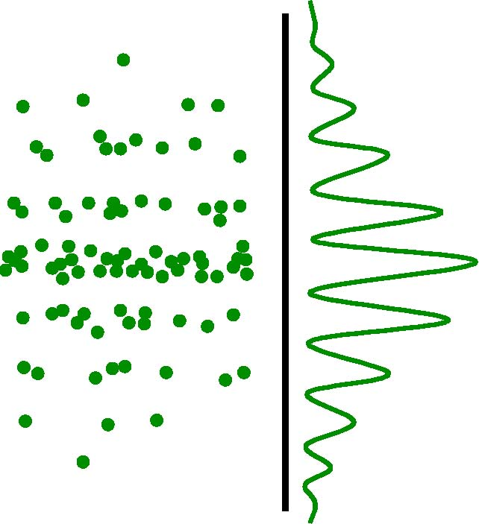
double slit experiment with very low intensity , i.e. one photon or atom at a time:
get still interference pattern if we wait long enough

Slide 50
Double slit experiment – QM interpretation
  patterns on screen are result of distribution of photons
  no way of anticipating where particular photon will strike
  impossible to tell which path photon took – cannot assign specific trajectory to photon
  cannot suppose that half went through one slit and half through other
  can only predict how photons will be distributed on screen (or over detector(s))
  interference and diffraction are statistical phenomena associated with probability that, in a given experimental setup, a photon will strike a certain point
  high probability ⇒ bright fringes
  low probability ⇒ dark fringes

Slide 51
Double slit expt. -- wave vs quantum
wave theory
quantum theory
pattern of fringes:
  Intensity bands due to variations in square of amplitude, A², of resultant wave on each point on screen
role of the slits:
  to provide two coherent sources of the secondary waves that interfere on the screen
pattern of fringes:
  Intensity bands due to variations in probability, P, of a photon striking points on screen
role of the slits:
  to present two potential routes by which photon can pass from source to screen

Slide 52
double slit expt., wave function
  light intensity at a point on screen I depends on number of photons striking the point number of photons ∝ probability P of finding photon there, i.e I ∝ P = |ψ|², ψ = wave function
  probability to find photon at a point on the screen : P = |ψ|² = |ψ₁ + ψ₂|² = |ψ₁|² + |ψ₂|² + 2 |ψ₁| |ψ₂| cosφ;
  2 |ψ₁| |ψ₂| cosφ is “interference term”; factor cosφ due to fact that ψs are complex functions
  wave function changes when experimental setup is changed
    by opening only one slit at a time
    by adding detector to determine which path photon took
    by introducing anything which makes paths distinguishable

Slide 53
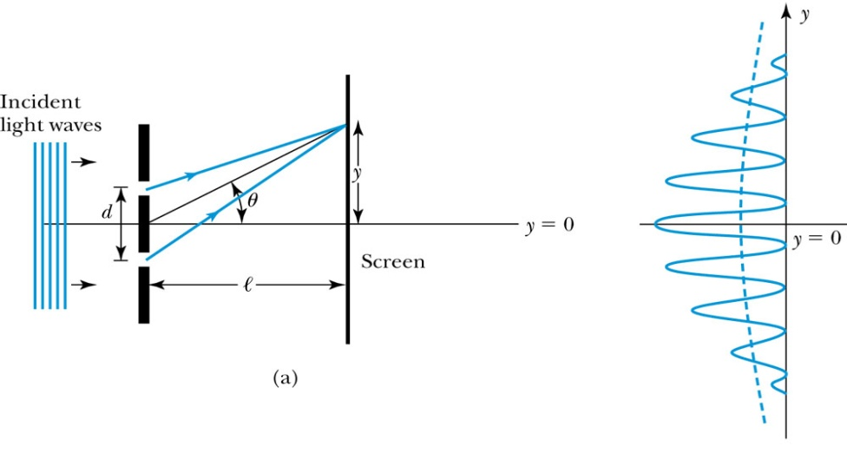
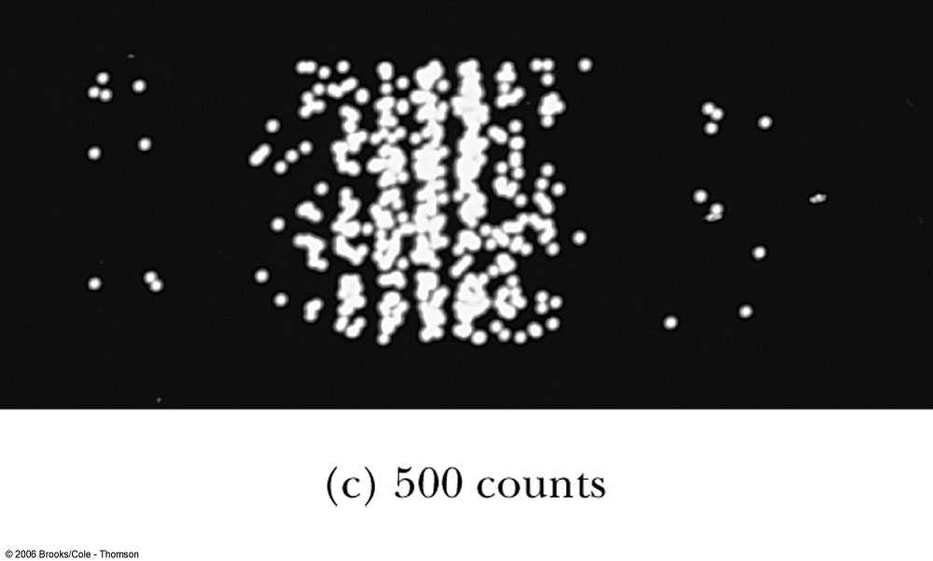
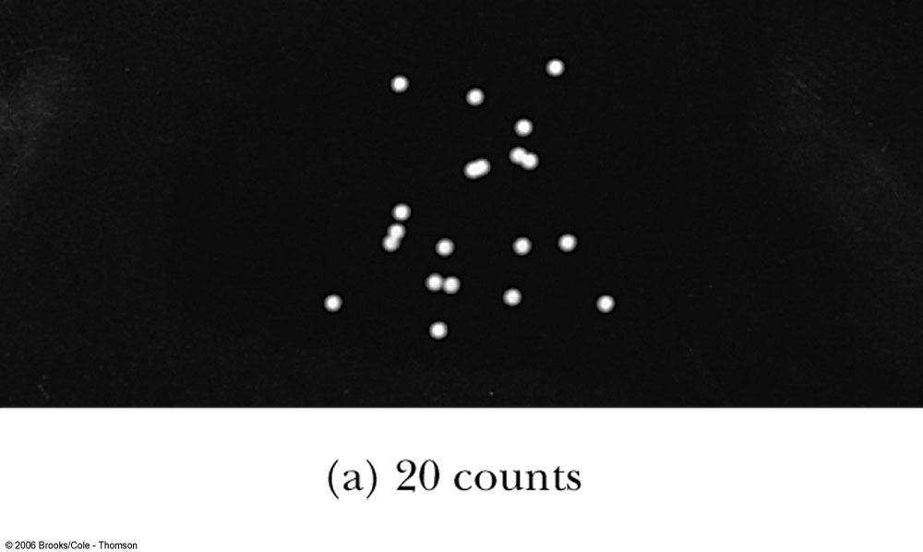
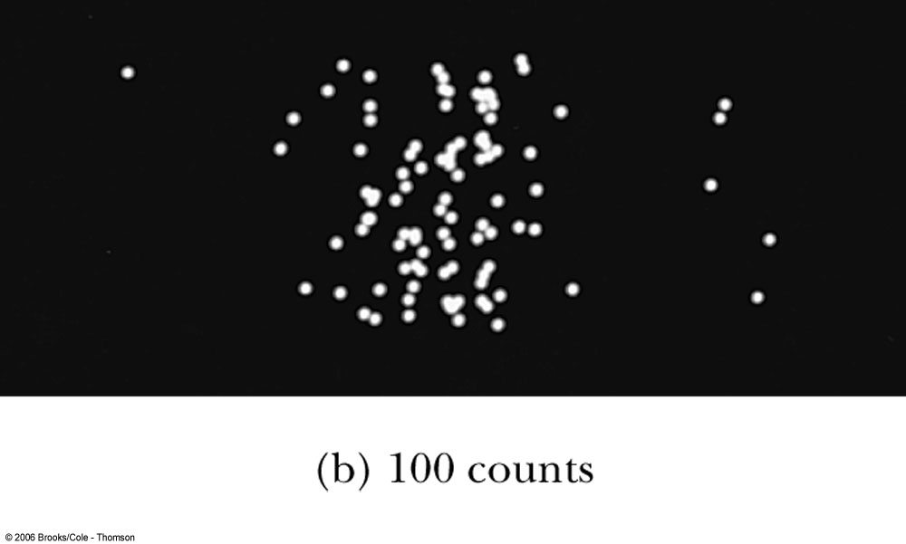
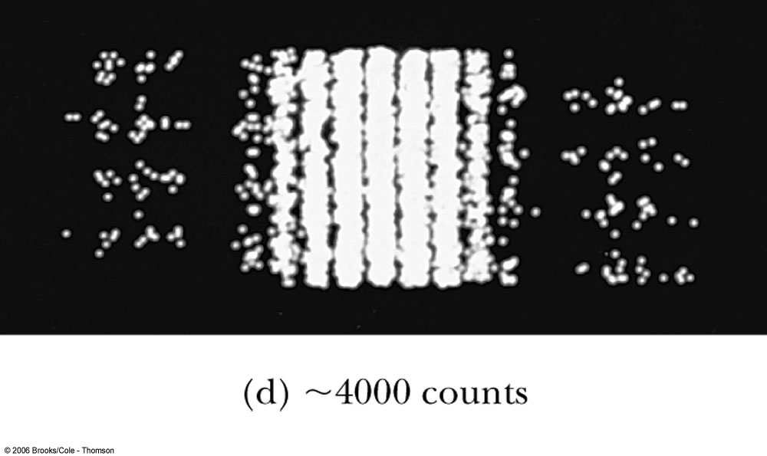
Waves or Particles?
Young’s double-slit diffraction experiment demonstrates the wave property of light.
However, dimming the light results in single flashes on the screen representative of particles.

Slide 54
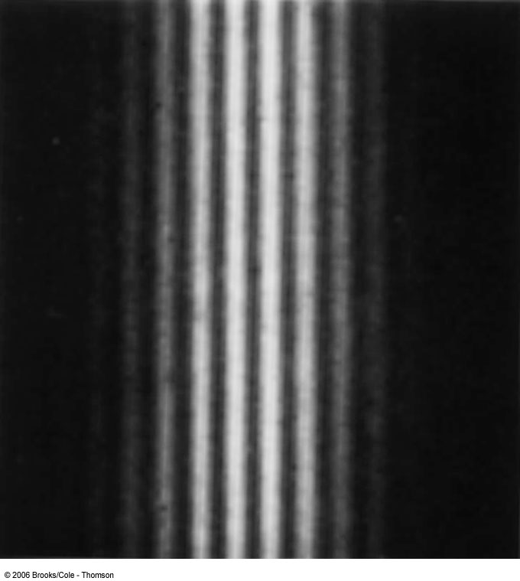
Electron Double-Slit Experiment
C. Jönsson (Tübingen, Germany, 1961
  very narrow slits
  relatively large distances between the slits and the observation screen.
  ⇒ double-slit interference effects for electrons
experiment demonstrates that precisely the same behavior occurs for both light (waves) and electrons (particles).

Slide 55
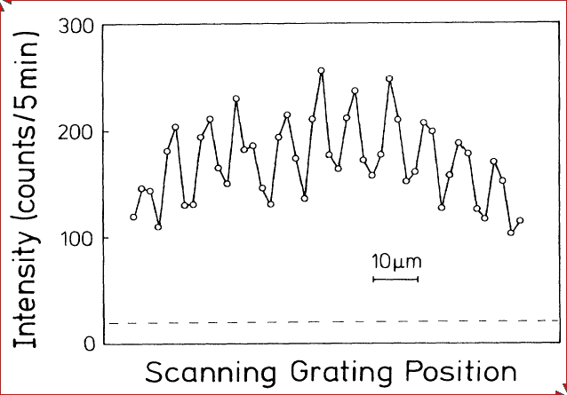
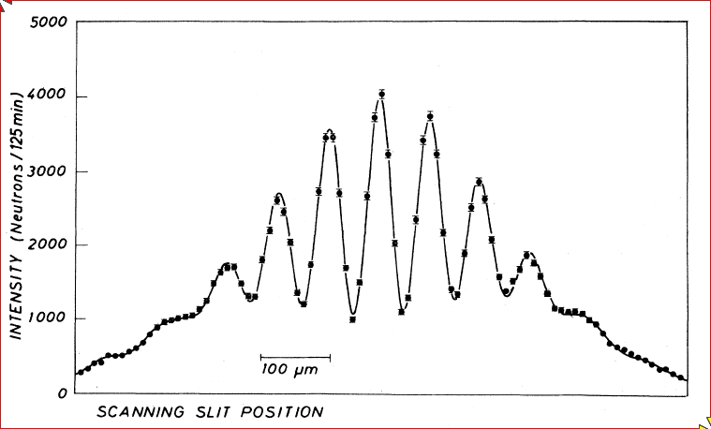
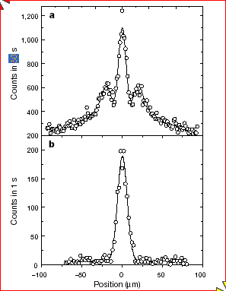
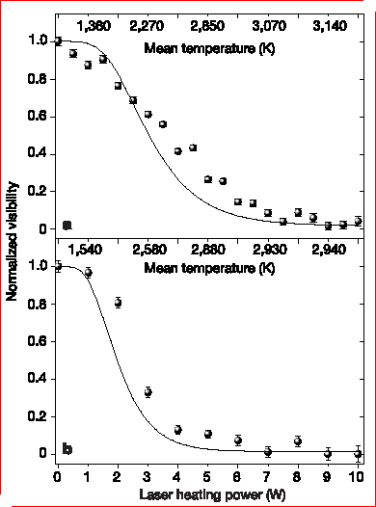
Results on matter wave interference
Neutrons, A Zeilinger et al. Reviews of Modern Physics 60 1067-1073 (1988)
He atoms: O Carnal and J Mlynek Physical Review Letters 66 2689-2692 (1991)
C₆₀ molecules: M Arndt et al. Nature 401, 680-682 (1999)
Fringe visibility decreases as molecules are heated. L. Hackermüller et al. , Nature 427 711-714 (2004)
With multiple-slit grating
Without grating
Interference patterns can not be explained classically - clear demonstration of matter waves

Slide 56
Double slit experiment -- interpretation
classical:
  two slits are coherent sources of light
  interference due to superposition of secondary waves on screen
  intensity minima and maxima governed by optical path differences
  light intensity I ∝ A², A = total amplitude
  amplitude A at a point on the screen A² = A₁² + A₂² + 2A₁ A₂ cosφ, φ = phase difference between A₁ and A₂ at the point
  maxima for φ = 2nπ
  minima for φ = (2n+1)π
  φ depends on optical path difference δ: φ = 2πδ/λ
  interference only for coherent light sources;
  For two independent light sources: no interference since not coherent (random phase differences)

Slide 57
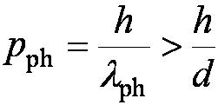
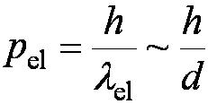
Which slit?
Try to determine which slit the electron went through.
Shine light on the double slit and observe with a microscope. After the electron passes through one of the slits, light bounces off it; observing the reflected light, we determine which slit the electron went through.
photon momentum
electron momentum :
momentum of the photons used to determine which slit the electron went through > momentum of the electron itself⇒ changes the direction of the electron!
The attempt to identify which slit the electron passes through changes the diffraction pattern!
Need λ_{ph} < d to distinguish the slits.
Diffraction is significant only when the aperture is ~ the wavelength of the wave.

Slide 58
Discussion/interpretation of double slit experiment
Reduce flux of particles arriving at the slits so that only one particle arrives at a time. -- still interference fringes observed!
  Wave-behavior can be shown by a single atom or photon.
  Each particle goes through both slits at once.
  A matter wave can interfere with itself.
Wavelength of matter wave unconnected to any internal size of particle -- determined by the momentum
If we try to find out which slit the particle goes through the interference pattern vanishes!
  We cannot see the wave and particle nature at the same time.
  If we know which path the particle takes, we lose the fringes .
Richard Feynman about two-slit experiment: “…a phenomenon which is impossible, absolutely impossible, to explain in any classical way, and which has in it the heart of quantum mechanics. In reality it contains the only mystery.”

Slide 59
Wave – particle - duality
So, everything is both a particle and a wave -- disturbing!??
“Solution”: Bohr’s Principle of Complementarity:
  It is not possible to describe physical observables simultaneously in terms of both particles and waves
  Physical observables:
    quantities that can be experimentally measured. (e.g. position, velocity, momentum, and energy..)
    in any given instance we must use either the particle description or the wave description
  When we’re trying to measure particle properties, things behave like particles; when we’re not, they behave like waves.

Slide 60


Probability, Wave Functions, and the Copenhagen Interpretation
Particles are also waves -- described by wave function
The wave function determines the probability of finding a particle at a particular position in space at a given time.
The total probability of finding the particle is 1. Forcing this condition on the wave function is called normalization.

Slide 61
The Copenhagen Interpretation
Bohr’s interpretation of the wave function consisted of three principles:
  Born’s statistical interpretation, based on probabilities determined by the wave function
  Heisenberg’s uncertainty principle
  Bohr’s complementarity principle
Together these three concepts form a logical interpretation of the physical meaning of quantum theory. In the Copenhagen interpretation, physics describes only the results of measurements.
correspondence principle:
  results predicted by quantum physics must be identical to those predicted by classical physics in those situations where classical physics corresponds to the experimental facts

Slide 62
Atoms in magnetic field
orbiting electron behaves like current loop
  ⇒ magnetic moment μ = current x area
  interaction energy = μ·B (both vectors!) = μ·B||
  loop current = -ev/(2πr)
  angular momentum L = mvr
  magnetic moment = - μ_{B} L/ħ
  μ_{B} = e ħ/2m_{e} = “Bohr magneton”
  interaction energy = m μ_{B} B_{z} (m = z –comp of L)
A
I
e⁻

Slide 63
Splitting of atomic energy levels
m = +1
m = 0
m = -1
(2l+1) states with same energy: m=-l,…+l
B ≠ 0: (2l+1) states with distinct energies
(Hence the name “magnetic quantum number” for m.)
Predictions: should always get an odd number of levels. An s state (such as the ground state of hydrogen, n=1, l=0, m=0) should not be split.
Splitting was observed by Zeeman

Slide 64
Stern - Gerlach experiment - 1
magnetic dipole moment associated with angular momentum
magnetic dipole moment of atoms and quantization of angular momentum direction anticipated from Bohr-Sommerfeld atom model
magnetic dipole in uniform field magnetic field feels torque, but no net force
in non-uniform field there will be net force ⇒ deflection
extent of deflection depends on
  non-uniformity of field
  particle’s magnetic dipole moment
  orientation of dipole moment relative to mag. field
Predictions:
  Beam should split into an odd number of parts (2l+1)
  A beam of atoms in an s state (e.g. the ground state of hydrogen, n = 1, l = 0, m = 0) should not be split.
N
S

Slide 65
Stern-Gerlach experiment (1921)
z
Magnet
Oven
N
x
0
S
Ag beam
Ag-vapor
Ag
collim.
screen
N
B = 0
Ag beam
# Ag atoms
B=b
B=2b
S
non-uniform
0
z

Slide 66
Stern-Gerlach experiment - 3
beam of Ag atoms (with electron in s-state (l =0)) in non-uniform magnetic field
force on atoms: F = μ_{z}· ∂B_{z}/∂z
results show two groups of atoms, deflected in opposite directions, with magnetic moments μ_{z} = ± μ_{B}
Conundrum:
  classical physics would predict a continuous distribution of μ
  quantum mechanics à la Bohr-Sommerfeld predicts an odd number (2ℓ +1) of groups, i.e. just one for an s state

Slide 67
The concept of spin
Stern-Gerlach results cannot be explained by interaction of magnetic moment from orbital angular momentum
must be due to some additional internal source of angular momentum that does not require motion of the electron.
internal angular momentum of electron (“spin”) was suggested in 1925 by Goudsmit and Uhlenbeck building on an idea of Pauli.
Spin is a relativistic effect and comes out directly from Dirac’s theory of the electron (1928)
spin has mathematical analogies with angular momentum, but is not to be understood as actual rotation of electron
electrons have “half-integer” spin, i.e. ħ/2
Fermions vs Bosons

Slide 68
Summary
wave-particle duality:
  objects behave like waves or particles, depending on experimental conditions
  complementarity: wave and particle aspects never manifest simultaneously
  Are really neither wave nor particle in the everyday sense of the word (problem of semantics)
Spin:
  results of Stern - Gerlach experiment explained by introduction of “spin”
  later shown to be natural outcome of relativistic invariance (Dirac)
Copenhagen interpretation:
  probability statements do not reflect our imperfect knowledge, but are inherent to nature – measurement outcomes fundamentally indeterministic
  Physics is science of outcome of measurement processes -- do not speculate beyond what can be measured
  act of measurement causes one of the many possible outcomes to be realized (“collapse of the wave function”)
  measurement process still under active investigation – lots of progress in understanding in recent years

