Slide 1
The Muon, g-2

Slide 2
Atoms in magnetic field
orbiting electron behaves like current loop
  ⇒ magnetic moment μ = current x area
  interaction energy = μ·B (both vectors!) = μ·B||
  loop current = -ev/(2πr)
  angular momentum L = mvr
  magnetic moment = - μ_{B} L/ħ
  μ_{B} = e ħ/2m_{e} = “Bohr magneton”
  interaction energy = m μ_{B} B_{z} (m = z (m = z comp of L)
A
I
e⁻

Slide 3
Gyromagnetic ratio
orbiting charged particle behaves like current loop
  ⇒ magnetic moment μ = current x area
  loop current = qv/(2πr)
  angular momentum L = mvr
  magnetic moment
Same formula is obtained for rotating body
  (can be thought of as consisting of many small particles orbiting around axis)
Def: gyromagnetic ratio
  G= ratio between magnetic dipole moment and angular momentum
  For classical particle
A
I
q

Slide 4
Gyromagnetic ratio for spin
For microscopic particles, there may be additional factor g
  For classical body and orbital ang. mom., “g-factor” = 1
  For isolated electron g=2 according to Dirac equation , S= spin
  QED predicts that g≠2
  a=(g-2)/2 (“anomaly”) for the electron has been calculated and measured to very high precision (12 decimal places)

Slide 5
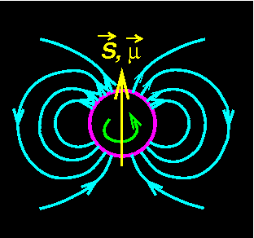
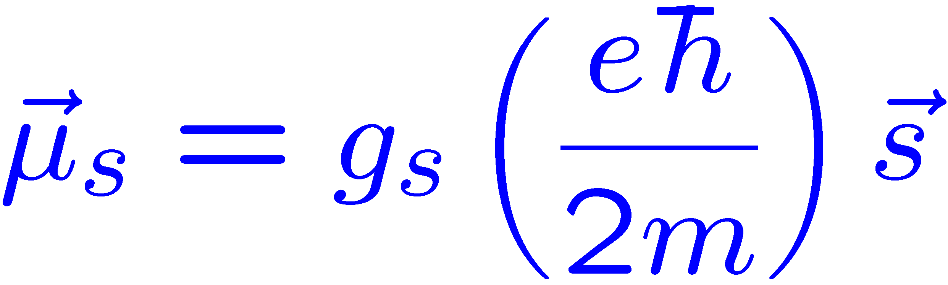
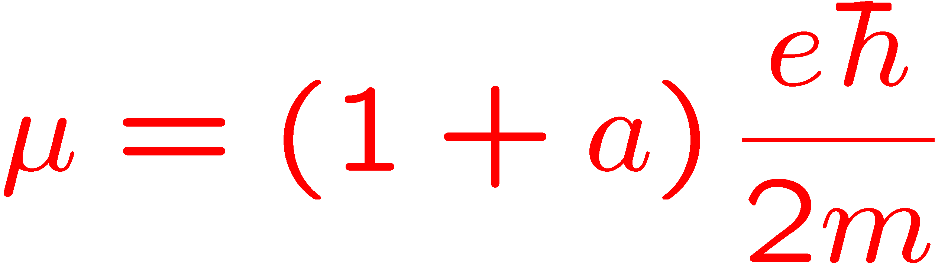
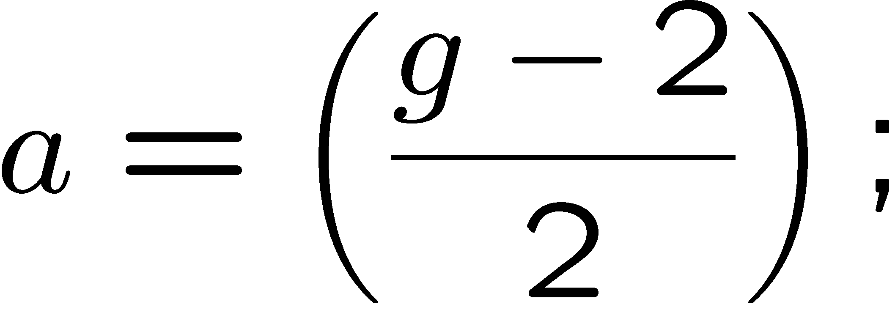
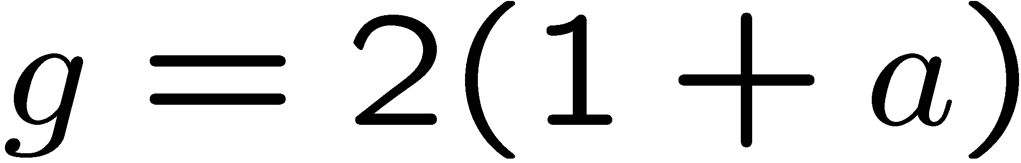
Summary of μ_{S}
the moment consists of 2 parts
Dirac + Pauli moment
the anomaly
or
SM predicts a

Slide 6

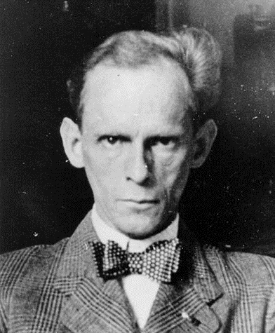
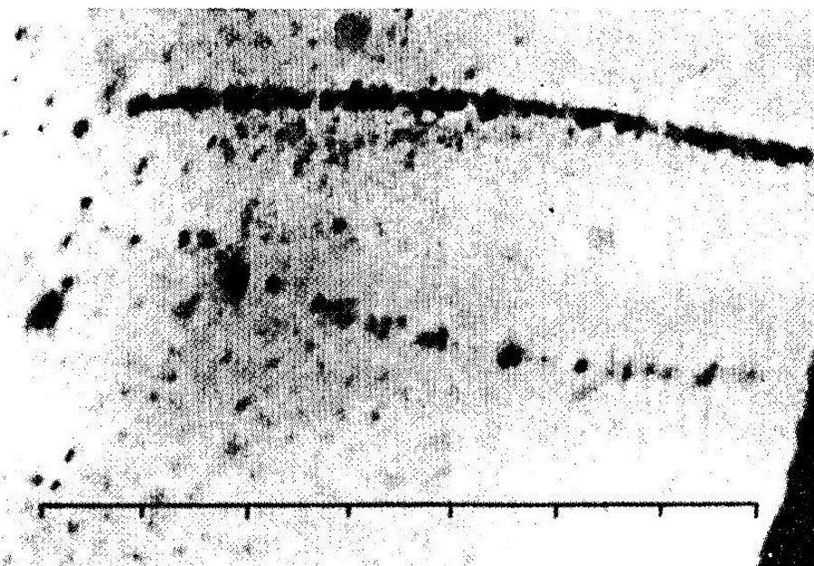
The Muon
First observed in cosmic rays in 1933
“a particle of uncertain nature”
Paul Kunze, Z. Phys. 83, 1 (1933)

Slide 7
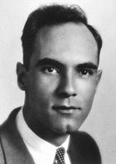
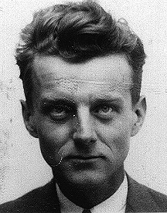
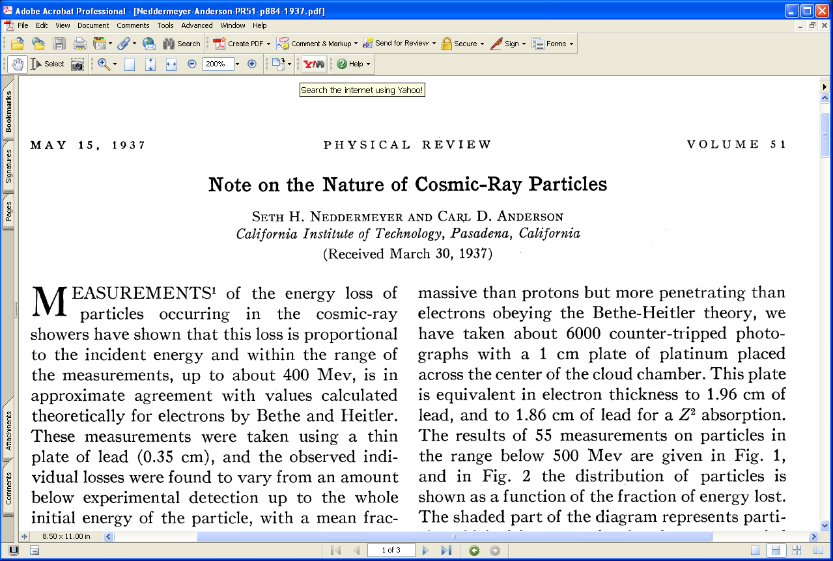
Identified in 1936
Study of cosmic rays by Seth Neddermeyer and Carl Anderson

Slide 8
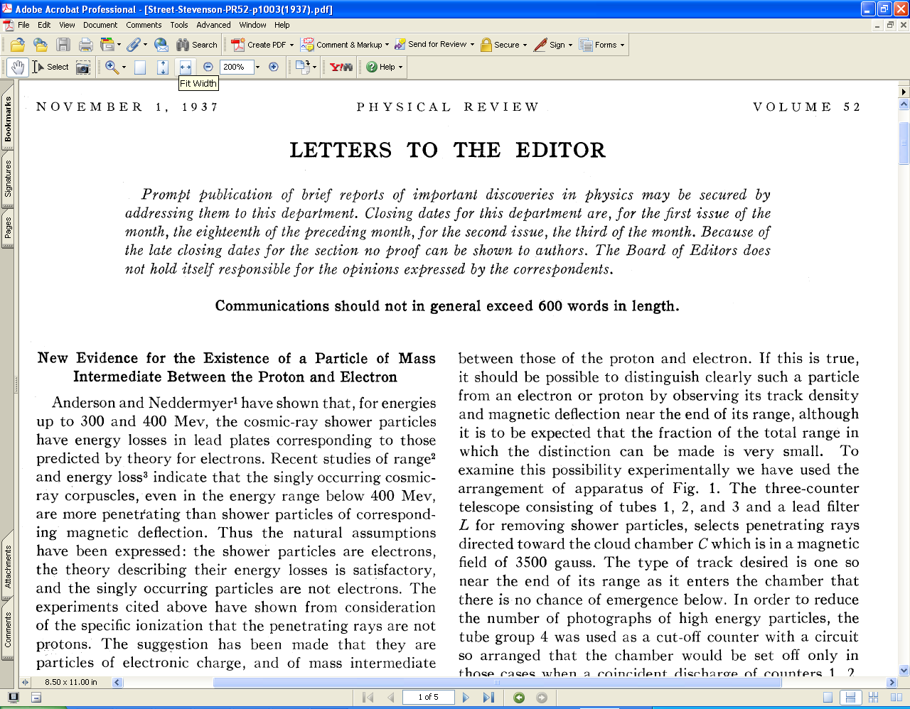
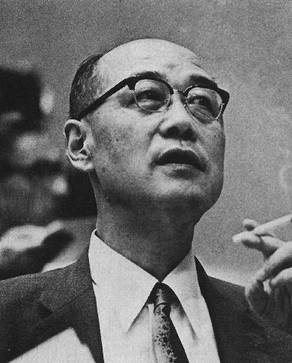
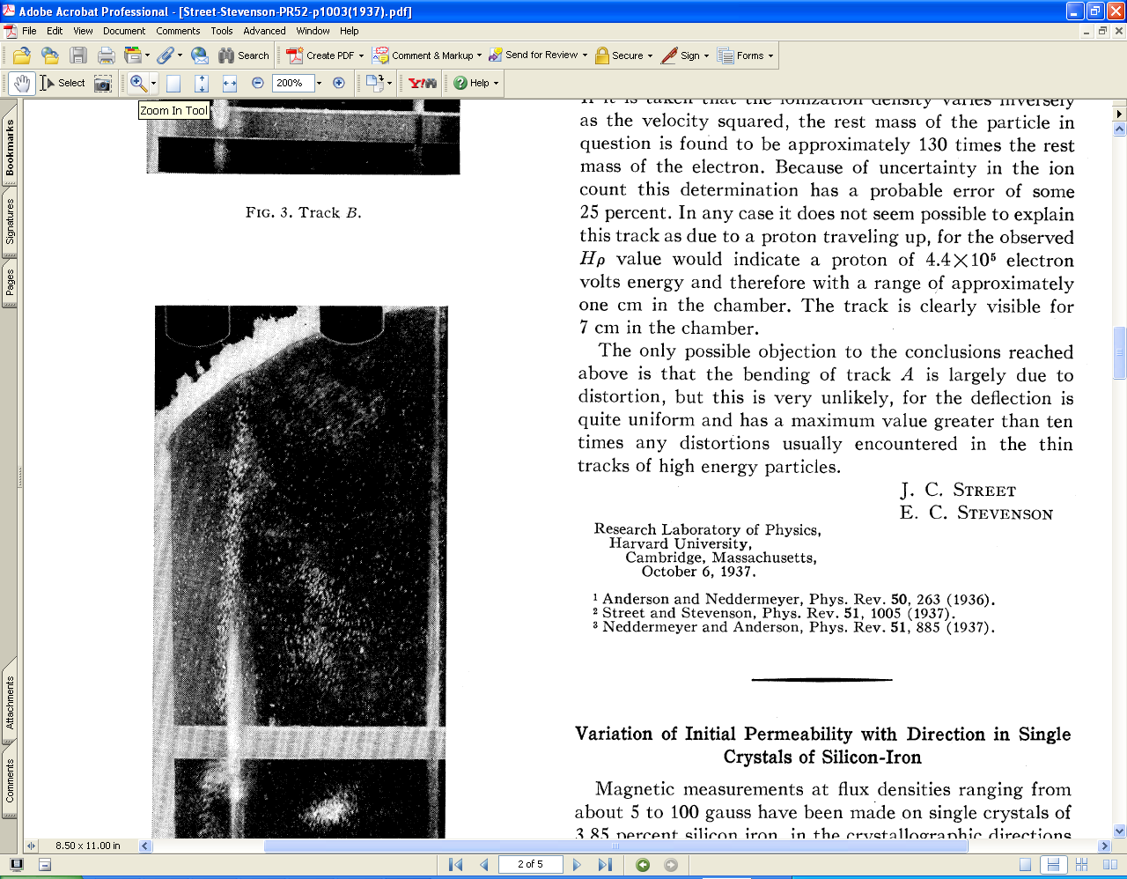
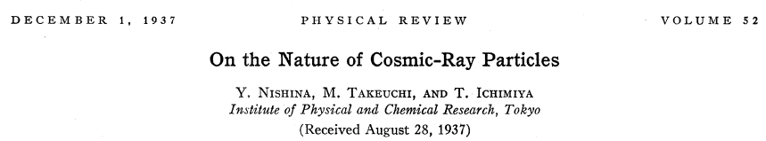
Confirmed by: Street & Stevenson, Nishina, Tekeuchi & Ichimiya
It took 10 years to conclude that the muon interacted too weakly with matter to be the “Yukawa” particle which was postulated to carry the nuclear force

Slide 9
The Standard Model (Our Periodic Table)
e | μ | τ
ν_{e} | ν_{μ} | ν_{τ}
Leptons
Interact weakly through the
γ | Z⁰ | W±
Electroweak gauge bosons
u | c | t
d | s | b
Quarks
Interact strongly through the gluons
g

Slide 10
Spin, helicity
As all matter particles, leptons are spin ½ particles
“helicity”
  =projection of spin on momentum direction (component of spin in mom dir.)
Left and right-handedness:
  “left-handed” fermion: spin is in the opposite direction to their momentum
  “right-handed” fermion: spin is in the same direction as their momentum
According to SM: only left-handed fermions and right-handed antifermions participate in weak interactions
  “right-handed e⁺, μ⁺, τ⁺ and “left-handed e⁻, μ⁻, τ⁻ feel weak int.
  (corresponding statements for neutrinos and quarks)

Slide 11
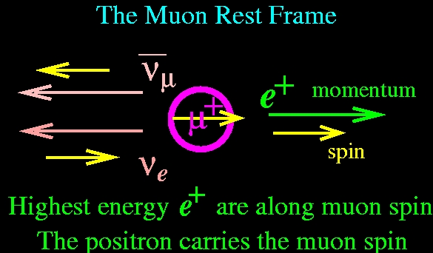
Death of the Muon
Decay is self analyzing
The highest energy e± from μ± decay carry information on the spin direction.

Slide 12
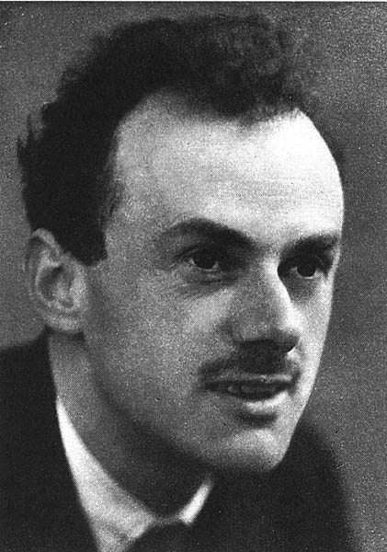
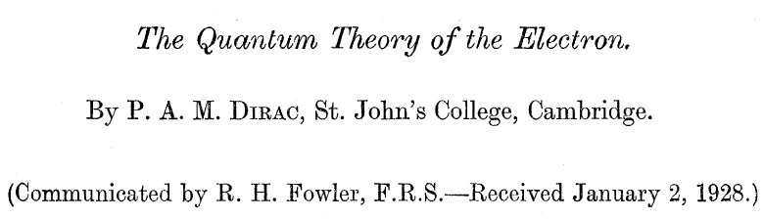
Theory of Magnetic and Electric Dipole Moments
Dirac equation
  Relativistic generalization of Schrödinger equation
  Predicts spin of electron
  Predicts antiparticles (positron)
  Predicts g_{e} = 2
Proc. R. Soc. (London) A117, 610 (1928)

Slide 13
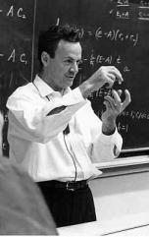
Quantum electrodynamics: radiative corrections change g from its Dirac value of 2. corrections symbolically expressed as “Feynman diagrams”
Dirac Stern-Gerlach
Schwinger Kusch-Foley
perturbation expansion:

Slide 14
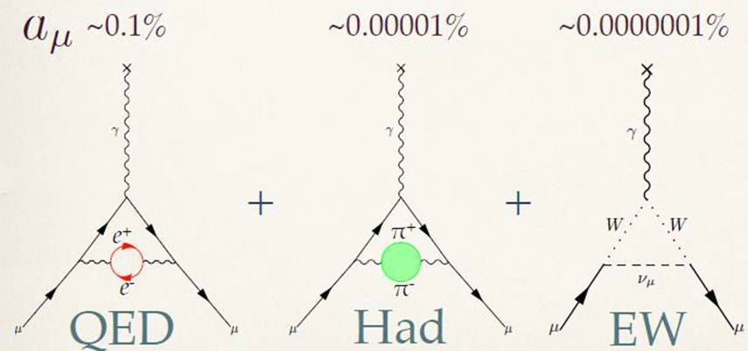
g-2 for muons
Calculation somewhat more complicated:
  Muon mass 200 times electron mass
  Some corrections depend on mass rations – bigger contributions for muon

Slide 15
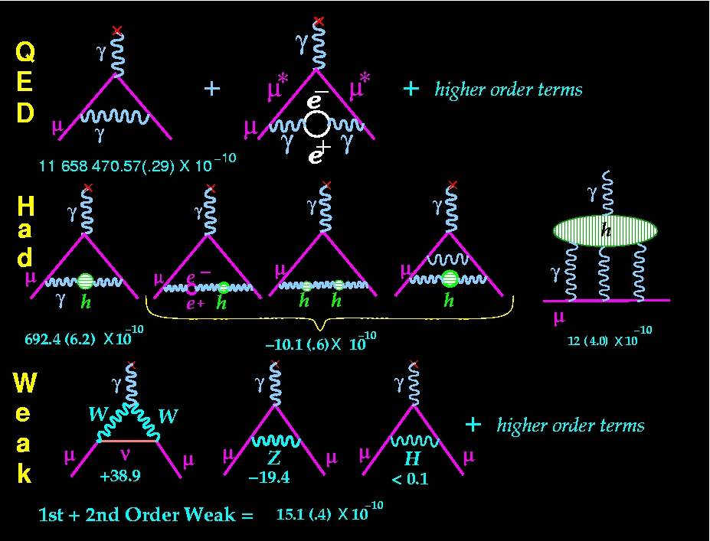
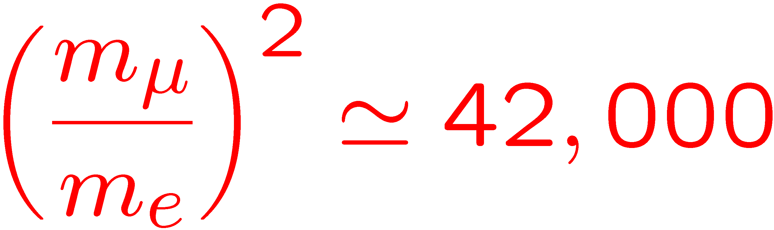
The SM Value for electron, muon and tau anomalies
e*,
e,
e,
e,
e,
e,
e,
e,
e,
e,
e,
e vs. μ : relative contribution of heavier things

Slide 16


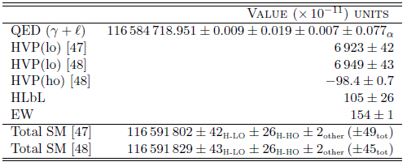
Theory calculation
[47] DHMZ, Eur.Phys.J.C72:1874 (2012)
[48] HLMNT, J.Phys.G38,085003 (2011)
Δa_{μ}= (286 ± 80) X 10^{-11 [47]}
Δa_{μ}= (260 ± 78) X 10^{-11 [48]}
Dominating theoretical uncertainties are hadronic components
Most from low energy non-perturbative QCD regime
The hadronic vacuum polarization (HVP) is related to the cross section for hadron production e⁺e⁻ → hadrons
The hadronic light by light (HLbL) is model specific (cannot be determined from data directly), much less known (25% error)
Lattice QCD is starting to get involved, could be a big help

Slide 17
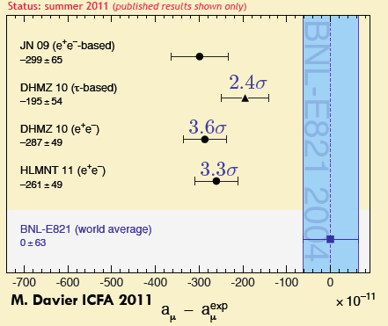
Comparison
  (3 – 3.6) σ difference depending on HVP LO contribution
    If the discrepancy between the theory and the experimental result sustains, it can point to new physics
    More importantly, Δa_{μ} tightly constraints new physics models and has significant implications to interpret any new phenomena

Slide 18
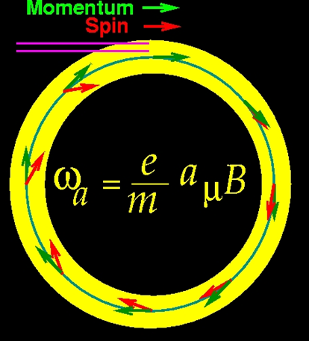
Spin Motion in a Magnetic Field
charged (q) particle moving in a magnetic field: momentum turns with cyclotron frequency ω_{C}, spin turns with ω_{S}
Spin turns relative to momentum with ω_{a}
Measure the frequency difference between the spin and momentum precession

Slide 19


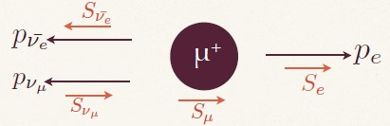

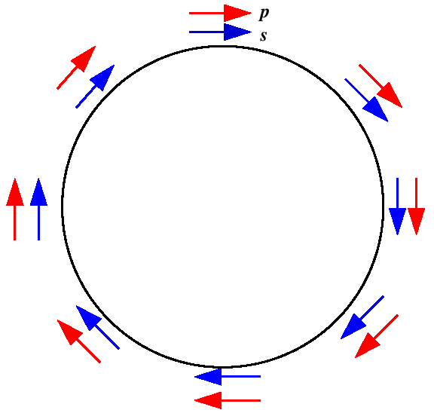
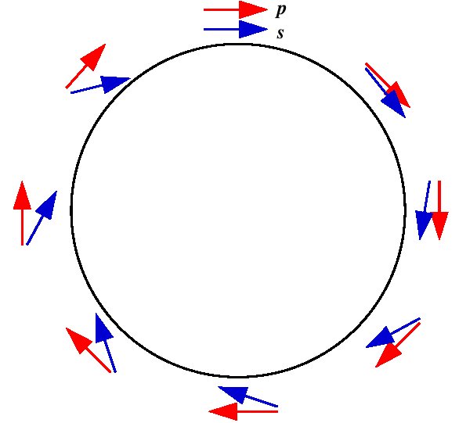
How to measure?
Put (polarized) muons in a magnetic field and measure precession freq
Get muon spin direction from decayed electrons
a_{μ} ~ difference between precession
frequency and cyclotron frequency
-
g=2
g>2

Slide 20

A slight complication…
The magic muon momentum
Muons make horizontal circular movement under influence of magnetic field B, what about vertical movement?
  Need to use electrostatic quadrupoles to confine muons vertically, this brings additional complication
How to measure E?
  No need! choose γ = 29.3, then coefficient vanishes!
  γ = 29.3 means p_{μ}= 3.09 GeV (magic momentum)

Slide 21
The magic muon momentum
Muons make horizontal circular movement under influence of magnetic field B, what about vertical movement?
Need to use electrostatic quadrupoles to confine muons vertically, this brings additional complication

Slide 22
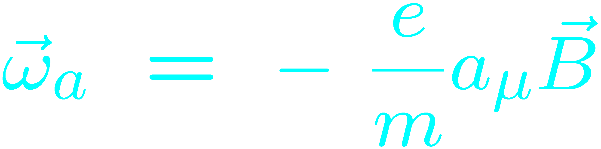
Experimental Technique AGS experiment
Proton bunches from accelerator
x_{c} ≈ 77 mm
β ≈ 10 mrad
B·dl ≈ 0.1 Tm
Pions
Inflector
p=3.1GeV/c
Target
(1.45T)
Injection orbit
Muon polarization
Muon storage ring
injection & kicking
focus with Electric Quadrupoles
24 electron calorimeters
Central orbit
Storage
ring
Kicker
Modules
R
R
β
Electric Quadrupoles
x_{c}

Slide 23
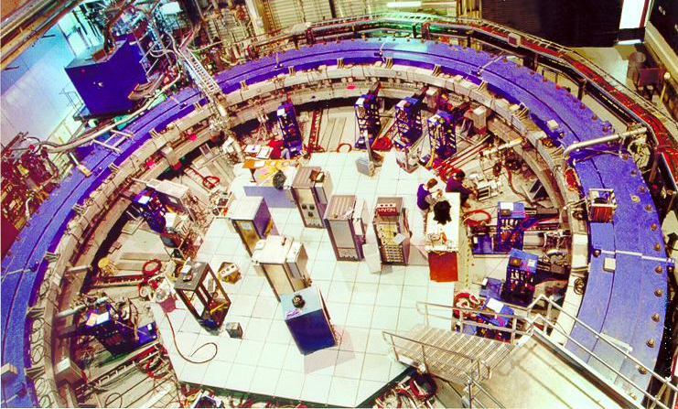
muon (g-2) storage ring at BNL
Muon lifetime t_{μ} = 64.4 μs
(g-2) period t_{a} = 4.37 μs
Cyclotron period t_{C} = 149 ns

Slide 24
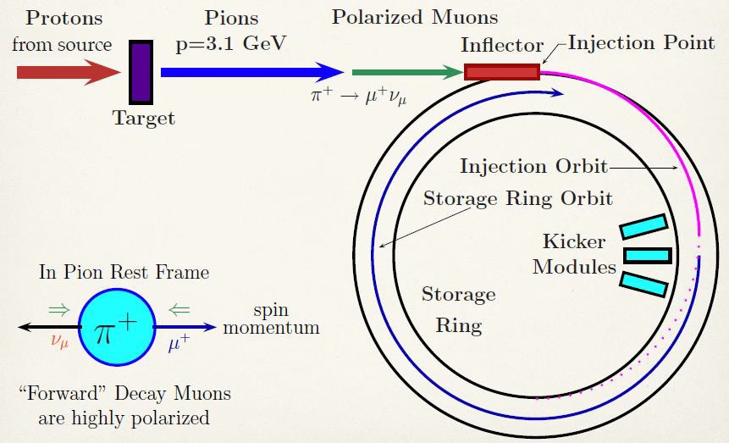
The experiment setup

Slide 25
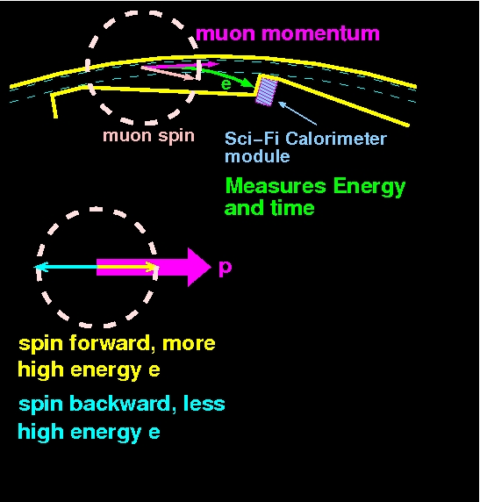
To measure ω_{a}, we used Pb-scintillating fiber calorimeters.
400 MHz digitizer gives t, E
Count number of e⁻ with E_{e} ≥ 1.8 GeV

Slide 26
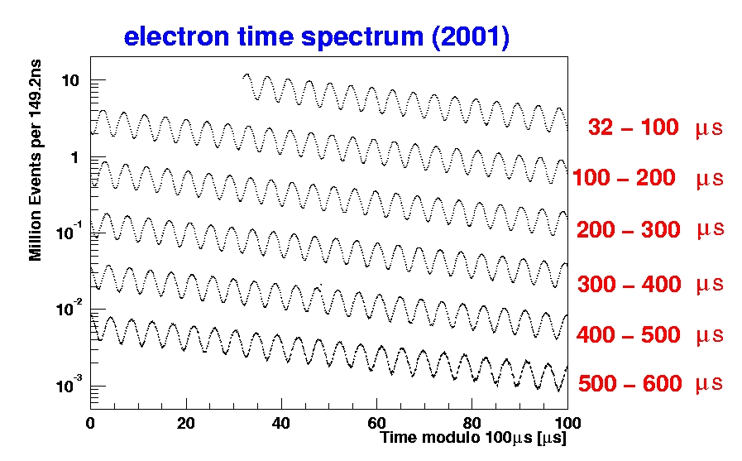
BNLexpt 821: arrival-time spectrum of high-energy decay electrons

Slide 27
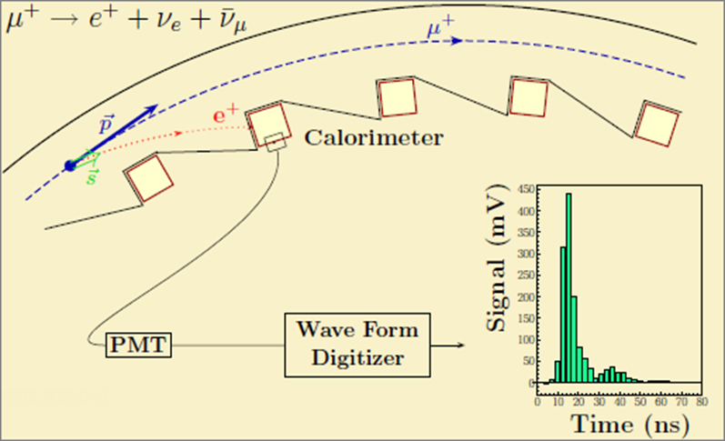
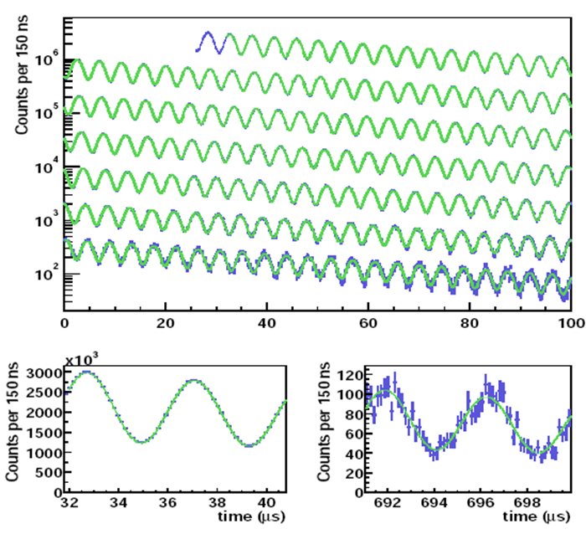
Fermilab expt: Measuring ω_{a}
The integrated number of electrons (above Eth) modulated at ω_{a}
Angular distribution of decayed electrons correlated to muon spin
Five parameter fit to extract ω_{a}

Slide 28
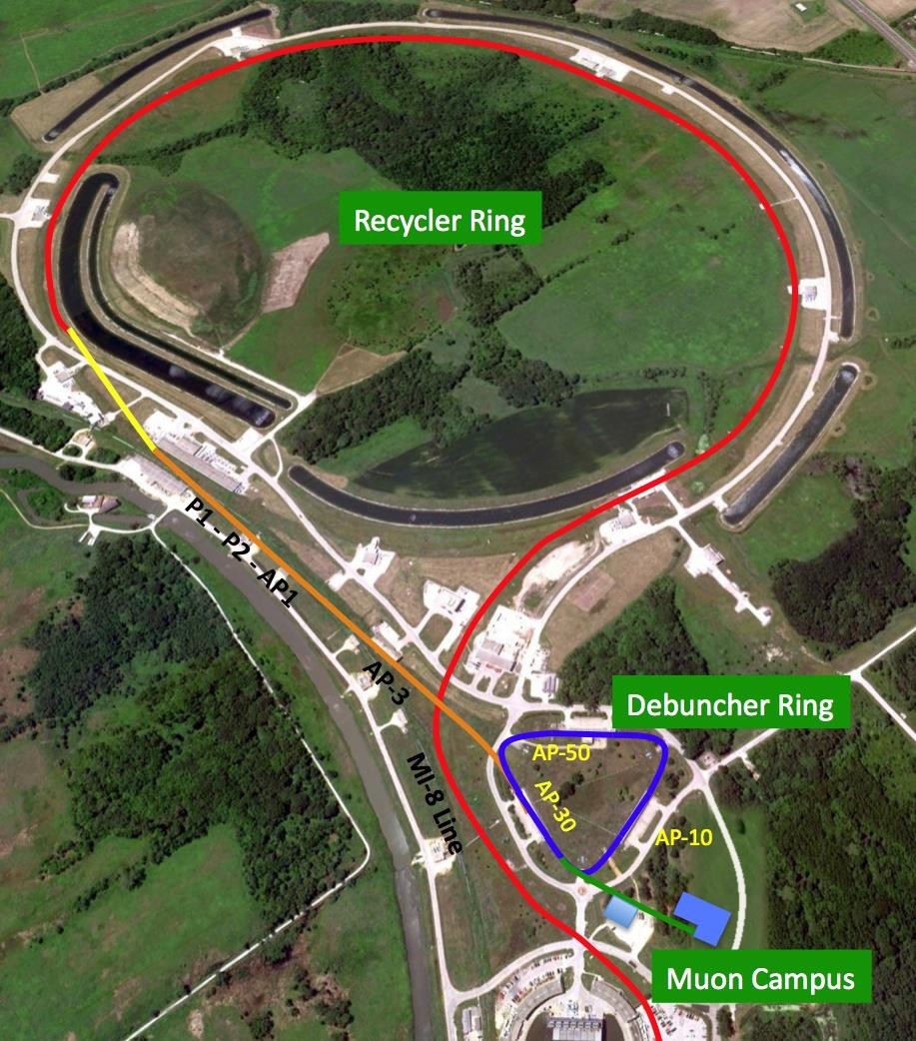
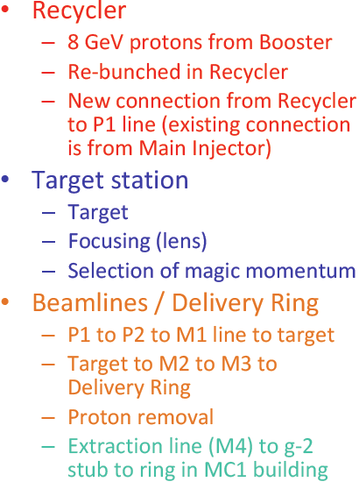
Fermilab Muon Campus

Slide 29
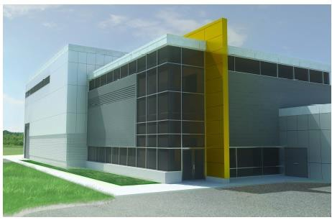
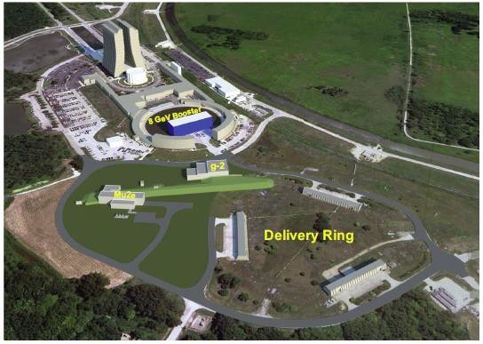
Fermilab Muon Campus

Slide 30
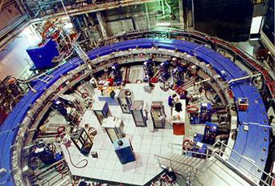
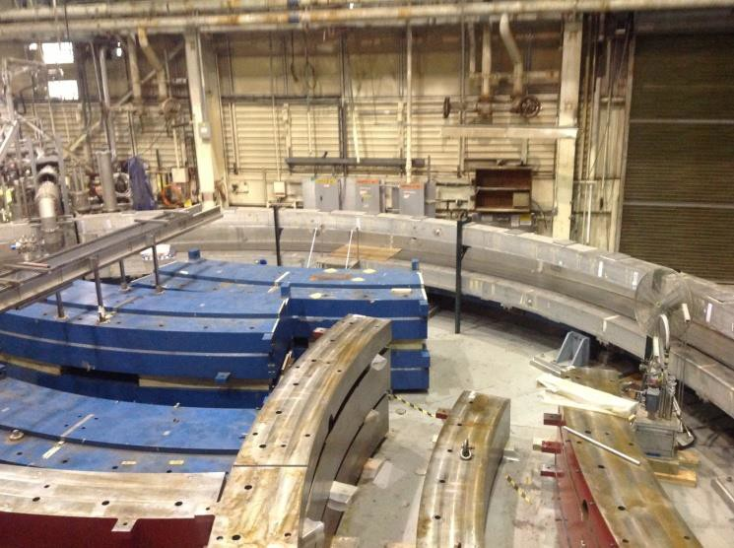
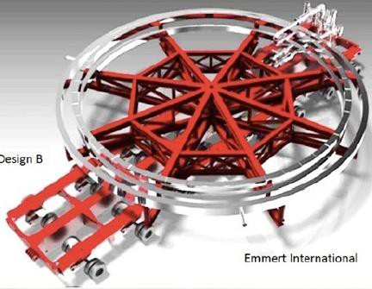
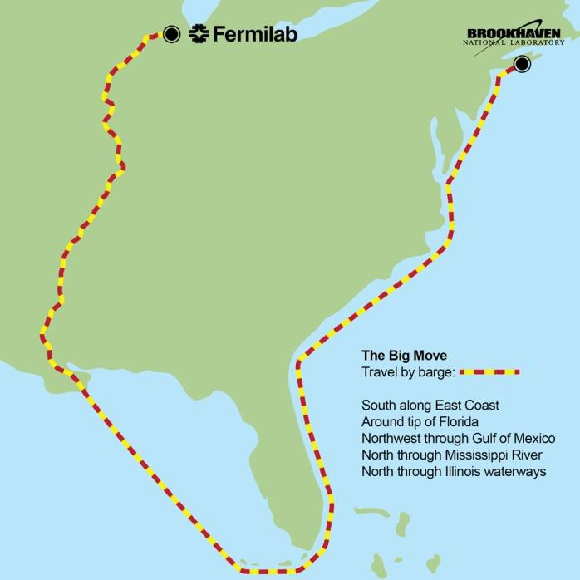
The ring has moved…
Disassembly
The Big Move
arrived at FNAL July 2013

Slide 31
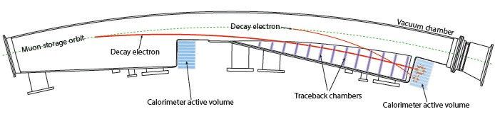
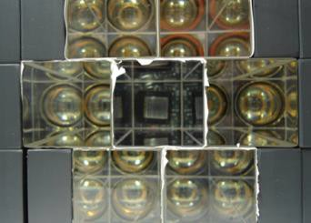
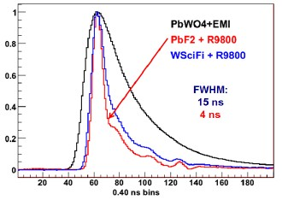
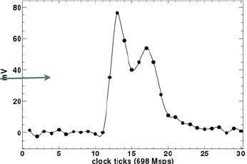
Detector upgrade
Two laser pulses at SiPM by 5ns
Segmented, fast response, crystal calorimeter
Lead-fluoride Cherenkov crystal (PbF2) can reduce pileup
Silicon photomultiplier (SiPM) directly on back of PbF2
Not disturb magnetic field, avoid long lightguides

Slide 32
Summary
The measurement of e ± and μ± magnetic dipole moments has been an important benchmark for the development of QED and the standard model of particle physics.
Presently, difference between measured a_{μ} and the standard-model prediction (3.6 σ)
theory situation is evolving
a_{μ} has been particularly valuable in restricting physics beyond the standard model.
will continue to be important in guiding the interpretation of the LHC data.

Slide 33
Summary – g-2 at Fermilab
Flagship project within Fermilab muon campus
Received Mission Need approval
g-2 is extremely sensitive to new physics and high order calculations, correction
Aiming to reduce experimental uncertainty by a factor of 4
Theoretical uncertainty also expected to reduce by a factor of 2
Could achieve 5.6 σ deviation with the same central value
Great discovery potential and bright future in line with Fermilab muon / Project-X programs

Slide 34
References, acknowledgments
Used slides from presentations by experts:
  Lee Roberts http://g2pc1.bu.edu/~roberts/
  Liang Li talk at SPSC2013 https://indico.cern.ch/event/234546/session/9/contribution/20/attachments/392218/545413/Muon_g-2_Experiment_at_Fermilab_SPCS2013.pdf
  Hoecker&Marciano: g-2 summary at PDG http://pdg.lbl.gov/2013/reviews/rpp2013-rev-g-2-muon-anom-mag-moment.pdf

